Slide 1

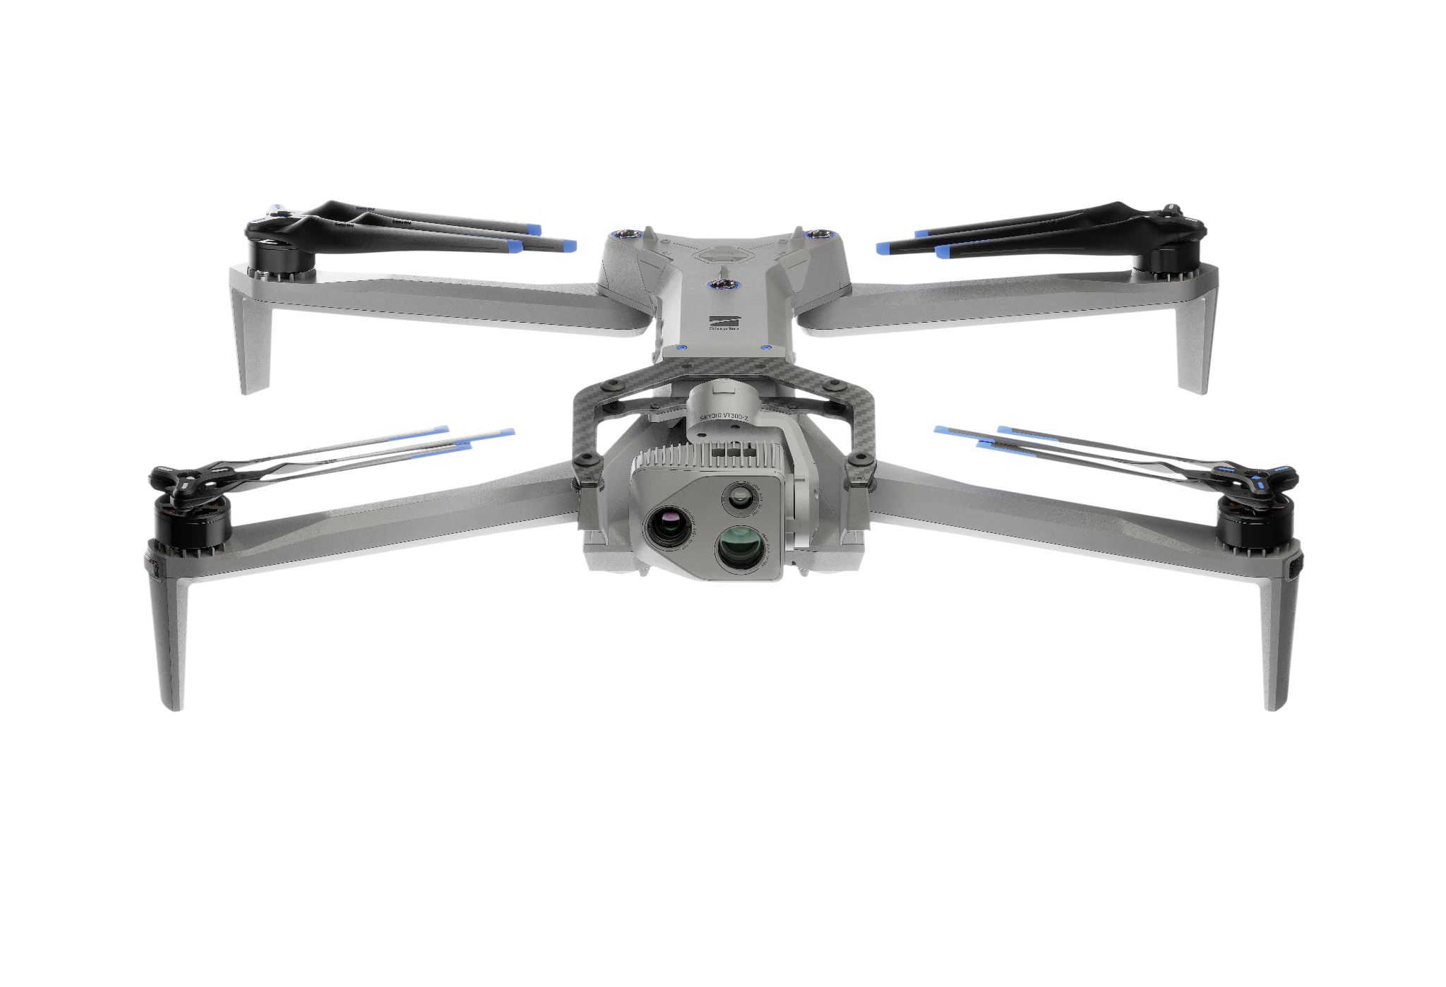
Maintaining Your Skydio X10D
Skydio | R47-ATO-IP-deck5-4.3.26

Slide 2
What You’ll Learn
Maintaining Your Skydio X10D
Postflight
Fleet Data Maintenance
01
04
Perform post flight procedures.
Learn proper battery care methods, including charging and storage.
Charging & Battery Care
Maintenance & Storage
02
05
Introduce the charging hardware and methods of charging.
Learn the proper methods to maintain and store Skydio X10D and its components.
Software Updates
Getting Support
03
06
Perform software updates on your controller, aircraft, batteries, sensor packages, and attachments.
Discover the many ways you can connect with Skydio for support.
Notes:
Trainer Script: This module teaches you how to keep your Skydio X10D aircraft and support equipment in mission-ready condition. We’ll cover post-flight tasks, proper battery handling, software updates, maintenance best practices, and getting support when you need it. These steps help ensure your gear is always ready when you need it.

Slide 3
Postflight
Maintaining Your Skydio X10D
01
Notes:
Trainer Script: Let’s start with postflight procedures.

Slide 4
Postflight | Inspection
Maintaining Your Skydio X10D
Visually inspect hardware components for serviceability; including fuselage, arms, battery
Check props and motors
Clear any debris
Wipe down chassis and cameras
Notes:
Trainer Script: After every flight, conduct a visual inspection of your aircraft cleanliness and serviceability.
Check the chassis, arms, motors, props, and battery
Remove dirt, foliage, or debris
Wipe down cameras and airframe to preserve optics and airworthiness
These steps mirror post-mission inspections in other platforms; Treat it like weapons maintenance.

Slide 5
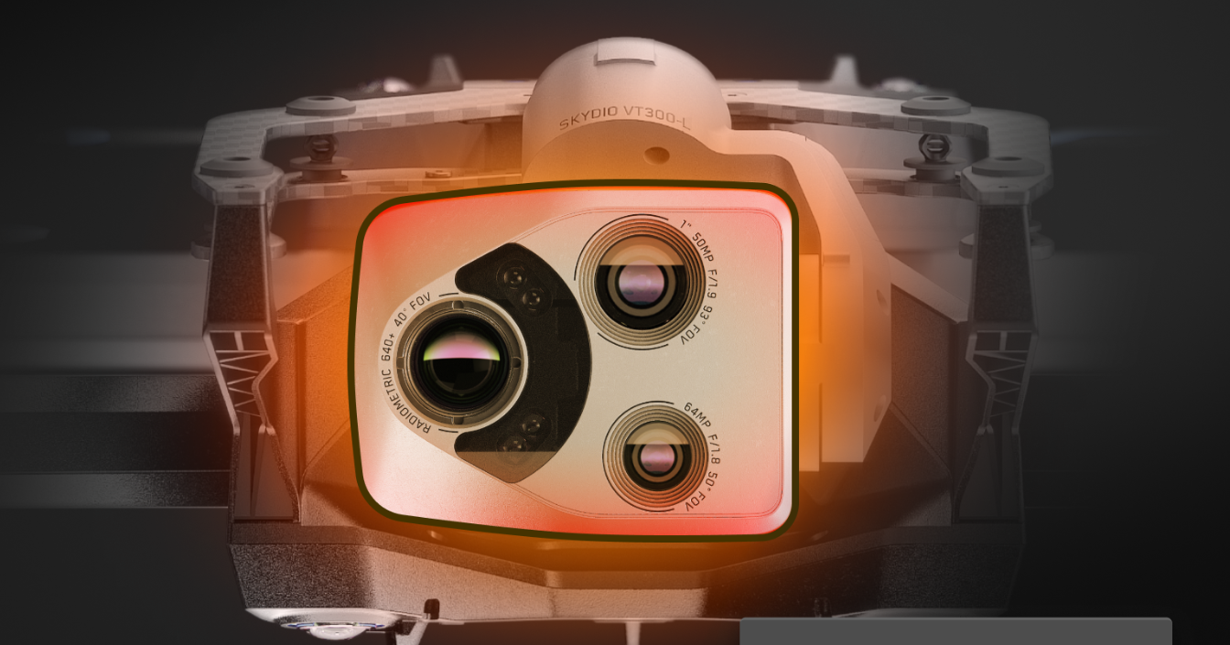
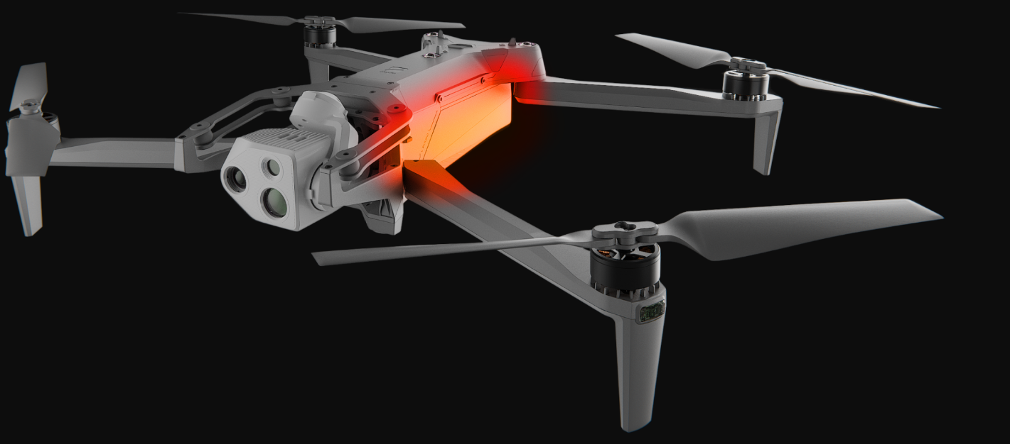
Postflight | Handling
Maintaining Your Skydio X10D
Sensor package and attachments may be hot to the touch; Use caution
Allow sensor package and attachments to cool for ~30-60 seconds
Battery and aircraft may also be hot to the touch
Notes:
Trainer Script: Be cautious when handling the drone immediately after flight.
The sensor package, battery, or attachments can be hot
Wait 30 - 60 seconds before disassembly
Always inspect for heat stress or warping after long or hot flights

Slide 6
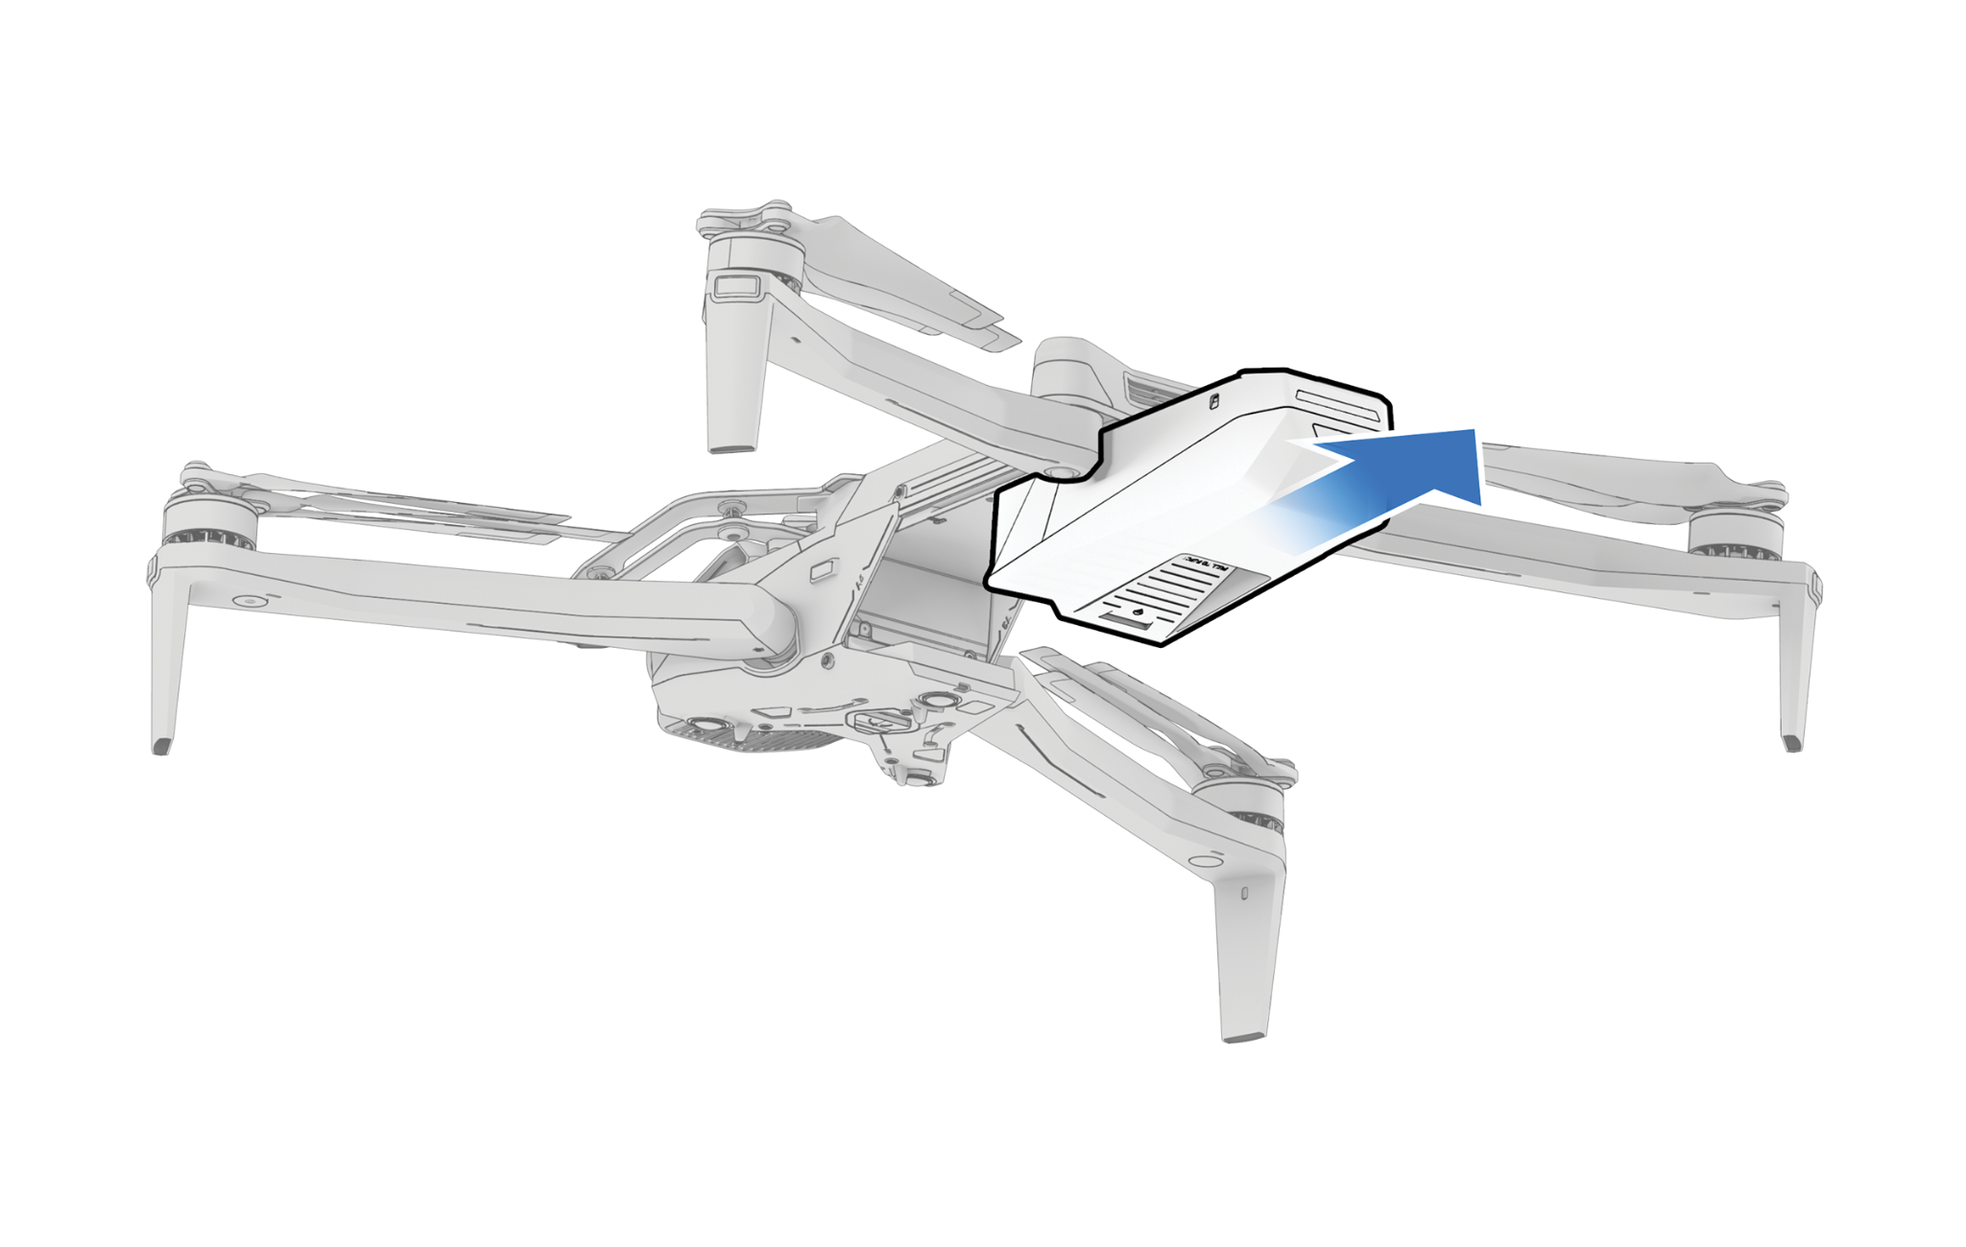
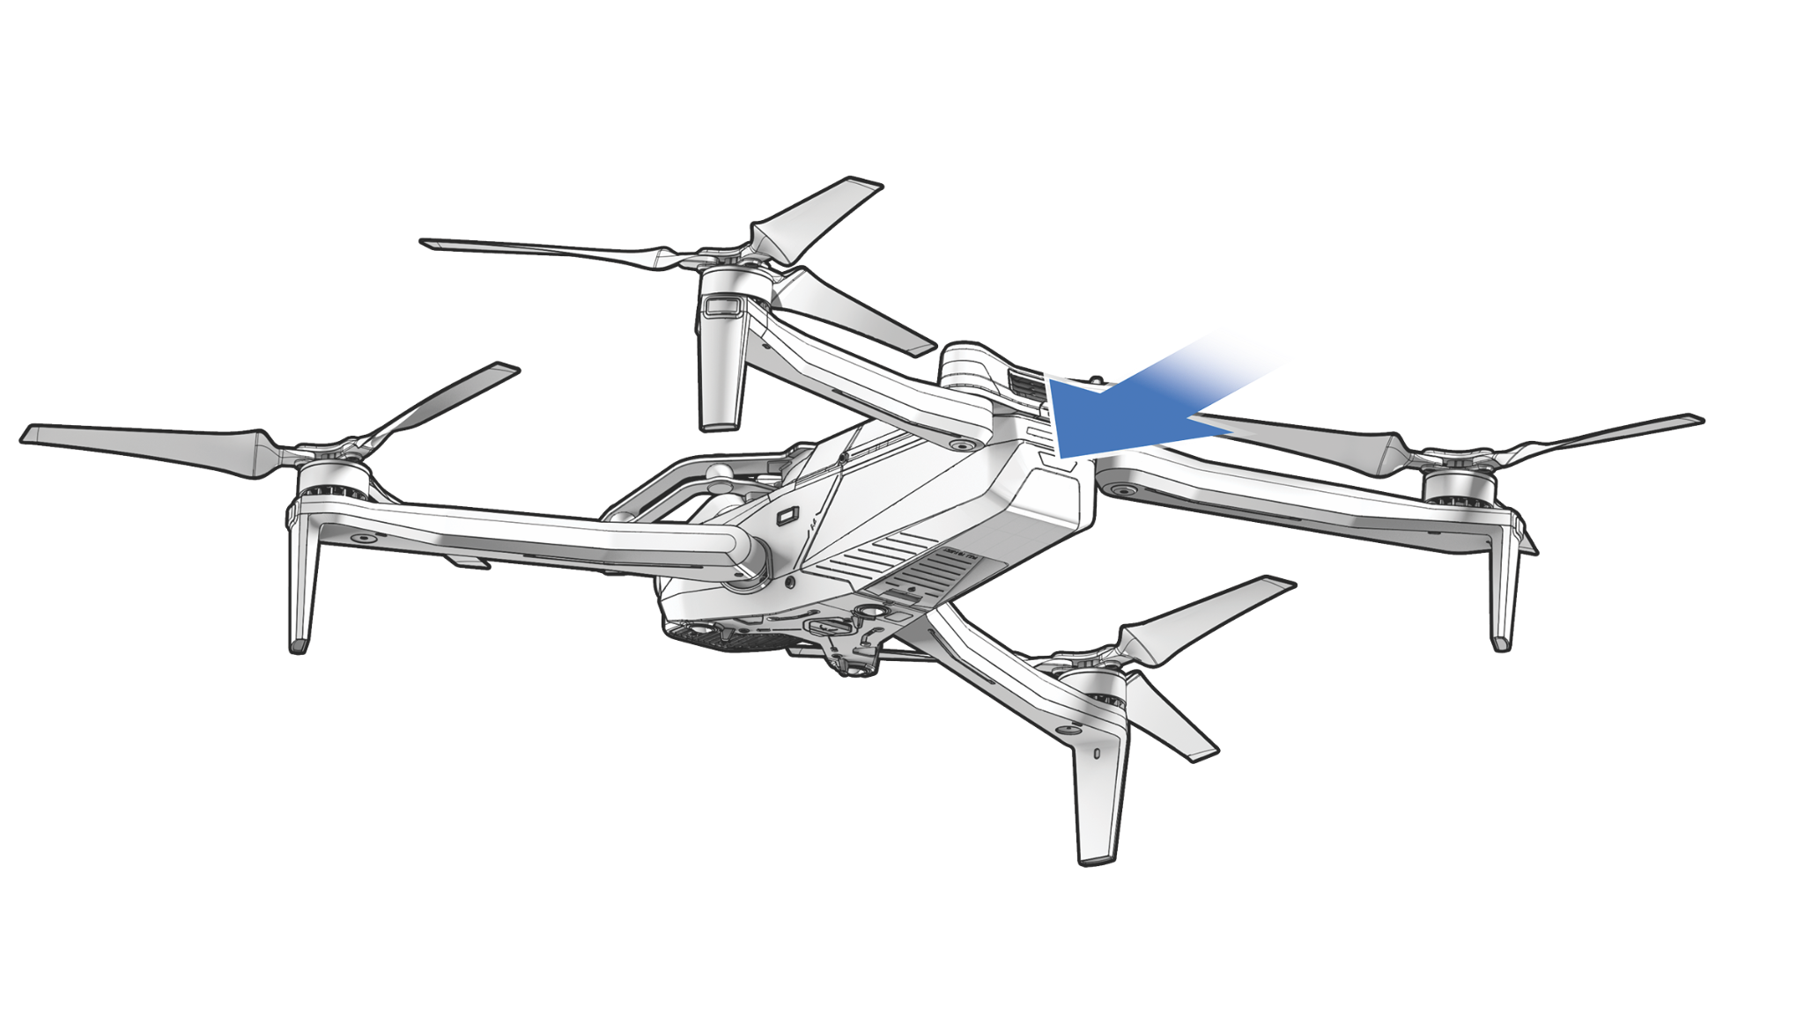
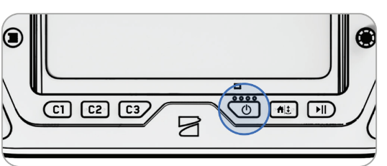
Postflight | Power Down
Maintaining Your Skydio X10D
Power Off Drone
Remove Battery
Power Off Controller
Press and hold battery button until LEDs shut off.
Using a firm grip, pull the battery towards the rear until clear of aircraft.
Press and hold power button until Power Off message appears.
Notes:
Trainer Script: Once you’re mission complete, pack it all up.
Power off the aircraft by holding the battery button until the lights shut off
Remove the battery by pulling it to the rear
Shut down the controller by holding the power button until prompted
Close the controller lids and fold the aircraft back up to get it ready for transport

Slide 7
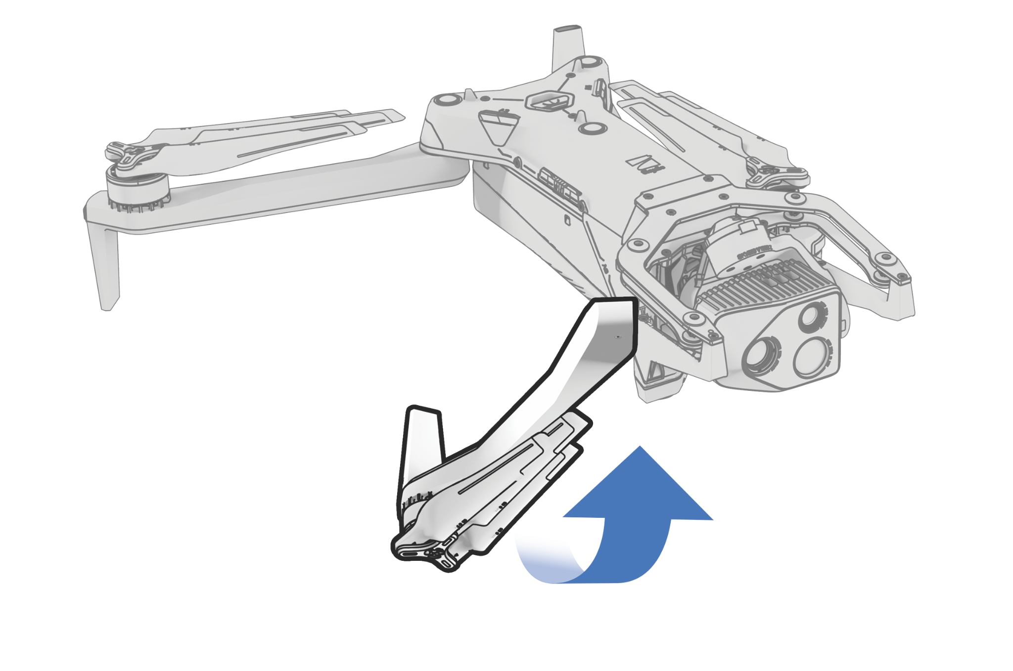
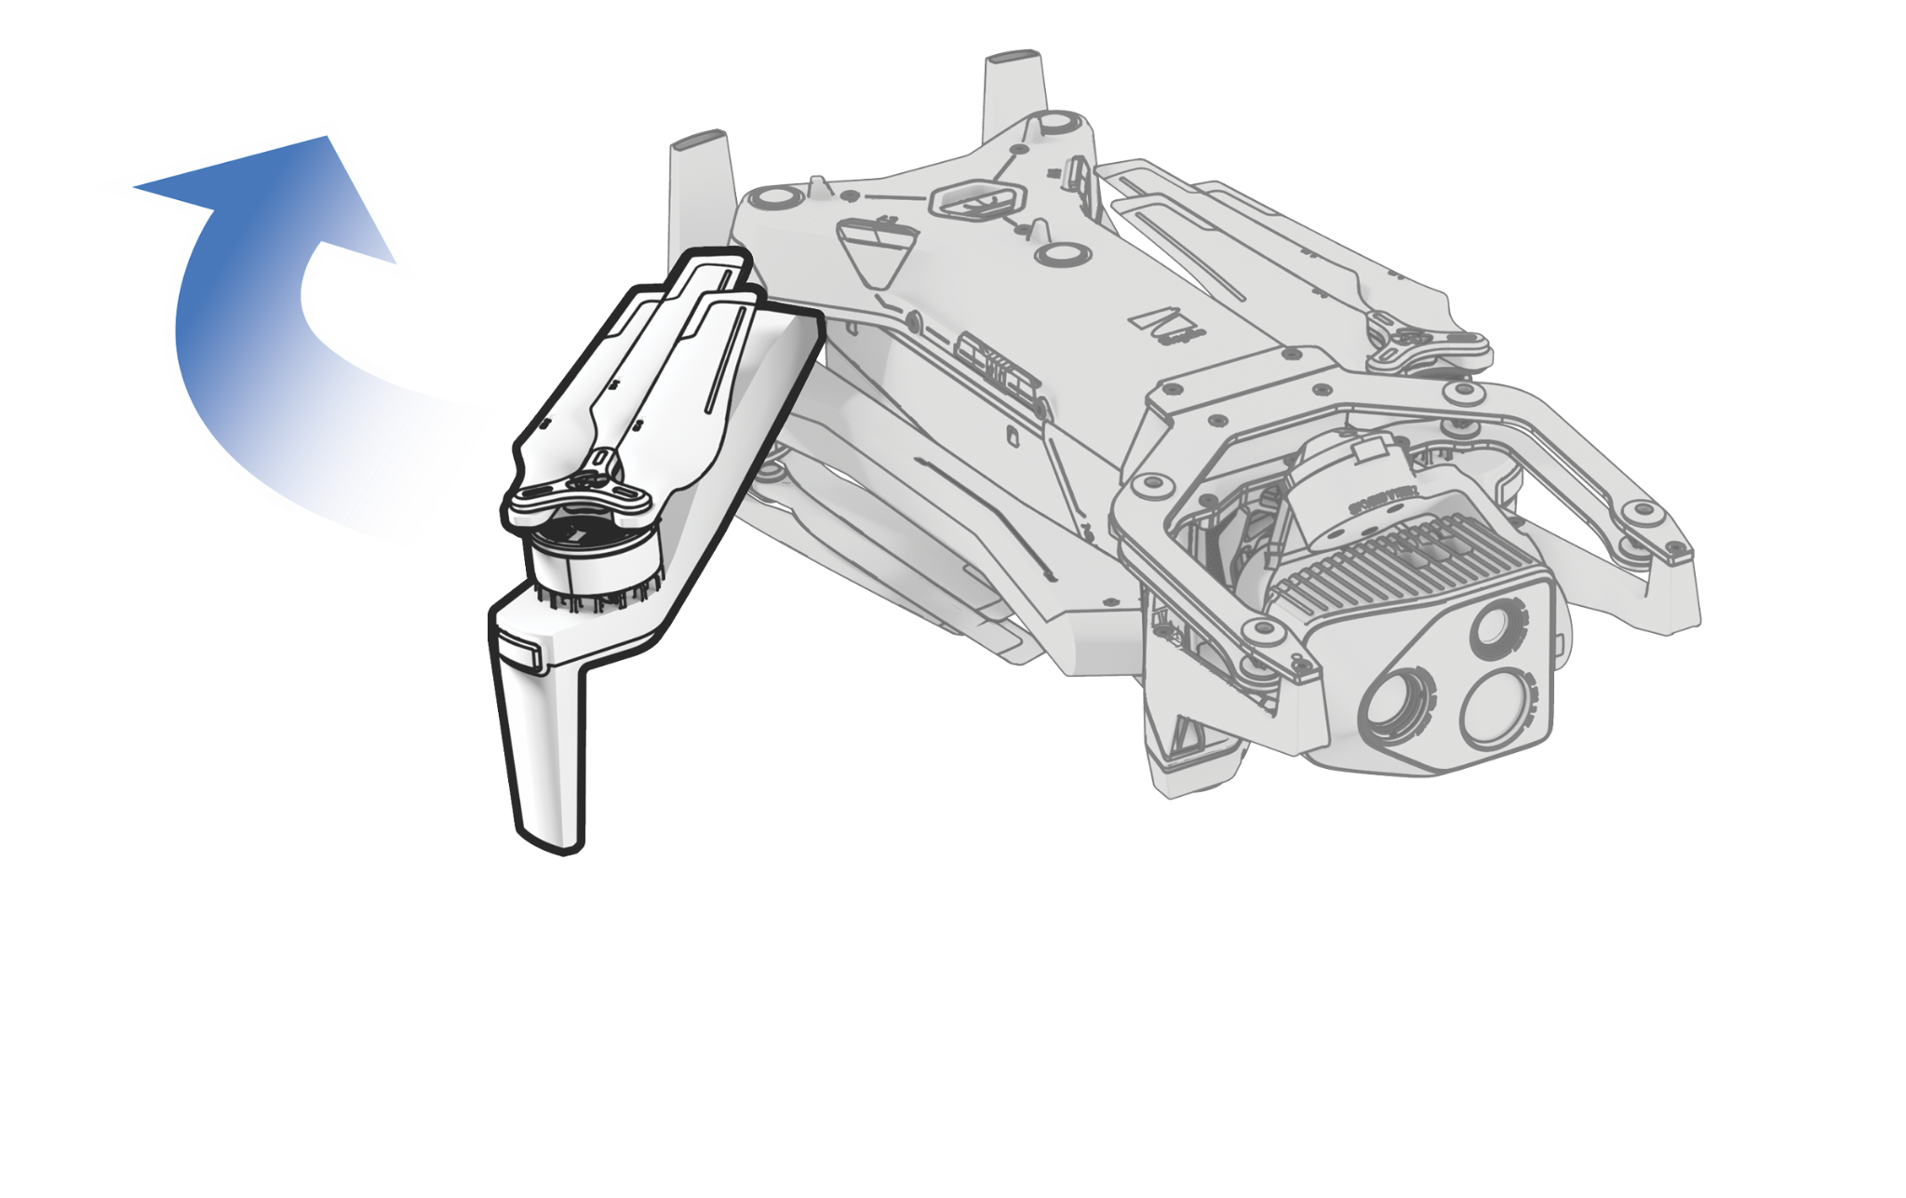
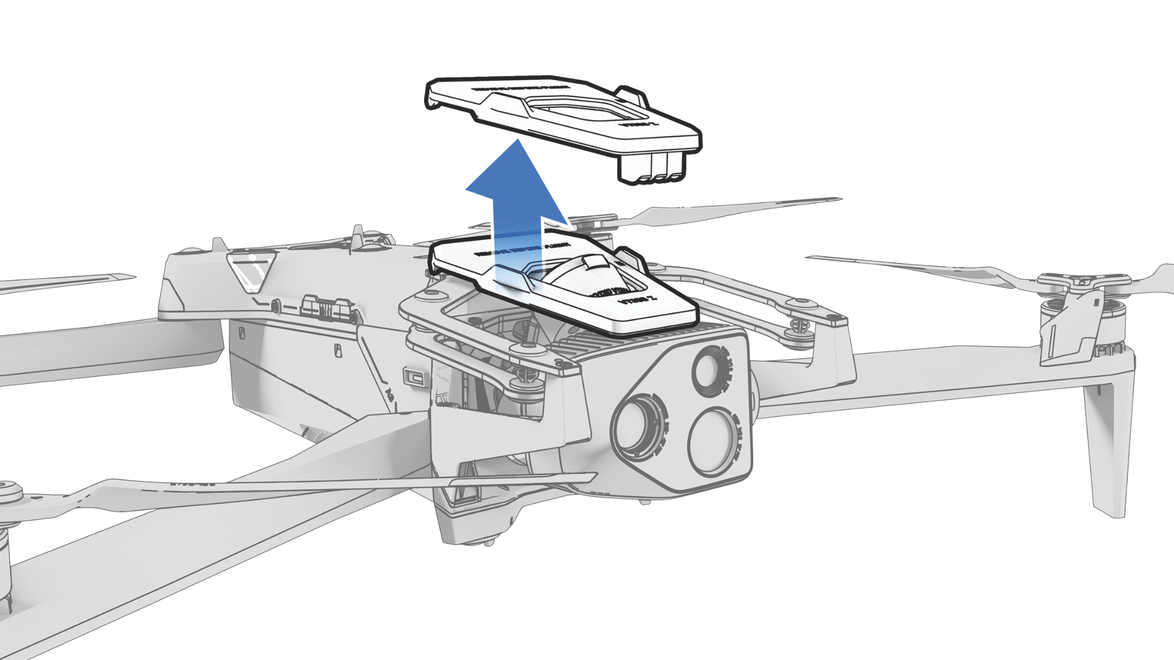
Postflight | Disassemble
Maintaining Your Skydio X10D
Fold Front Arms
Fold Rear Arms
Lock Sensor Package
Fold front arms backward and down towards the battery well.
Push rear arms toward the front of the drone. Rests on magnet.
Insert the sensor package lock into the holes on top of gimbal.
Notes:
Trainer Script: Break down the drone properly. Ensure you fold the arms in the correct order or risk damaging the aircraft.
Push front arms down and towards the rear until they rest on the magnetic stops
Fold the rear arms toward the front
Lock the sensor package using the sensor lock
Stabilize the gimbal with one hand and with the other insert the black rubber stoppers into the appropriate slots on the top of the camera.
Set the sensor package lock so that it sits on the rear of the sensor package
The magnets will pull the sensor package lock into position if installed correctly

Slide 8
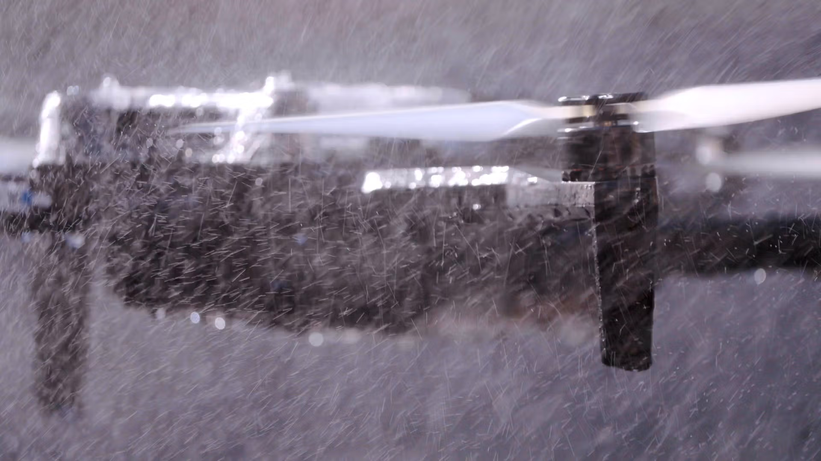
Postflight | After Flight in Precipitation
Maintaining Your Skydio X10D
Critical internal components are protected
Rotate X10D to allow water to drip out through drain holes
Remove battery
Do not remove sensor package or attachments while wet
Air dry for 12 hours (unfolded) before storing
Notes:
Trainer Script: If flown in rain, there are some precautions you must take to ensure no moisture remains inside the aircraft
Do not remove the sensor or attachments while wet
Rotate the aircraft to let water drip through the drain holes on the bottom of the drone
Remove the battery
Air dry unfolded for at least 12 hours before storing
If you’re on mission, keep infolded inside a vehicle
If not able to keep unfolded, pack it up and unfold it once you get back to the house

Slide 9
Charging &
Battery Care
Maintaining Your Skydio X10D
02
Notes:
Trainer Script:

Slide 10
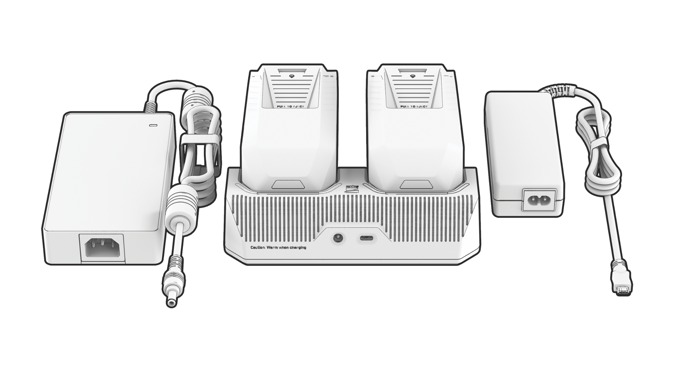
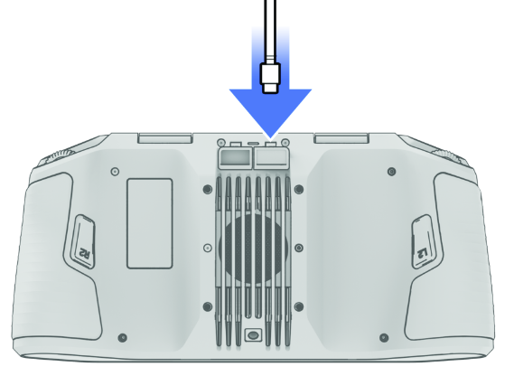
Charging & Battery Care | Controller Batteries
Maintaining Your Skydio X10D
~5 hours of operational time
Charge the controller using the USB-C port on the back of the controller
You can charge while flying
Use 100W power adapter included
0-100% in ~1 hour
Notes:
Trainer Script: Charge the controller with the included 100W adapter.
Plug into the rear USB-C port
Takes about an hour to charge from 0 - 100%
You can also charge while flying, extending operational time
Don’t use third-party power bricks as they may not deliver enough wattage or cause overheating

Slide 11
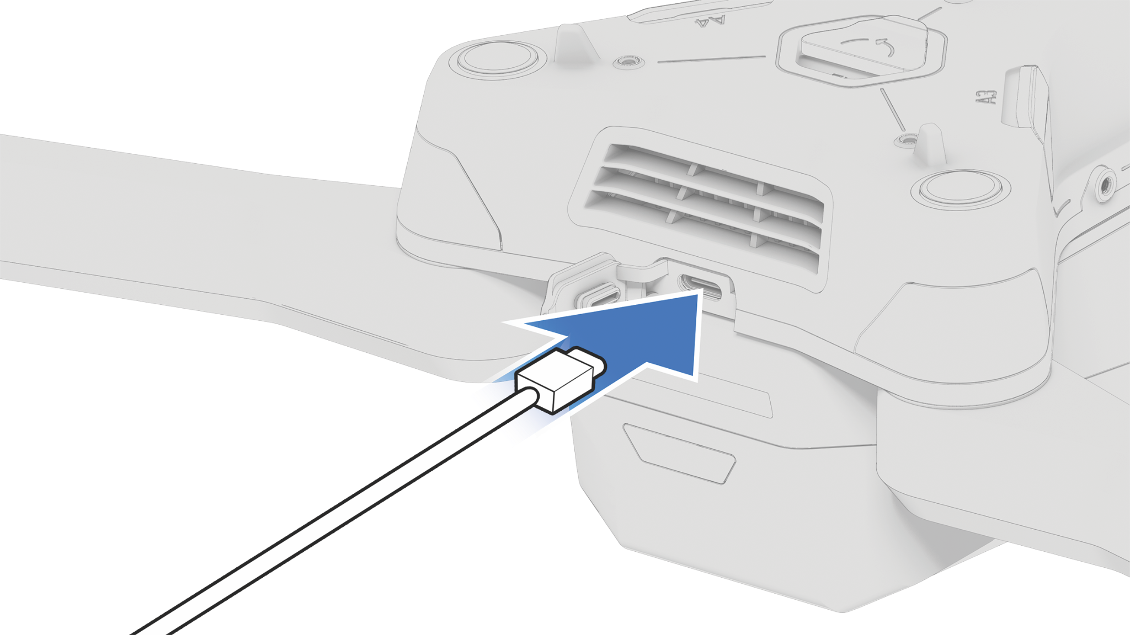
Charging & Battery Care | Aircraft Batteries
Maintaining Your Skydio X10D
Charge a single battery in the aircraft
Charge 2 batteries sequentially with the dual charger
Dual charger prioritizes the battery with the higher charge level
Charger LED will flash blue while charging then solid green when fully charged
230W power adapter | 0-100% in ~1 hour (rapid charge to 90%)
100W power adapter | 0-100% in ~1 hour & 45 mins
Notes:
Trainer Script: You can charge a single battery in the drone with the 100W power adapter. Just plug the charger into the rear USB-C port on the aircraft with the battery installed.
This should take about an hour and 45 minutes to go from 0 - 100
Alternatively, you can charge 2 batteries in the dual charger using the 230W power adapter
LEDs flash blue while charging and turn solid green when full
The dual charger will charge your batteries in sequence starting with the battery with the higher charge
This is meant to get you up and flying as quickly as possible
The batteries will rapid charge up to 90% then slowly charge up to 100%
So to take 1 battery from 0 to 100, it should take about an hour (chances are you’ll never have a battery at 0% so it might take a little less than that)

Slide 12
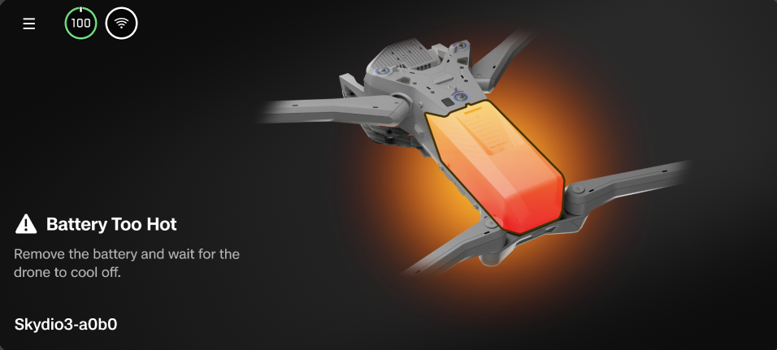
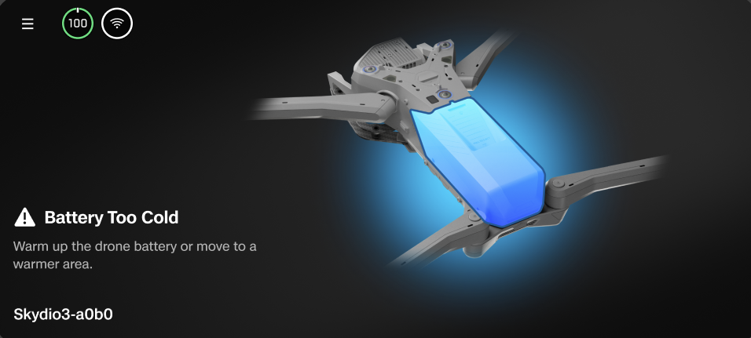
Charging & Battery Care | Environmental Factors
Maintaining Your Skydio X10D
Operational temperature range is -4° - 113°F (-20° - 45°C)
Performance may be reduced if flying in cold weather and with a cold battery
Launch prevented if batteries are below 32° F
Notes:
Trainer Script: Be aware of your temperature limitations
Your operational temp range is -4° - 113° F (-20° - 45° C)
If flying in hotter environments, expect to see heat warnings and be ready to respond
If flying in colder environments, you may start to see some performance limitations
Like… Launch is blocked below 32°F (0°C) battery temp
We’ll talk more about cold weather ops on the next slide

Slide 13
Charging & Battery Care | Self-Warming
Maintaining Your Skydio X10D
X10D batteries feature a built-in heater
Warms battery in about 5 minutes
Warm batteries when flying in temps <32° F
Triple-press battery button to start heater
Heats automatically if charged or if powered on inside drone
Must have at least 30% to self-warm
LEDs on battery will turn orange
Notes:
Trainer Script: For cold weather ops, your battery must be warm so that you don’t encounter performance issues.
The X10D has a built in heater that is designed to warm your batteries in colder environments
To activate it, triple-press battery button
You’ll notice the battery lights will turn orange and slowly start to extinguish as the battery heats up
This process takes about 5 mins depending on the battery’s internal temp
In order for the heater to kick on, there must be at least a 30% state of charge on the battery
You can also trigger warming by charging or powering on the drone with the battery installed
The battery heating process will NOT block launch… But a battery temp of less than 32 will

Slide 14
Software
Updates
Maintaining Your Skydio X10D
03
Notes:
Trainer Script:

Slide 15
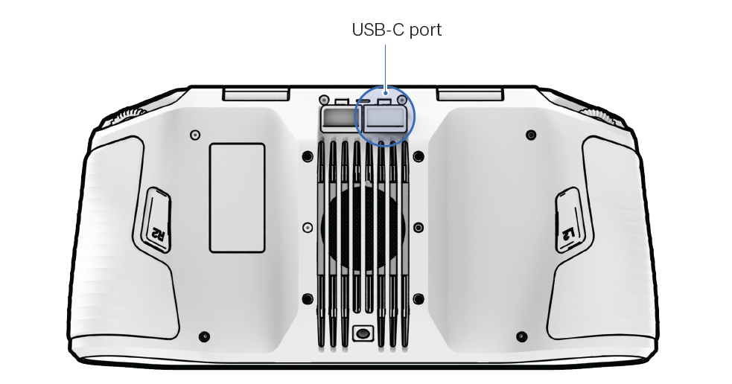
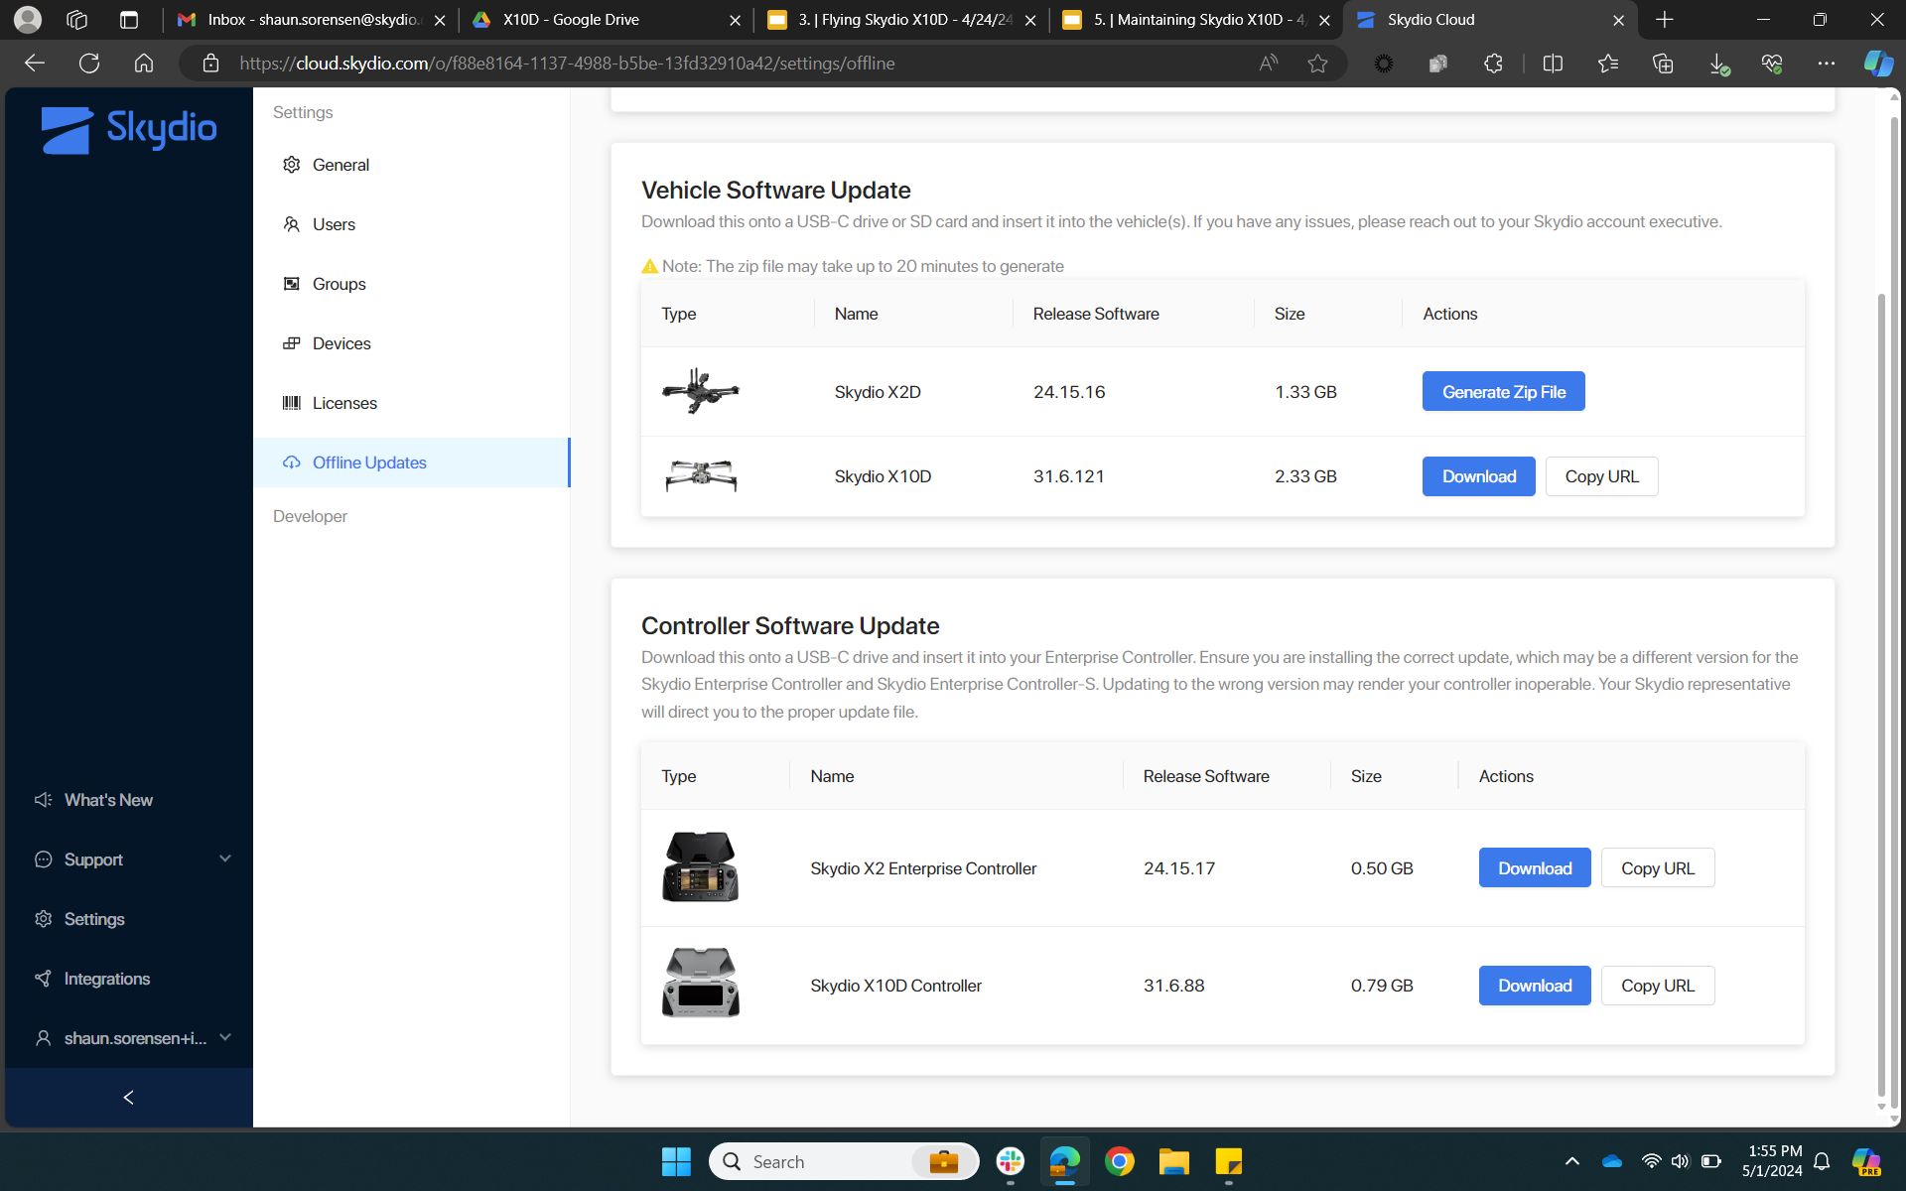
Software Updates | Updating Your Controller (Non-WiFi Enabled)
Maintaining Your Skydio X10D
Place the update file on a USB-C drive
Insert the USB-C drive into the USB-C port on the controller
Power on > Global Settings > Information > Controller Update > Update > My Files > USB Storage 1
Allow the update to complete
Controller may restart during the update
Notes:
Trainer Script: When a software update is released, there is usually a controller update and aircraft update. Occasionally, there are battery, sensor package, and attachment updates as well. If there is a controller update available, update the controller first.
First, you’re going to want to generate and download the update file in your Skydio Cloud for Offline Drones portal
Verify the new version numbers to ensure you are updating to the appropriate version (can be verified via the release notes on the Skydio website, the email that is sent out from Skydio, or the “What’s New” section of the portal)
Once generated and downloaded, place the .tar onto the root level of a USB-C drive
Safely eject the USB-C drive from the computer and insert it into the controller
Navigate to Global Settings > Information > Controller Update > Update > My Files > USB Storage 1
Select the .tar file and select done. This will start the update process.
The controller may restart during the update process
Just wait for the update complete message to appear then remove the USB-C drive

Slide 16
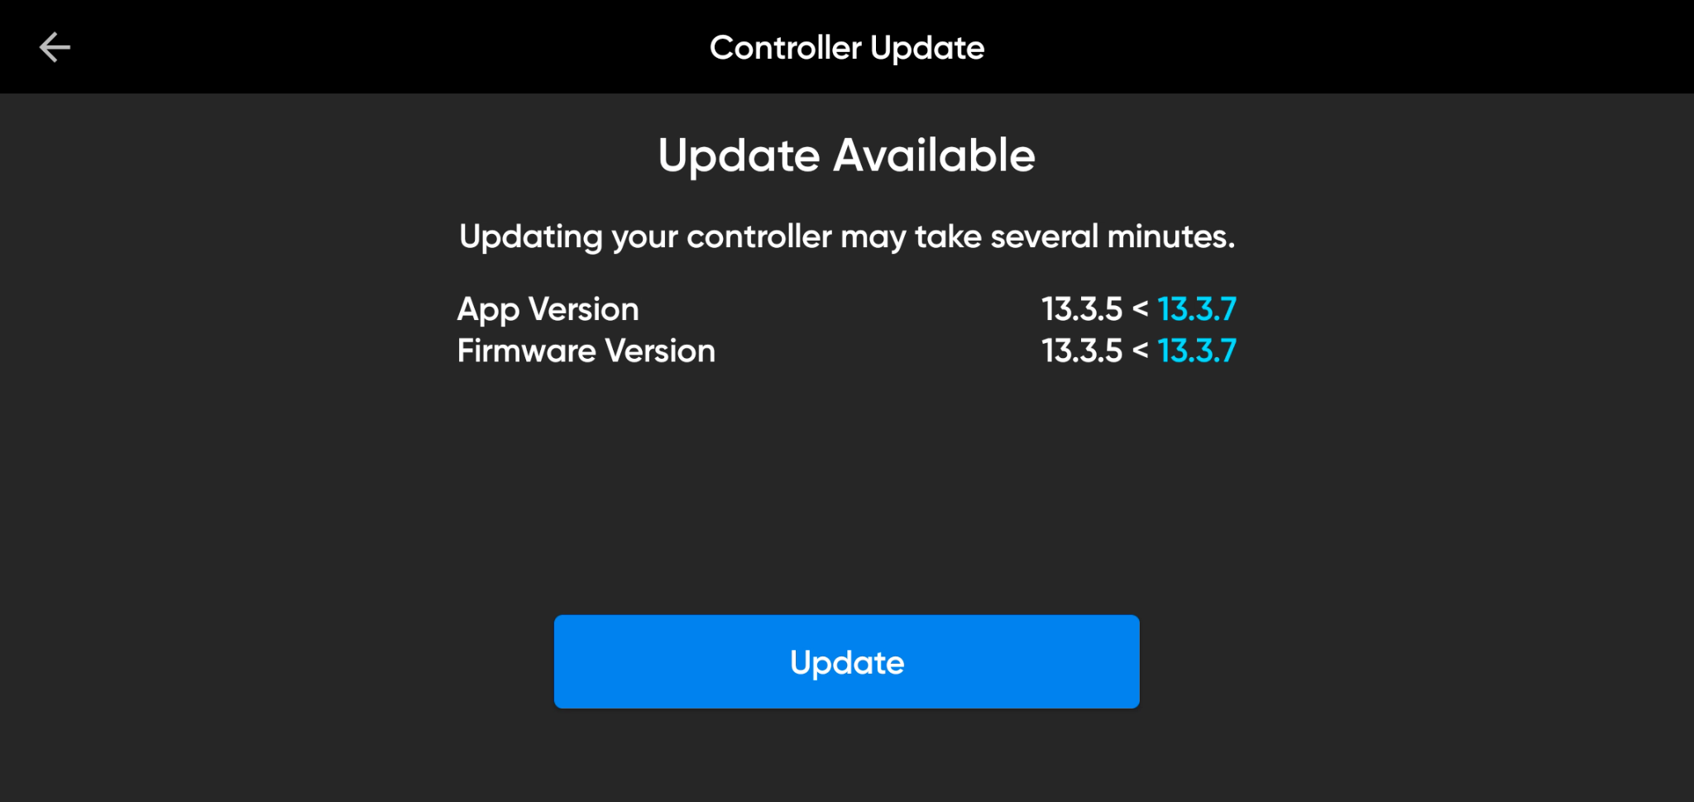
Software Updates | Updating Your Controller (WiFi-Enabled)
Maintaining Your Skydio X10D
WiFi must be enabled on your controller
Global Settings > Information > Controller Update > Check for Update > Update
Allow the update to complete
Controller may restart during the update
Notes:
Trainer Script: If your controller is WiFi enabled, software updates are a bit easier
Connect your controller to a wifi network
Navigate to Global Settings > Information > Controller Update > Check for Update > Update
If there is an update available, the new software version numbers will appear in blue
Make sure you have enough battery to complete the update
In fact, the controller will not let you update if there is not enough battery
You’ll notice the controller will restart during the update… This is normal
When complete, verify the new software version matches the blue numbers displayed prior to the update or against the relevant release notes on the support website

Slide 17
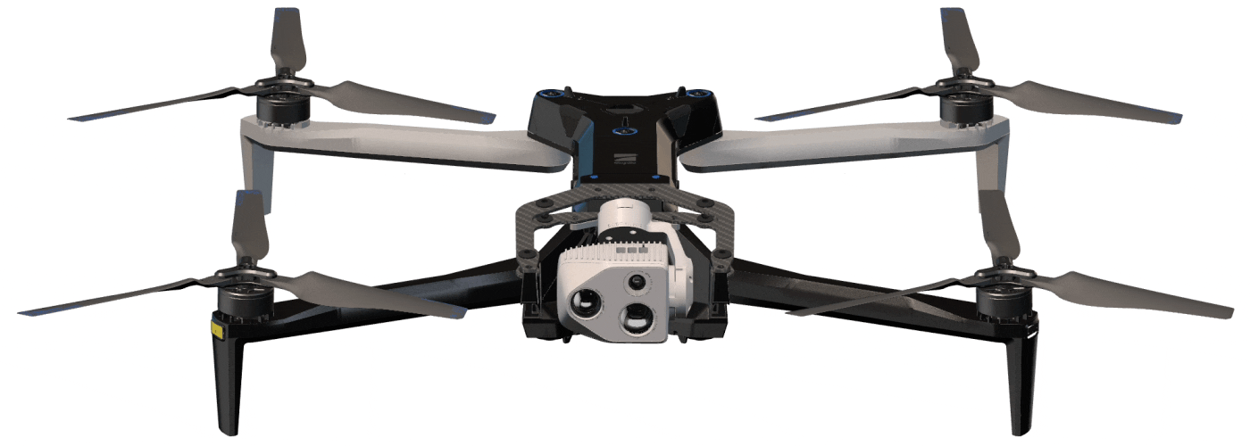
Software Updates | Updating X10D (MH)
Maintaining Your Skydio X10D
Place the update file on a USB-C drive or on the media MicroSD card
Insert the USB-C drive into the rear port on the X10D; OR
Insert the media MicroSD card back into the X10D
LEDs will turn yellow as the update progresses then green when complete
Ensure enough battery to complete update
Sensor will go slack during the update
Notes:
Trainer Script: Trainer Script: After you’ve updated the controller, update the aircraft. If a battery, sensor package, ot attachment update is available, it will automatically get pushed to the these if they are connected to the X10D.
First, you’re going to want to generate the update file in your Skydio Cloud for Offline Drones portal
Verify the new version numbers to ensure you are updating to the appropriate version (can be verified via the release notes on the Skydio website, the email that is sent out from Skydio, or the “What’s New” section of the portal)
Once generated and downloaded, unzip the folder
Place the folder named “offline_ota” onto the root level of a USB-C drive or the media SD card (not in another folder)
Safely eject the USB-C drive or SD card from the computer and insert it into the rear USB-C port or media card slot on the aircraft
Power on the X10D and the update will start automatically
You’ll notice the LEDs on the drone will turn yellow and indicate the update progress, the sensor will go slack, and you will hear the cooling fan kicking on and off
Once complete, the LEDs will turn blue and the camera will re-engage
You can then remove the USB-C drive
The SD card can remain inserted

Slide 18
Software Updates | Updating Your X10D (SL)
Maintaining Your Skydio X10D
Only compatible with Skydio Connect SL (5 GHz)
Must update the controller first
Global Settings > Information > select your drone > Update
LEDs will turn yellow as the update progresses then green when complete
Ensure enough battery to complete update
Sensor will go slack during the update
Notes:
Trainer Script: Trainer Script: Wifi updates are only compatible with the Skydio X10D with the Connect SL (5GHz) radio.
After updating the controller, navigate to Global Settings > Information > select your drone from the list, then tap the update button
Just like updating via USB or SD card, the aircraft LEDs will illuminate yellow one at a time (each light represents 25% progress
The sensor motors will disengage during updates causing the camera to go slack
The motors will re-engage once the update is complete

Slide 19
Fleet Data Maintenance
Maintaining Your Skydio X10D
04
Notes:
Trainer Script:

Slide 20
Fleet Data Maintenance | Cloud Data
Maintaining Your Skydio X10D
Update your software
Update claimed devices as they cycle in/out of your org
Remove old/Add new pilots
Notes:
Trainer Script: Fleet management isn’t just about hardware:
Keep software updated
Remove or reassign claimed devices
Keep pilot rosters current
This ensures your team stays organized, efficient, and compliant with SOPs

Slide 21
Maintenance & Storage
Maintaining Your Skydio X10D
05
Notes:
Trainer Script:

Slide 22

Maintenance & Storage | Battery Storage
Maintaining Your Skydio X10D
X10D battery life cycle is 1 year or 300 charge cycles
  Charge cycle = 80% cumulative depletion
Store batteries in clean, dry, climate controlled areas
  71°F - 82°F (22°C - 28°C)
  < 75% Relative humidity
After 14 days of non-use, batteries discharge to 50%
If storing long term, store at 50% state of charge
Fully charge and discharge (by flying) every 2 months
Notes:
Trainer Script: Some more battery guidelines…
You X10D’s batteries are good for 1 year or 300 charge cycles; Whichever comes first
What is a charge cycle??
A charge cycle is an 80% cumulative depletion of the battery
So if your battery is at 100% when you launched, a flight down to 20% is a charge cycle
Or 2 flights down to 50% from 100%
This doesn’t mean that your batteries need to be replaced at this point. It just means that you MIGHT start to see some performance degradation.
It is very possible that your batteries will last longer before you start to see any degradation at all if stored and cared for properly
When storing, choose a location with temps between 71°-82° F and under 75% relative humidity
Avoid leaving batteries in vehicles or rooms without climate control
And certainly do not store your batteries exposed to direct sun or any extreme environmental conditions
Batteries discharge to 50% automatically after 14 days of idle time
You might notice that the batteries are warm during this process… Totally normal.
If storing for an extended period of time, store the batteries at 50% to preserve them
Storing at very low charge levels may lead to damage
And finally… Take your batteries out of storage every 2 months to fully charge and then discharge before returning them to storage

Slide 23
Maintenance & Storage | Aircraft & Attachment Storage
Maintaining Your Skydio X10D
Do not store wet
Some attachments may require removal before storage
Observe attachment specific usage and storage recommendations
Notes:
Trainer Script: Before storing the aircraft…
Dry it completely, like we discussed earlier [can prompt the audience to shout out the procedures for storing your equipment after flying in rain]
Remove any attachments that prevent the aircraft from seating properly in its case
Follow specific storage guidelines per attachment (e.g. spotlight, speaker)
Proper storage extends life and ensures components are ready for redeployment

Slide 24
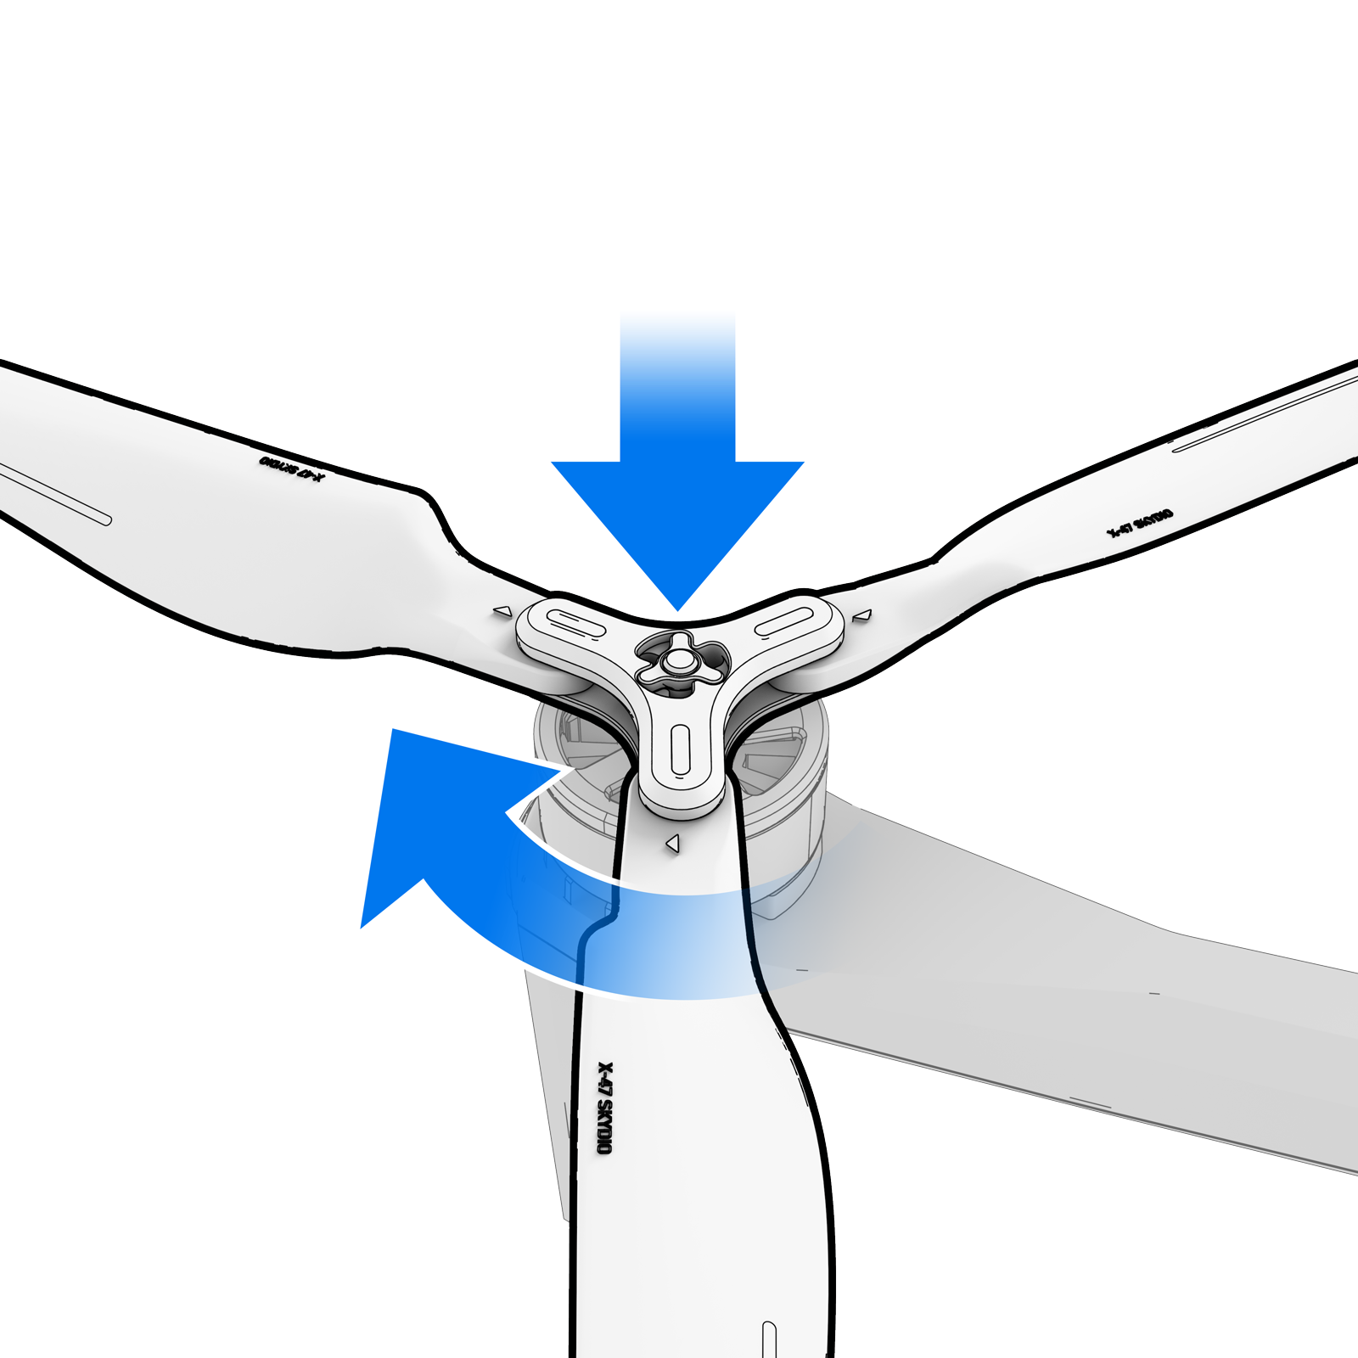
Maintenance & Storage | Replacing Propellers
Maintaining Your Skydio X10D
Twist Off
Replace
Twist On
Press down in the center of the propeller, twist opposite of the lock and lift.
Check Blue or Grey on old prop. Locate a new one that matches.
Press down in the center of the propeller and twist in the direction of the lock.
Notes:
Trainer Script: Never fly with damaged propellers. To replace a prop…
Hold the motor steady with one hand from the side or bottom
With your other hand, press down on the prop hub and twist off in the unlock direction (clockwise or counterclockwise, depending on the propeller)
Grab a new set of props with the matching color marks
The props are keyed to prevent installing the wrong prop on the motor
Press down and twist to lock the new prop
Always inspect after any incident or crash… even if it looks minor

Slide 25
Practical Application
Replace the X10D Propellers
Getting Started
Notes:
Trainer Script: Let’s practice replacing the props now.

Slide 26
Getting Support
Maintaining Your Skydio X10D
06
Notes:
Trainer Script: Finally, let’s talk about how to get help when you need it.

Slide 27

Getting Support | Notice to Operators (NTO)
Maintaining Your Skydio X10D
Skydio will publish safety and performance related guidance
Contains a brief description of the issue and mitigation steps
Usually fixed with software update
Visit website for up to date NTOs
Post or otherwise inform your pilots
Notes:
Trainer Script: Skydio issues NTOs (Notices to Operators) for safety issues or firmware bugs.
Always review current NTOs before flight
Most issues are resolved with a software update
Post NTOs in common areas or distribute via your ops chain

Slide 28
Getting Support | Exporting Flight Logs
Maintaining Your Skydio X10D
Insert USB-C drive into rear port on X10D
Global Settings > Information > SkydioX10-xxxx > Export Vehicle logs to USB-C
Lights will breathe yellow to indicate log transfer
Remove USB-C drive when complete
Notes:
Trainer Script: If you contact Skydio Support with an issue, they will most likely ask you to send flight or support logs. To export flight logs…
Insert a USB-C drive into the rear USB-C port of the X10D
Go to Global Settings > Information > [Device] > Export Logs
LEDs will breathe yellow during transfer
Remove the drive when finished
Coordinate with the support team to get the logs to them

Slide 29

Getting Support | Resources
Maintaining Your Skydio X10D
Skydio website for support articles manuals, how to videos
Skydio Academy for online training
Notes:
Trainer Script: Self serve support is available 24/7 on our website.
Visit support.skydio.com for user manuals, quick reference guides, support articles, and how-to videos, and more
I highly recommend visiting the support site if you have any questions at all

Slide 30
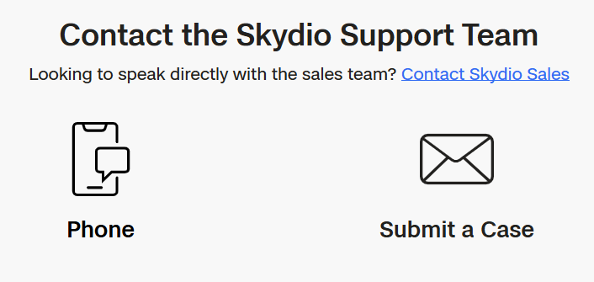
Getting Support | Contact
Maintaining Your Skydio X10D
Multiple contact methods for any questions or concerns
Program Managers
Field Support Reps
Notes:
Trainer Script: If you can’t resolve the issue yourself…
Contact your Skydio Program Manager or Field Support Rep
If you don’t know who they are or how to contact them, I can get you that info at the end of training. Just remind me.
Alternatively, you can contact support via phone, email, or chat on the website
If emailing or chatting, be sure to include logs, photos, a clear description of the problem, and any troubleshooting steps you’ve already taken. This will speed up the support process.
If you have any technical questions about the system, send an email to training@skydio.com
This goes directly to me and the rest of the training team. We’ll answer that ASAP.

Slide 31
You Learned
Maintaining Your Skydio X10D
Postflight
Maintenance & Storage
01
04
Perform post flight procedures.
Learn the proper methods to store Skydio X10D and its components.
Charging & Battery Care
Getting Support
02
05
Introduce the charging hardware and methods of charging.
Discover the many ways you can connect with Skydio for support.
Fleet Data Maintenance
03
Learn proper battery care methods, including charging and storage.
Notes:
Trainer Script: To recap…
You learned how to inspect, maintain, charge, and store your Skydio X10D system
You also practiced updating software and troubleshooting hardware
These are essential skills to sustain flight operations in the field

Slide 32
Questions
Maintaining Your Skydio X10D
Notes:
Trainer Script: Are there any questions?

Slide 33

Use or disclosure of data contained on this sheet is subject to the restriction on the second page of this proposal

