Slide 1
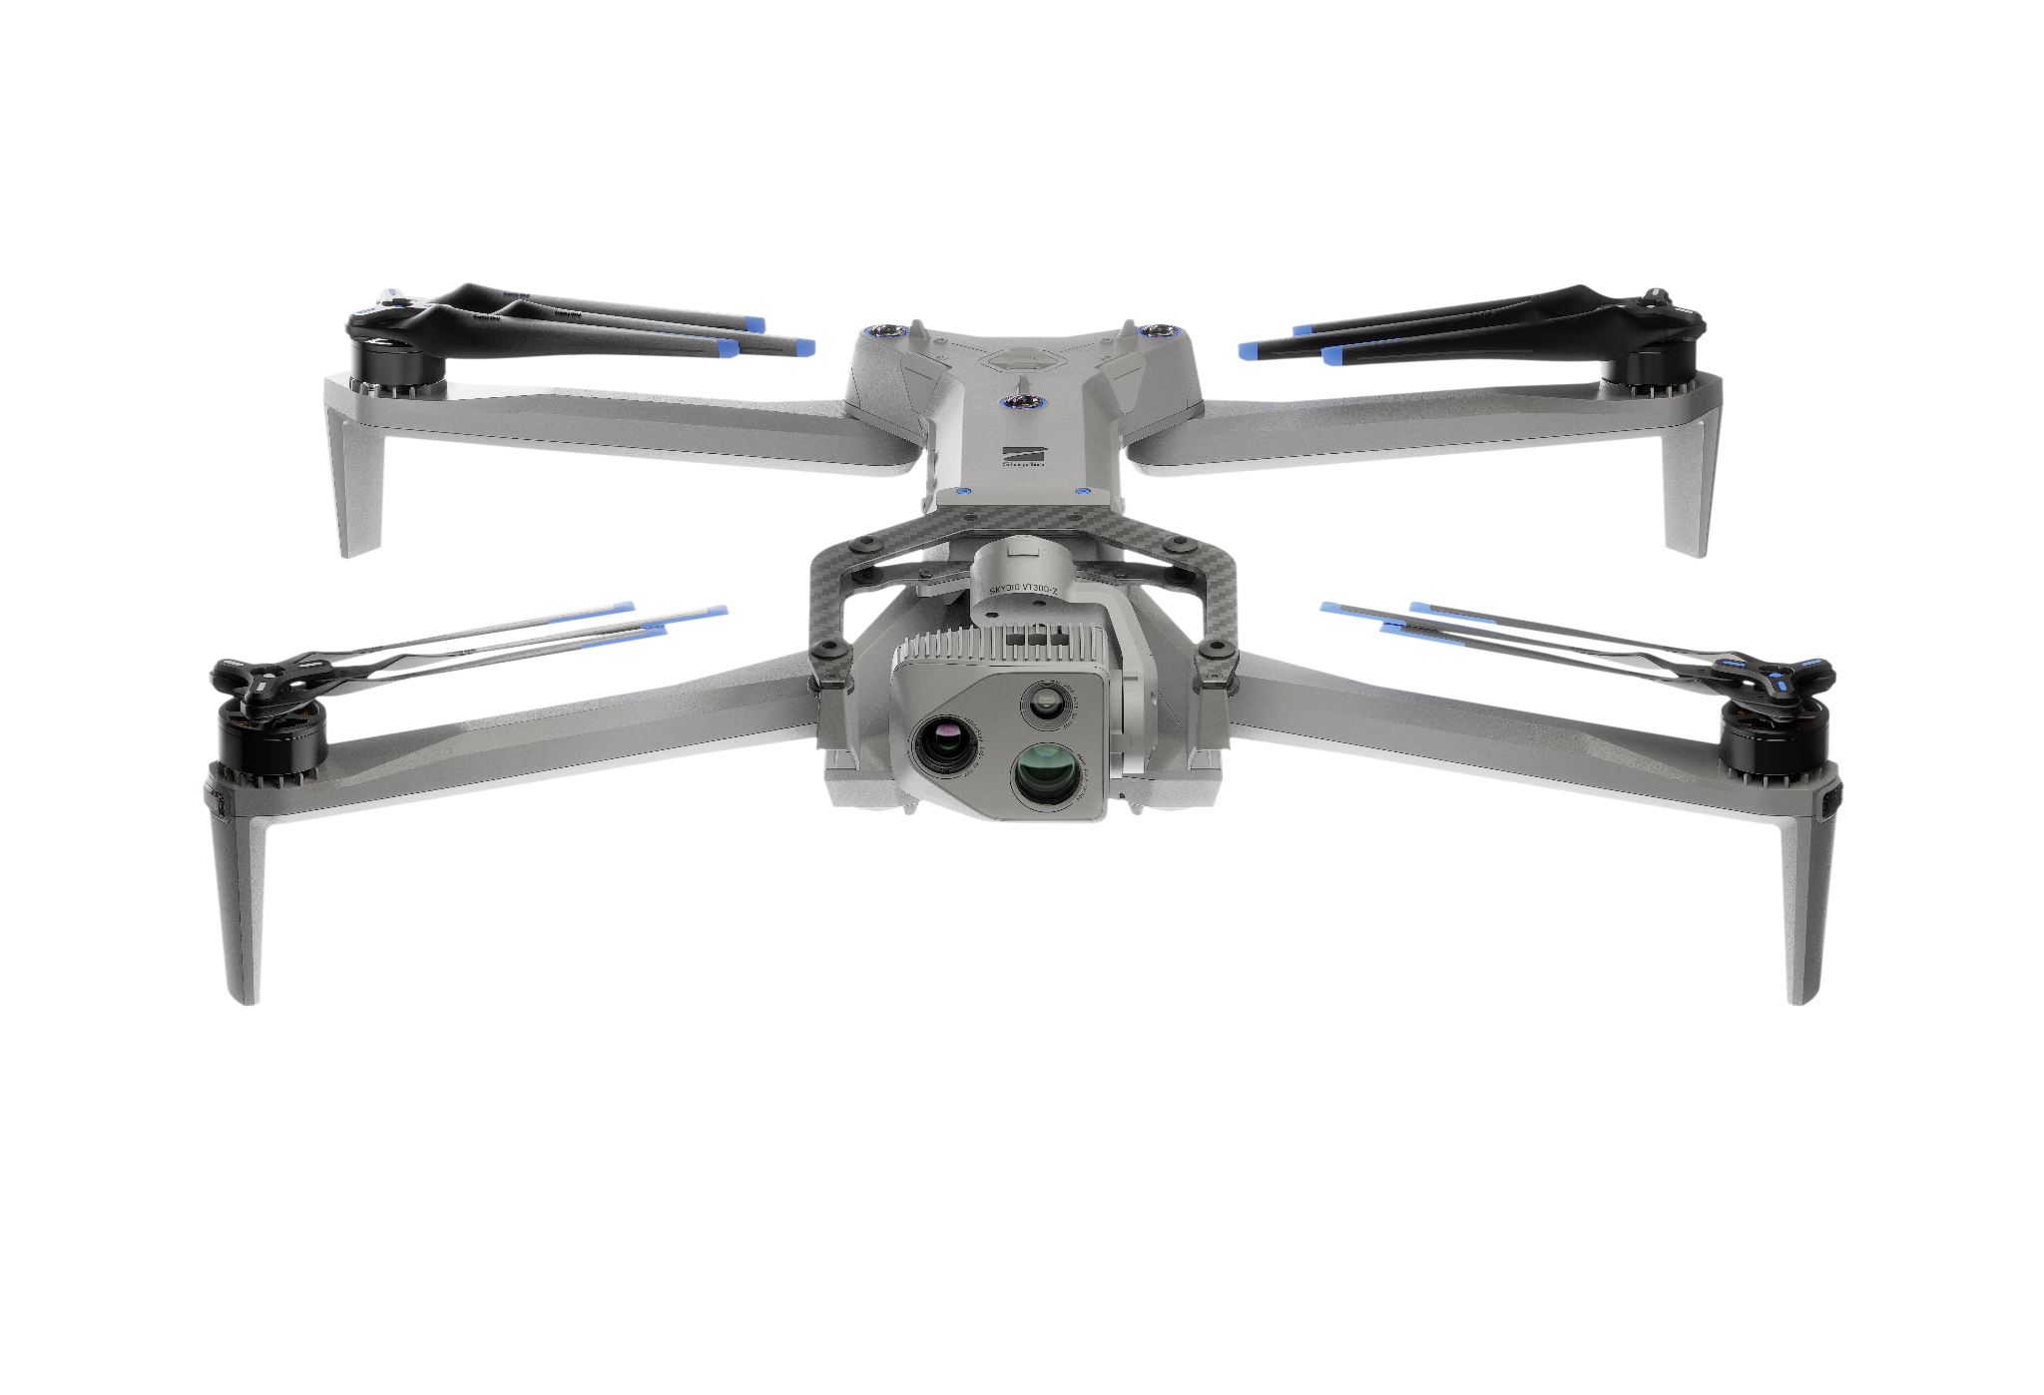

Sensor Operations
Skydio | R47-ATO-IP-deck4-4.3.26

Slide 2
What You’ll Learn
Sensor Operations
Sensor Packages
Media Management
01
03
Explore sensor specifications, capture modes, record features and imaging tools
Discuss media collection and storage locations. Learn to format SD card
Thermal Sensor
02
Understand the capabilities and settings of the thermal sensor.
Notes:
Trainer Script: This module introduces the sensor capabilities of the Skydio X10D. You’ll learn how to use the visible and thermal cameras, adjust imaging settings, and manage captured media. These tools enhance your ISR capabilities in both day and night ops, enabling more precise observation and data gathering.

Slide 3
Sensor
Package
Sensor Operations
01

Slide 4
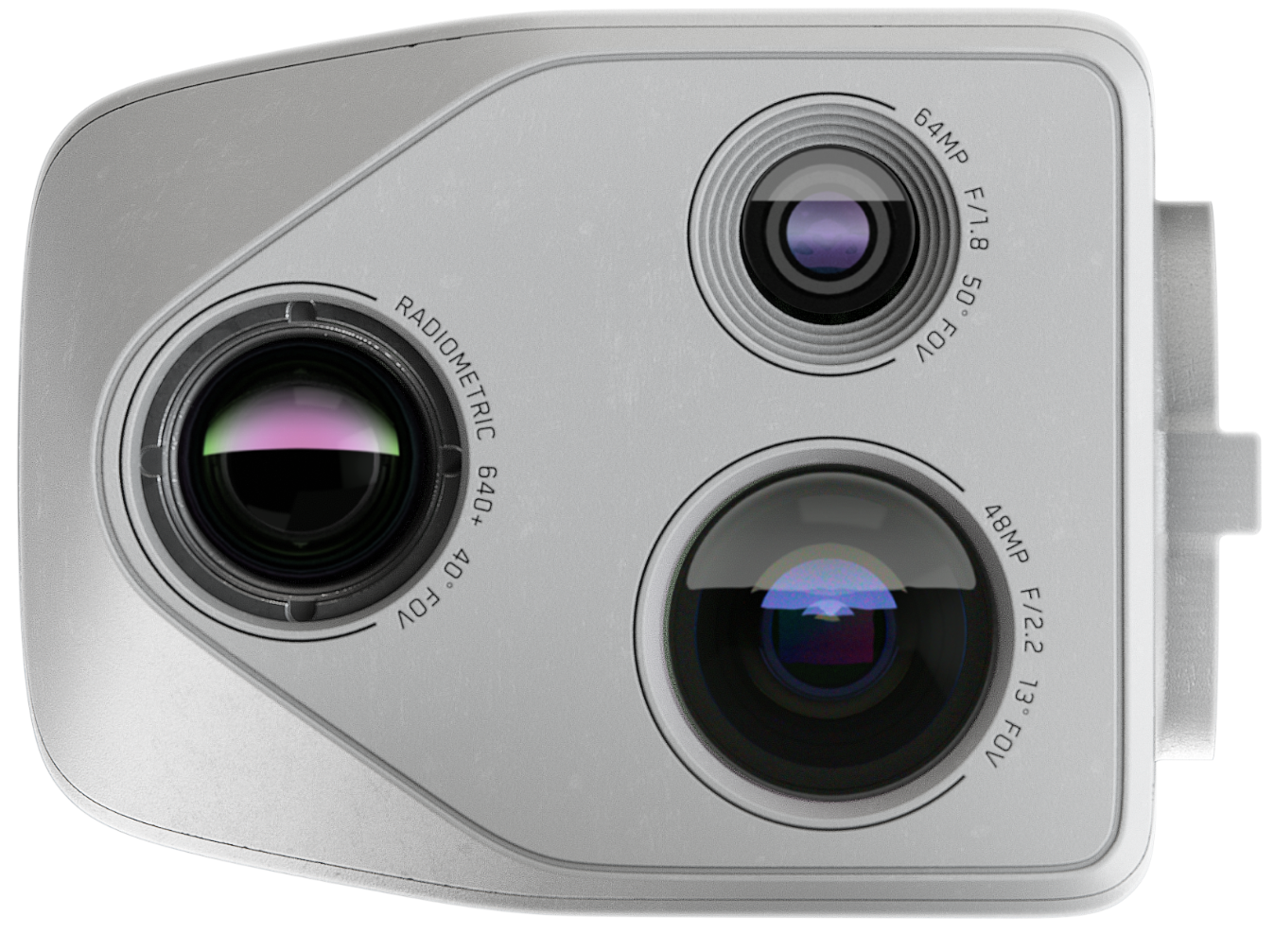
Sensor Package | VT300-Z
Sensor Operations
Narrow Camera | 64 MP
Telephoto camera | 48 MP
Radiometric Thermal camera | 640 x 512
Zoom | 128x (digital)
Notes:
Trainer Script: The VT300-Z sensor suite includes
A 64 MP narrow-angle EO camera
A 48 MP telephoto camera
A 640x512 radiometric thermal camera,
And 128x digital zoom
This combination gives you high-resolution imaging across multiple distances and spectra, useful for identification, surveillance, and damage assessment.

Slide 5
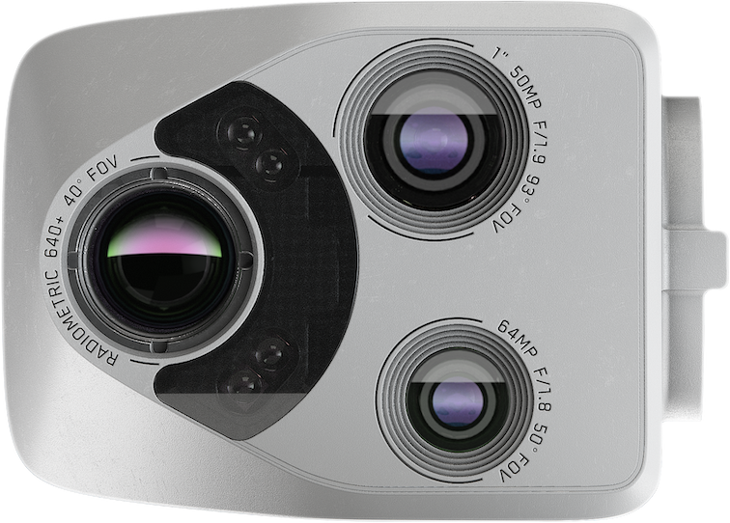
Sensor Package | VT300-L
Sensor Operations
Narrow Camera | 64 MP
1” Wide camera | 50 MP
Radiometric Thermal camera | 640 x 512
Flashlight | 10 ft effective Illumination
Zoom | 64x (digital)
Notes:
Trainer Script: The VT300-L sensor suite includes
A 64 MP narrow EO camera, just like the 300-Z
A 50 MP 1” wide EO camera, great for inspection uses
A 640 x 512 radiometric thermal camera, again, just like the 300-Z
And 64x digital zoom

Slide 6
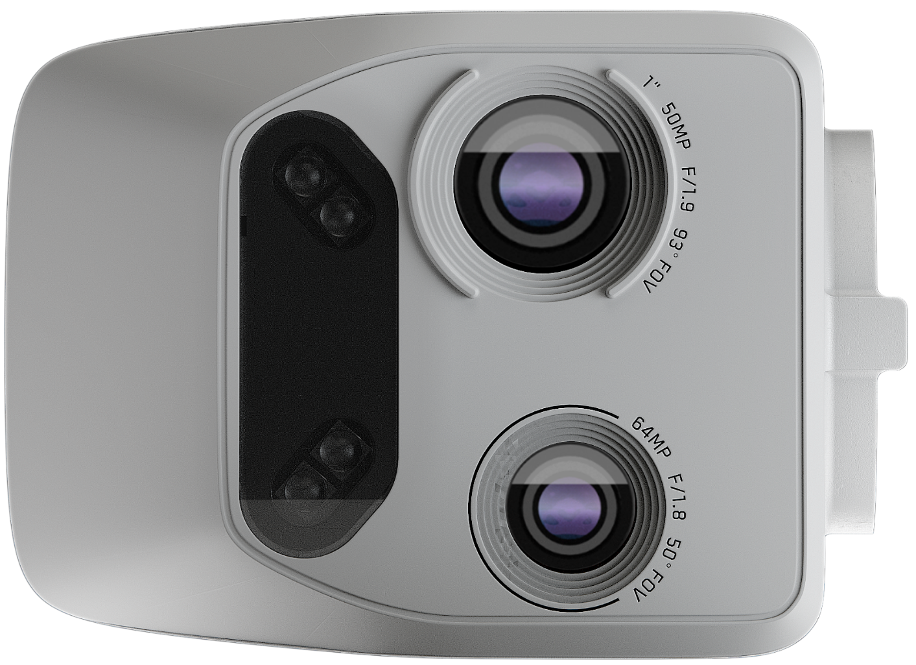
Sensor Package | V100-L
Sensor Operations
Narrow Camera | 64 MP
1” Wide camera | 50 MP
Flashlight | 10 ft effective Illumination
Zoom | 64x digital

Slide 7
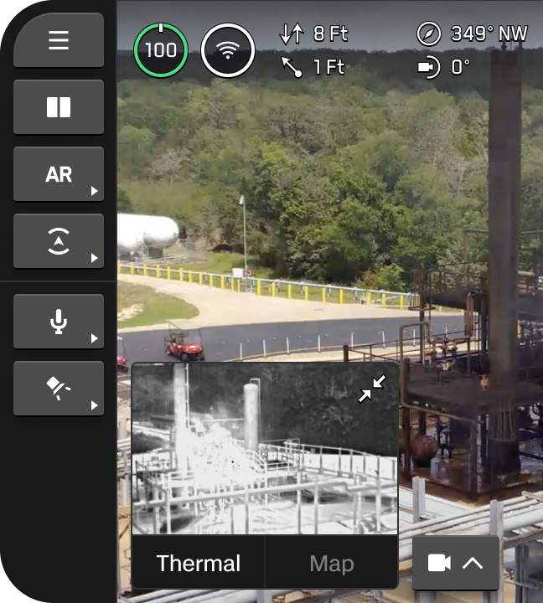
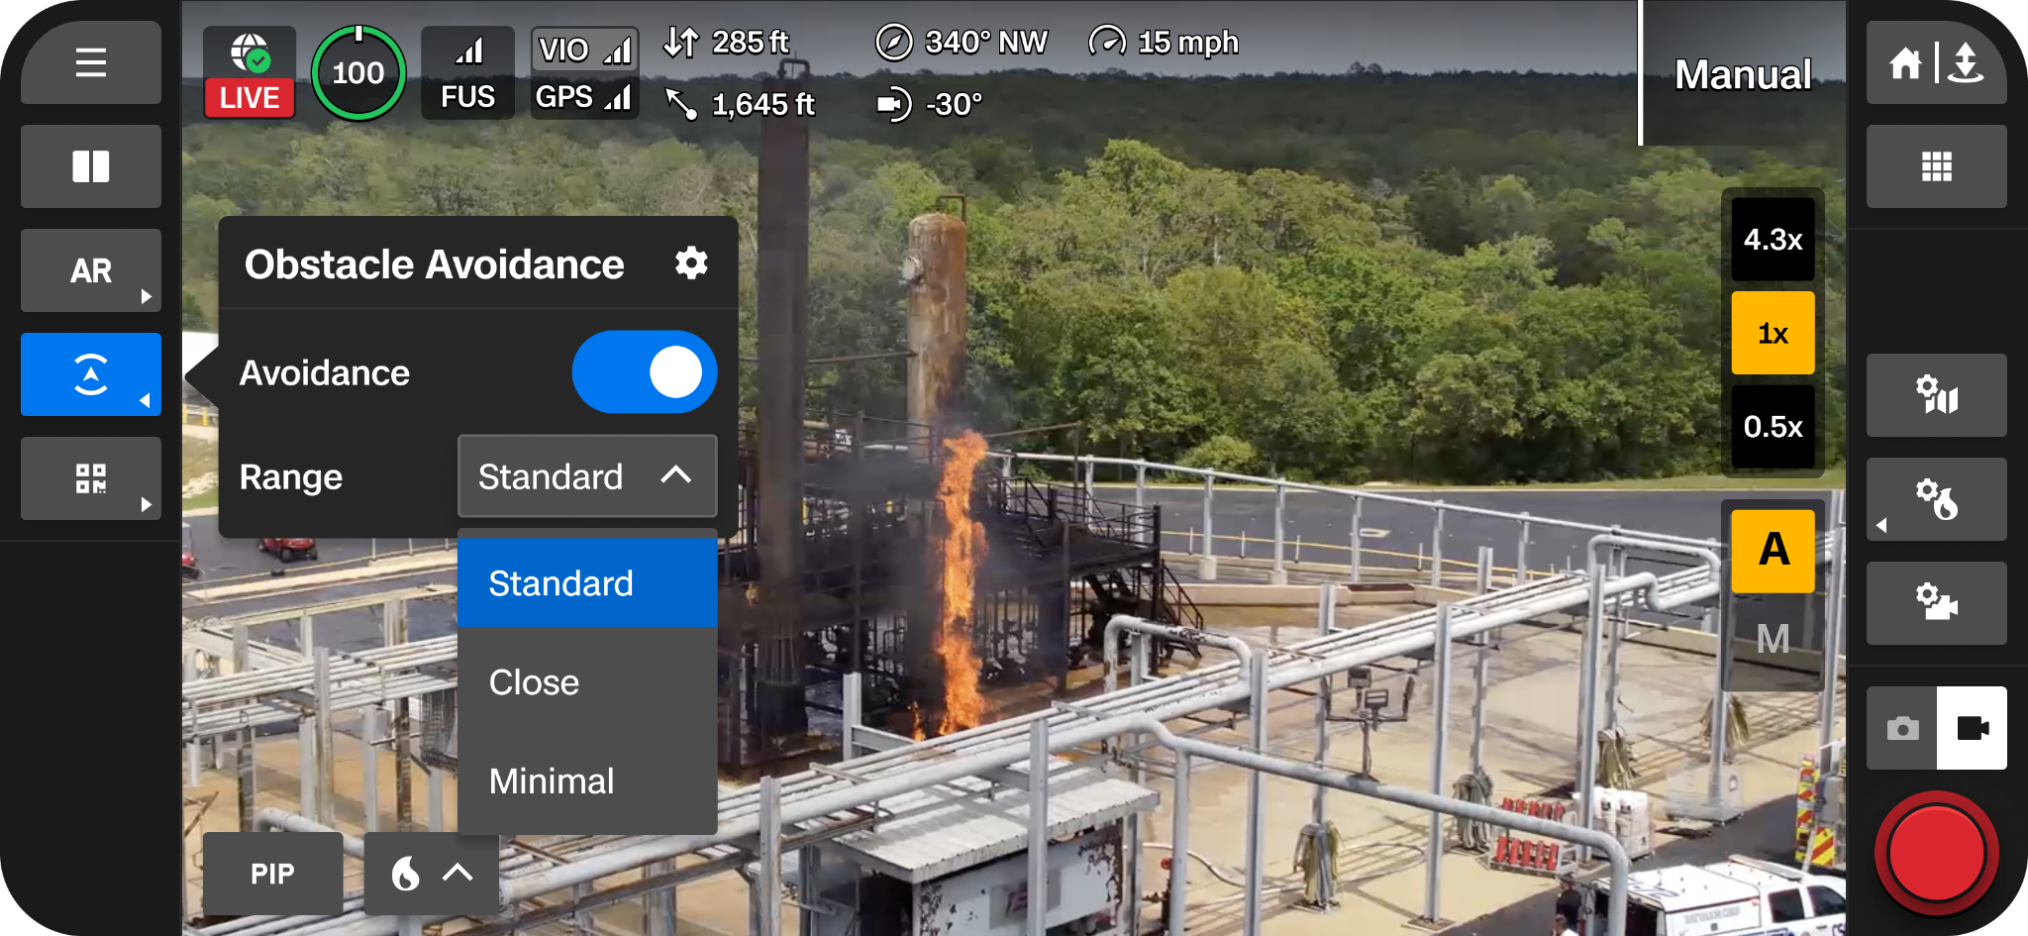
Sensor Package | Color Sensor
Sensor Operations
Quickly adjust between zoom presets using on-screen widgets
  1x (narrow camera)
  4.3x (telephoto camera)
  Surround Vision
Access Surround Vision
PiP displays map or opposite sensor
Adjust camera settings in flight
Zoom Widget
Camera Settings
Focus Widget
Notes:
Trainer Script: The VT300-Z sensor allows for ultimate manual control of the sensor itself and settings by the pilot
Use the on screen widgets to quickly snap to zoom presets
Or use the controller buttons
Picture-in-picture (PiP) allows you to view a map or alternate camera feed
Quickly access camera settings in flight
This interface is designed for real-time intelligence gathering where situational awareness and visual detail are equally important

Slide 8
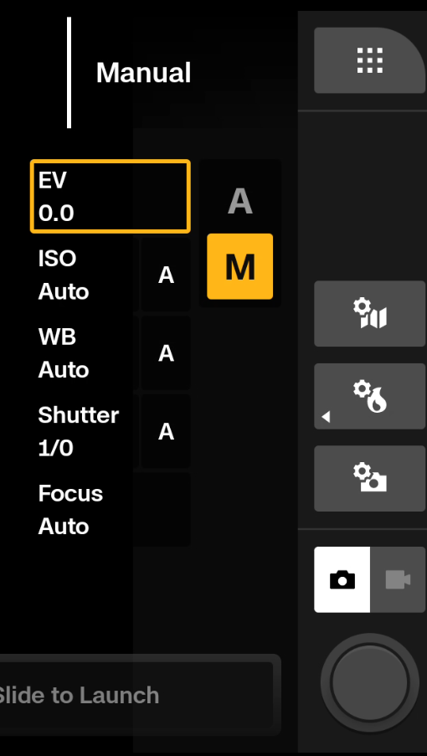
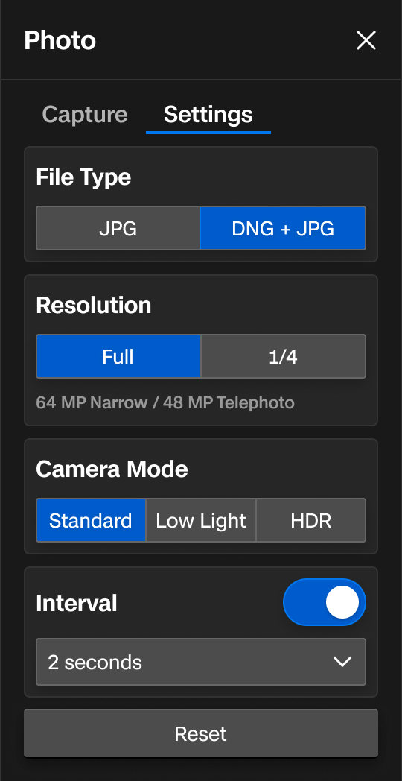
Sensor Package | Color Photo Settings
Sensor Operations
Brightness, White Balance, ISO, Shutter
JPG vs JPG + DNG
Resolution (Full vs ¼)
Camera Mode (presets)
Interval photo (2-60 sec)
Capture in color only, thermal only, or both
Toggle on shutter sound when taking photos
Create custom folders for your media
Notes:
Trainer Script: Fine-tune your images.
Adjust your capture settings manually or automatically
Brightness (EV) - Adjust this setting first if images are too bright or too dark
White Balance
ISO
Shutter
Adjust other sensor settings like
File type (JPG or JPG + DNG (Digital Negative aka Raw)
Raw photos allows for more flexibility in post processing since it isn’t compressed like a JPG is
The compression process usually removes fine detail and sharp color transitions in order to reduce the file size
Resolution
Full or quarter resolution
Use quarter resolution in low light environments or scenes with a wide range of brightness levels
Use Full resolution in bright environments (daytime or well lit scenes)
Camera Mode… These are camera presets designed for different types of environments
Standard… Designed for typical everyday lighting conditions.. This provides a balanced, standard level of exposure, image processing, and contrast.
Low Light is designed for environments with dim lighting (indoors, evenings, etc…). These settings are adjusted to capture more light. Reduce image noise, and improve visibility.
HDR (High Dynamic Range) is designed for dynamic lighting conditions. Multiple images are captured at different exposure levels and then combined to create a single, balanced image.
Interval allows you to capture images at certain intervals between 2 and 60 seconds
Thermal and radiometric thermal images (RJPG) can be captured simultaneously with color images. Just keep in mind that this will take up space in your memory card
Radiometric images are only needed if you are going to process the photos in radiometric software
And finally… Create custom folders for your data.
Can organize by mission, location, team, etc…

Slide 9
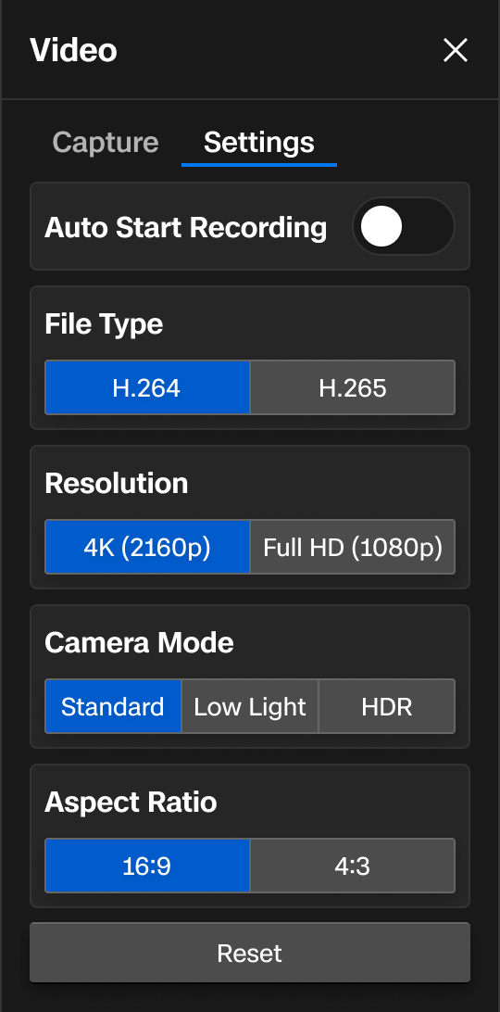
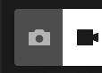
Sensor Package | Color Video Settings
Sensor Operations
Brightness, White Balance, ISO, Shutter
Auto record at launch
Choose file type and resolution
Modify light balance with Camera Mode presets
Define aspect ratio
Notes:
Trainer Script: Video settings offer most of the same settings you will find in photo settings with a few extras…
Auto-record at launch.. This is extremely useful as people tend to forget to press the record button after launch.
File Type is your video CODEC (Coder-Decoder). AKA how your video is compressed. This is essentially the method by which your video is encoded and then decoded for playback.
Verify your playback device codec compatibility
H.265 is a more efficient video compression standard and is ideal for 4k video
H.264 is more widely supported and more efficient for older devices ro platforms
Most media players are compatible with both
Resolution
1080p (HD) offers great resolution without taking up too much space on your SD card
2160p (4k) records ultra high resolution video but results in larger file sizes
Aspect Ratio
16:9 offers a more cinematic feel while eliminating a portion from the tops and bottom of your video
4:3 is a more square shaped aspect ratio and includes the portion of video that is lost in the 16:9 aspect ratio

Slide 10
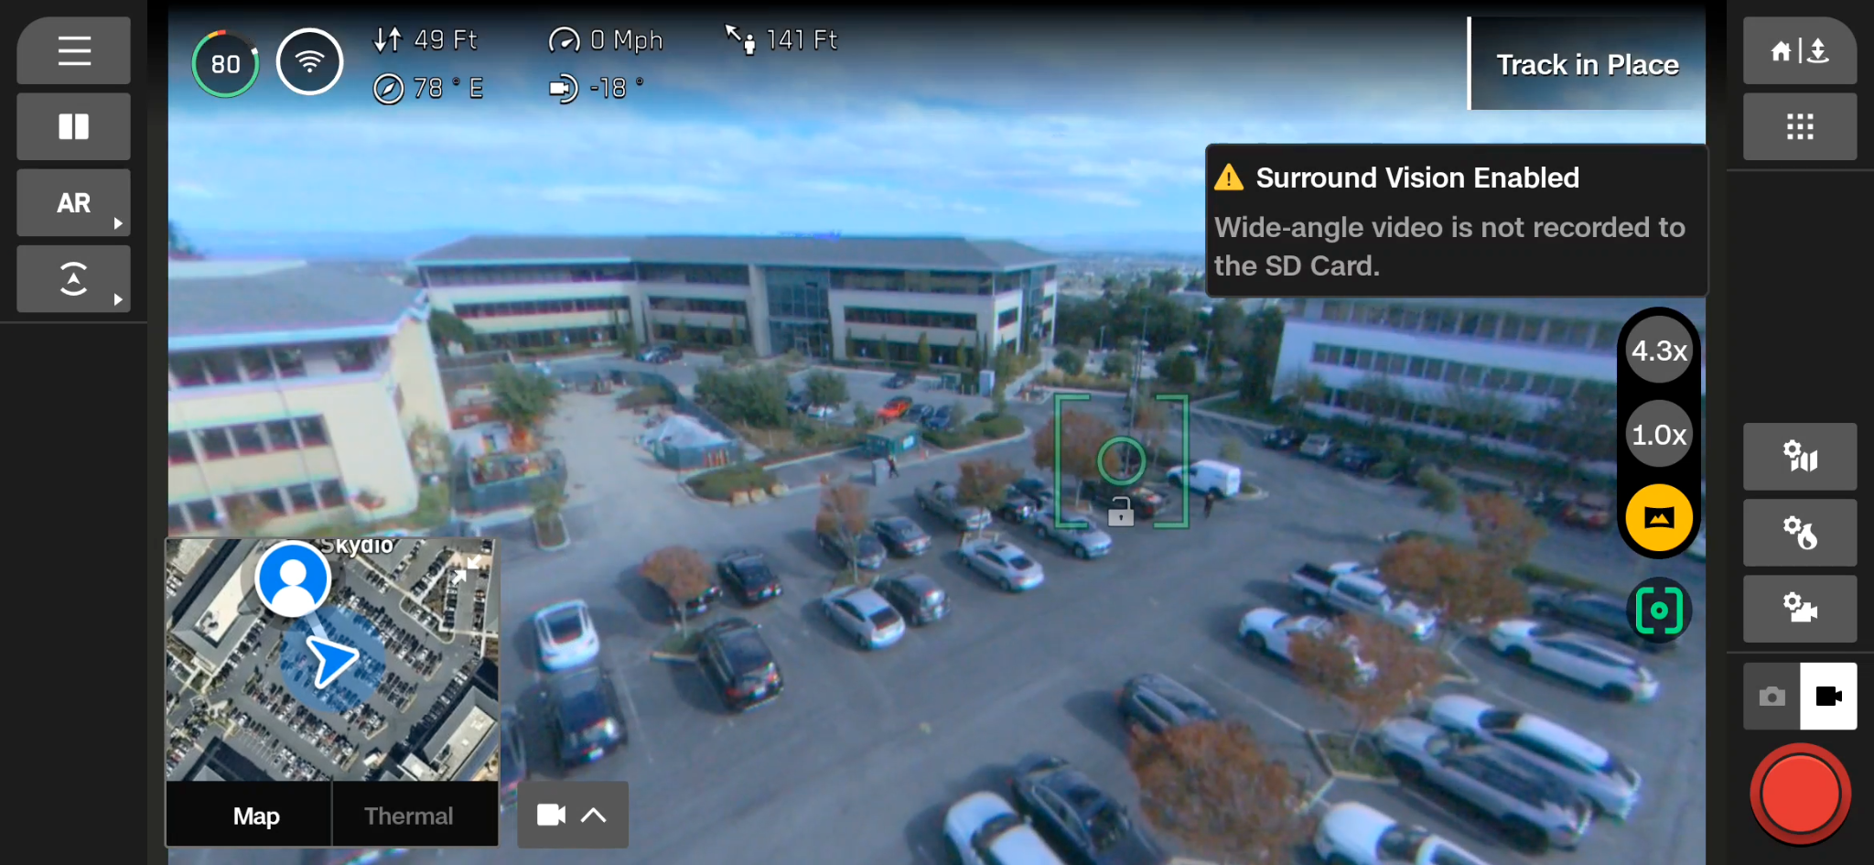
Sensor Package | Surround Vision
Sensor Operations
Uses the nav cams to generate an ultra-wide FOV
Provides greater situational awareness
Recorded photos and videos will be saved at the 1x zoom level
Most useful when scanning broad areas at a hover or low speed
Notes:
Trainer Script: Surround Vision uses the X10D’s nav cams to generate an ultra-wide FOV, increasing situational awareness.
Useful for identifying movement or tracking targets in cluttered environments
Especially useful when hovering or scanning broad areas
However, your recorded video and photos will be saved at 1x zoom

Slide 11
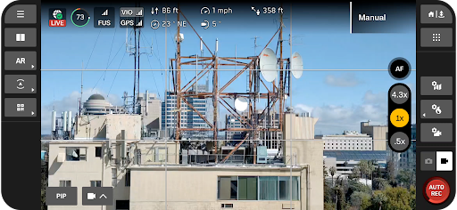
Sensor Package | Image Framing
Sensor Operations
On-screen framing guides to improve image composition
Centerpoint | Displays a crosshair in the center of the screen
Gridlines | Adds a rule of thirds overlay for balanced framing
Diagonal | Displays two intersecting diagonal lines from opposite corners, aiding in angular alignment
Notes:
Trainer Script: X10D provides users with tools to help with image framing and composition.
Centerpoint is your video crosshairs
Gridlines and Diagonal display vertical, horizontal, and diagonal lines in the image
These tools are extremely useful for structural inspections or when framing your video to capture the same shot over multiple flights
These overlays do NOT appear in your recorded photos or video

Slide 12
Thermal
Sensor
Sensor Operations
03

Slide 13
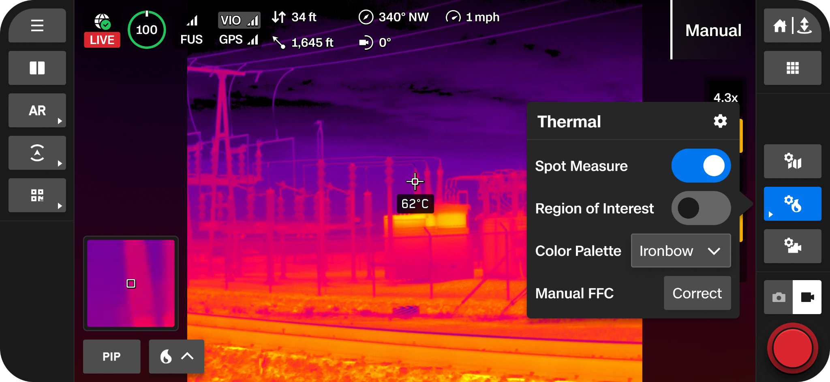
Sensor Package | Thermal Sensor
Sensor Operations
Radiometric
640 x 512 resolution
Black Hot, White Hot, Ironbow, Rainbow
Adjust settings for best picture quality
  Spot Meter
  ROI
  Isotherm
  FFC
Notes:
Trainer Script: Your IR sensor provides high resolution radiometric thermal imagery.
640 x 512 resolution
Multiple color palettes: Black Hot, White Hot, Ironbow, Rainbow
You can resize the Region of Interest (ROI) to focus on a specific area
This is crucial for personnel detection, hot spot identification, or locating recently used equipment

Slide 14
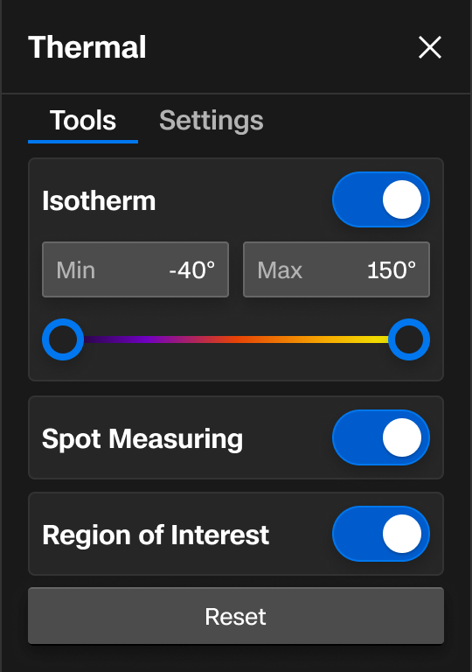
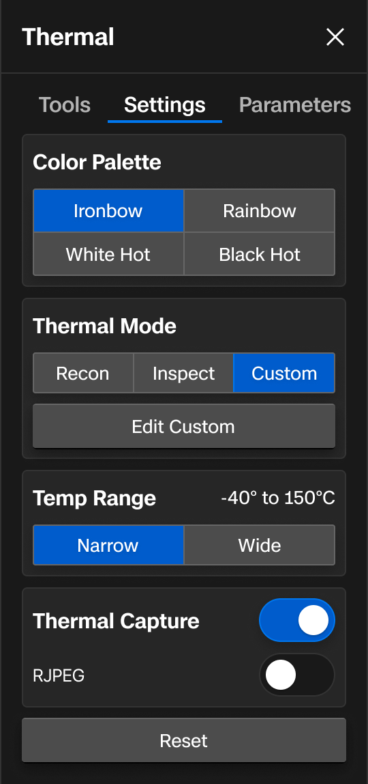
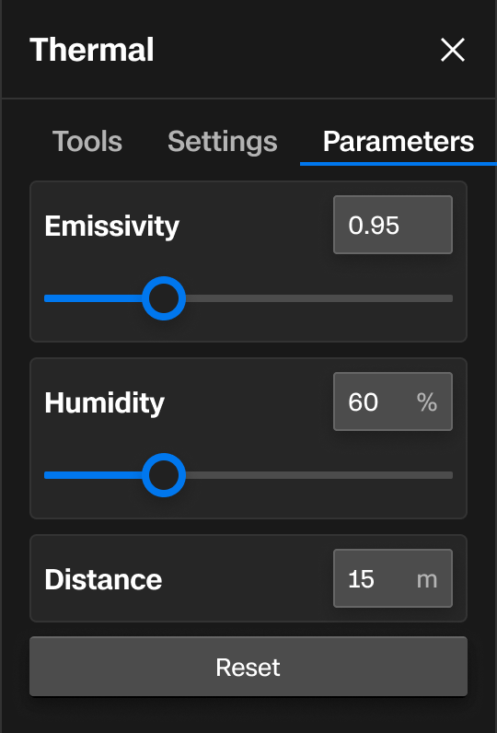
Sensor Package | Thermal Sensor Settings
Sensor Operations
Make custom adjustments for precise temperature measurement
Identify temperature ranges for for easier detection
Capture radiometric JPEGs for post analysis
Capture IR media alongside your color media
Enter environmental data to improve picture quality and radiometric accuracy
Notes:
Trainer Script: The thermal sensor settings allow you to
Manually adjust image tuning for image clarity
Enter environmental data to enhance radiometric accuracy
Save thermal images alongside RGB for correlation
And record radiometric JPEGs for forensic-level analysis post-flight

Slide 15
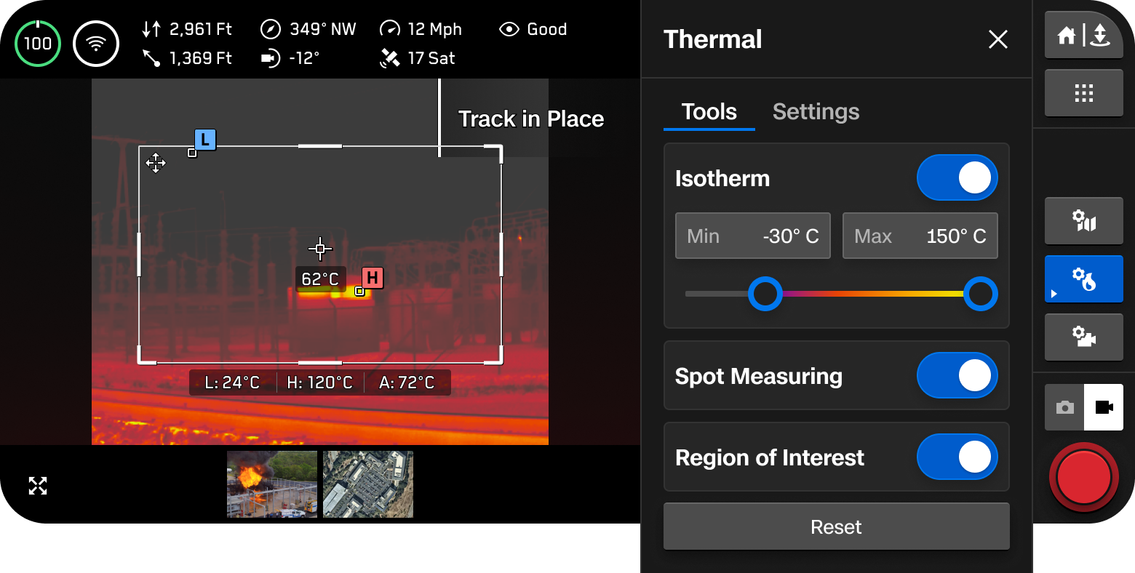
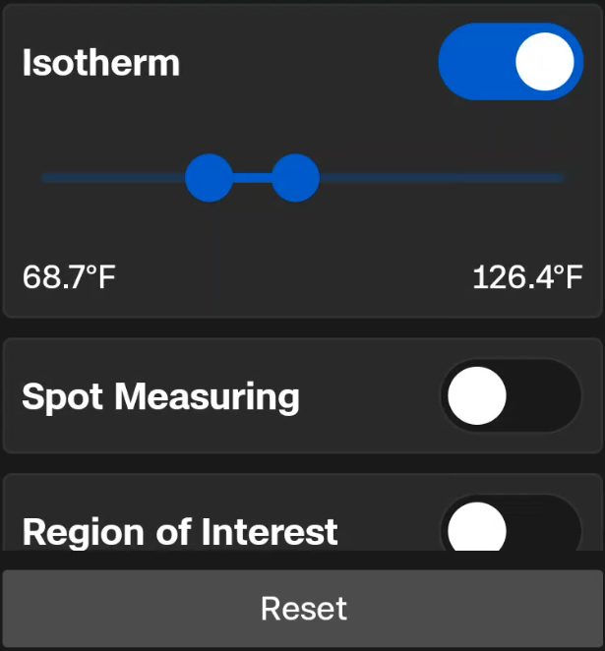
Sensor Package | Isotherm
Sensor Operations
Isotherm allows users to define a temperature range to detect
The temps defined will appear as the selected palette
Temperatures outside of that range will appear as Black Hot
If Black Hot or White Hot are currently selected, the temperatures in that range appear in Rainbow
Notes:
Trainer Script: Isotherm is a very useful tool that allows you to define a temperature range for the sensor to detect.
Temps in that range appear as the currently selected palette
Temps outside of that range will appear as black hot
If black hot or white hot is the currently selected palette, the temps in that range will appear as Rainbow
Useful for Search and Rescue (SAR), personnel detection, or when searching for specific temps or temp ranges

Slide 16
Sensor Package | Spot Meter & Region of Interest
Sensor Operations
Spot Meter
Obtain a temperature reading from a specific item or region on the screen
PiP to magnify Spot locations for more accurate measurements
Region of Interest
Toggle on ROI for High/Low temperature markers
Low, average, high temps displayed under window
ROI window is adjustable
Notes:
Trainer Script: Spot Measuring is a tool that allows you to obtain temperature readings from specific areas on the screen.
You can drag the spot on the screen and place it on the desired area or pixel
The small picture in picture view on the left hand side provides a zoomed in view to assist spot placement accuracy
You can also enable Region Of Interest (ROI) to show low, average, and high temps within the defined zone
You’ll see the Low, High, and Average banner just under the ROI
You’ll also see the High and Low markers in the ROI itself on the highest and lowest pixel temps
Drag and resize the window as needed during flight
Ideal for inspecting engines, transformers, or personnel heat signatures.

Slide 17
Sensor Package | Flat Field Correction
Sensor Operations
Mitigates and compensates for errors that build up over time during the thermal camera operation
Performed in the background automatically
Can perform manually at any time, on ground or in flight
Actuation of the shutter may be noticeable at higher zoom levels
Notes:
Trainer Script: And finally, for the thermal sensor tools, you have the Flat Field Correction or FFC. This process reduces thermal image distortion
It works by recalibrating the thermal sensor to maintain accuracy over time
It happens automatically but can be manually triggered
You may see a brief freeze or hear the shutter click… This is normal

Slide 18
Sensor Package | Thermal Mode
Sensor Operations
Thermal Modes
Tuning presets to enhance your thermal image for the desired use
Recon | Optimized for SAR and Reconnaissance
Inspect | Optimized for inspection use cases
Custom | Allows fine tuning of Gain, High Tail, and Low Tail
Notes:
Trainer Script: Thermal modes enhance temperature differences in the image for the selected mode
Recon mode is tuned to increase the contrast between the overall scene and targets
Best for Search and Rescue, reconnaissance, or overall situational awareness
Recon helps differentiate the scene from things like people, vehicles, or animals
Inspect mode decreases the overall contrast so that temperature anomalies are easier to identify in inspection use cases.
This makes it easier to not only see the anomaly, but help track the source of the heat signature

Slide 19
Sensor Package | Temp Range
Sensor Operations
Temp Range
Range of temperatures the X10D will detect
  Narrow | -40° - 302° F (-40° - 150° C)
  Wide | -40° - 662° F (-40° - 350° C)
Notes:
Trainer Script: Temp Range determines the range of temperatures the X10D will detect
The Narrow range is between -40 and 302 degrees fahrenheit and will provide more contrast detail because of its smaller range
While the Wide range is between -40 and 662 degrees fahrenheit
The wide range will generally not be able to pick up subtle temperature differences

Slide 20
Sensor Package | Thermal Parameters
Sensor Operations
Allows pilots to correct for environmental factors
  Emissivity | How efficiently an object emits thermal radiation
  Humidity | Moisture content in the air
  Distance | Range between the aircraft and the target
Material | Emissivity Value
Aluminum | Anodized | .77
Aluminum | Polished | .05
Red Brick | .92
Cement | .54
Concrete | .92 - .97
Glass | .92
Gravel | .28
Dry Mortar | .94
Sand | .90
Human Skin | .95-.98
Soil | .93
Notes:
Trainer Script: Correct for environmental factors by adjusting the thermal parameters.
Emissivity is the measure for how efficiently an object emits thermal radiation
The more emissive the object is, the higher you should set this value
Generally speaking Metal, Rusted or oxidized surfaces, Water, Human skin all have higher emissivity values
The less emissive the object is, the lower you should set this value
Generally speaking Stainless steel, Shiny surfaces, Windows, and similar objects have low emissivity values
You can find emissivity values for different types of surfaces with a quick internet search
Humidity can affect the accuracy of your radiometric readings
Set your humidity value to accurately reflect the aircraft’s environment (not the pilot’s environment)
Why is distance important?
Thermal radiation intensity decreases with distance
Temp and humidity over longer distances affect radiometric accuracy
Over distance, the area a single pixel covers increases. This means the thermal sensor is averaging the temperature for a much wider area.
Input the distance between the sensor and the target to compensate for this

Slide 21
Media
Management
Sensor Operations
04
Notes:
Trainer Script: The final section of this module is Media Management. Here, we’ll talk about how to manage all of that imagery data you’re collecting.

Slide 22
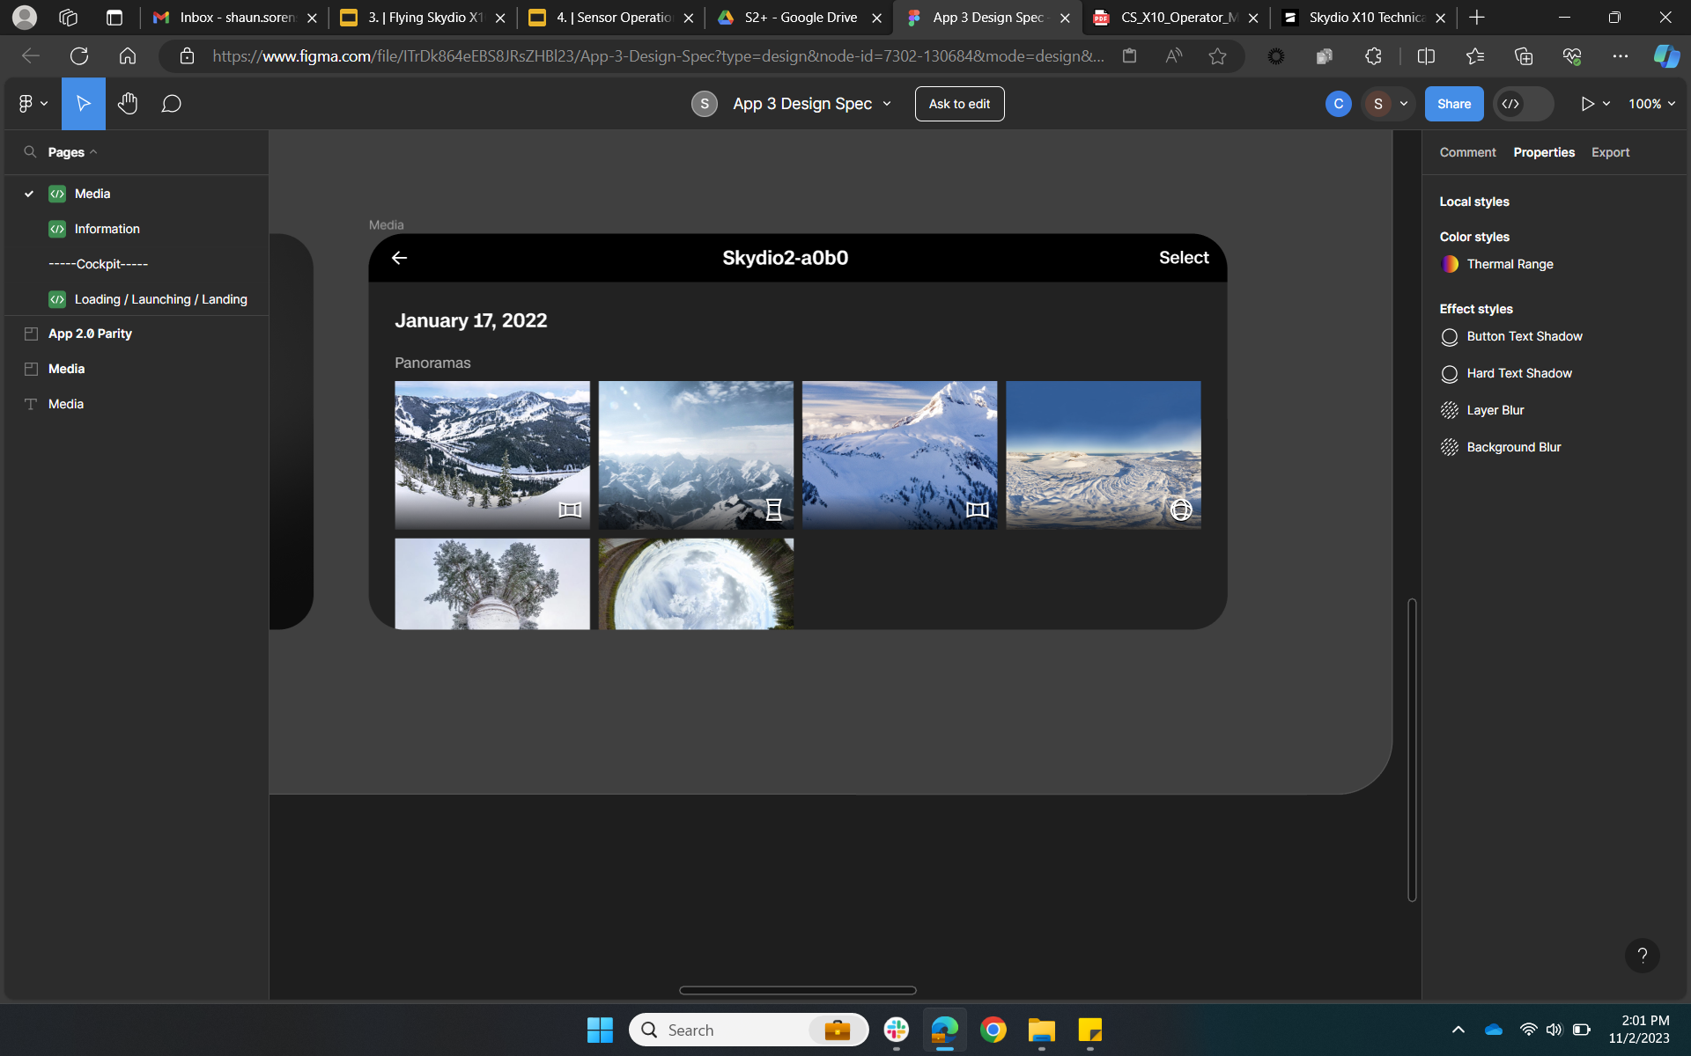
Data Management | Viewing Unencrypted Media
Sensor Operations
Recorded media cannot be viewed in flight
Use Media menu to review or delete videos and photos captured
JPGs and LRVs only
Offload media to review DNG photos and HD video
New MicroSD Cards must be formatted in the aircraft
SkydioX10-g4n4
Notes:
Trainer Script: To review your captured media
First things first… You cannot review media in flight. This can only happen while the aircraft is on the ground.
Navigate to the Media tab to review saved media
But you are limited to viewing JPGs and LRVs via the controller
Full-resolution images and RAW files require offloading
Encrypted media must be decrypted before viewing and viewed only by connecting the aircraft directly to a computer
Format all new SD cards in the aircraft, not on your computer, to ensure compatibility

Slide 23
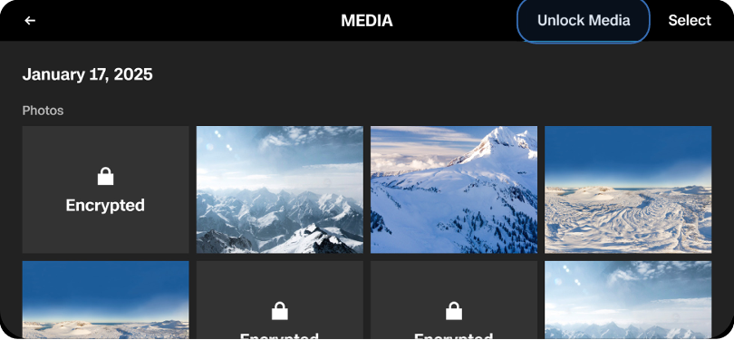
Data Management | Decrypting Your Media
Sensor Operations
Controller-Based Decryption
Media must be unlocked in order view on the controller
Global Settings > Media > Unlock Media > Unlock
Fleet Manager-Based Decryption
Used to decrypt SD card files without the drone
Skydio Fleet Manager Settings > Security > File Decryption
Notes:
Trainer Script: Now decrypting the data is as easy as encrypting it. However, there are 2 ways of doing this. On the controller and in the Fleet Manager
When decrypting your data on the controller, navigate to the Media menu, and select Unlock Media. You’ll receive an “are you sure” prompt. Select Unlock and the media will be revealed.
If the aircraft is not functional and can’t connect to Fleet Manager or the controller, you can remove the SD card and decrypt the data in the Fleet Manager via web browser.
All you have to do is insert the SD card into your computer
Log into your fleet manager account and navigate to Settings > Security > File Decryption
Enter the passphrase for the active encryption key
Click on Select Files under step 2
Select the files from the file navigator when it appears
Reminder… Disabling encryption is NOT the same as decrypting. You must decrypt or let it upload to cloud in order to view it

Slide 24
You Learned
Sensor Operations
Sensor Packages
Media Management
01
04
Explore sensor specifications, capture modes, record features and imaging tools
Discuss media collection and storage locations. Learn to format SD card
Color Sensor
02
Understand the capabilities and settings of the color sensor.
Thermal Sensor
03
Understand the capabilities and settings of the thermal sensor.
Notes:
Trainer Script: To recap
You’ve learned how to operate and adjust the X10D’s full sensor suite
Configure color and thermal imaging settings
And manage your media securely
These skills help ensure quality ISR collection and protection of sensitive data.

Slide 25
Questions
Sensor Operations

Slide 26

Use or disclosure of data contained on this sheet is subject to the restriction on the second page of this proposal

