Slide 1
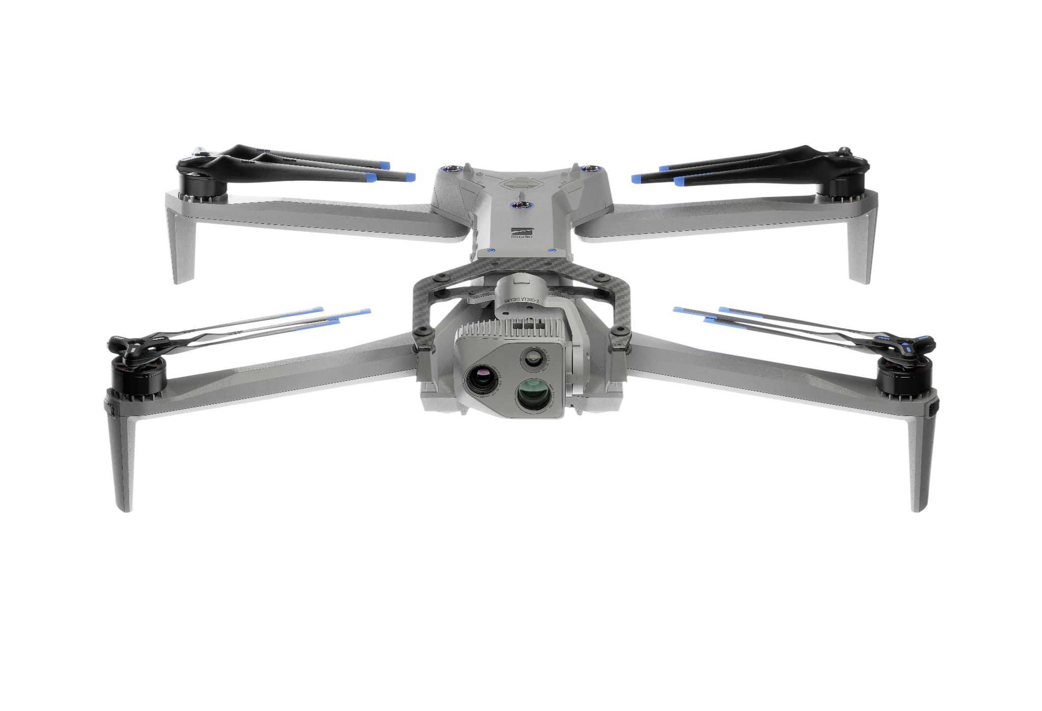

Getting Started
R47-ATO-IP-deck2-4.3.26

Slide 2
What You’ll Learn
Getting Started
Safety
Fleet Manager for Offline Drones
01
04
Identify and understand safe practices when flying your Skydio X10D
Manage drones and users across your organization with single dashboard
Hardware Overview
Before you Fly
02
05
Introduce the Skydio X10D hardware components, including controller
Prepare your Skydio X10D for flight with a series of hardware and software checks
System Setup
Paraverse
03
06
Prepare your Skydio X10D system for use with radio pairing
Create and fly an X10D simulator.
Notes:
Trainer Notes: This module will give you a tactical understanding of how to safely prep and launch your X10D, manage users and equipment through the Fleet Manager, and conduct necessary preflight steps. Everything we cover today is foundational for operations in real-world conditions, especially in GPS-degraded or communication-contested environments.

Slide 3
Safety
Guidelines
Getting Started
01
Notes:
Trainer Notes: The Skydio X10D’s advanced autonomy reduces pilot workload, but safety protocols still apply. Keep in mind, propellers can cause injury, and Skydio’s sensors do not detect everything, especially wires or reflective surfaces. You’re still the operator in command. It is your responsibility to maintain situational awareness.

Slide 4




Safety | Regulations & Equipment
Getting Started
Regulations
Open Water
Precipitation
Propellers
Follow all federal guidelines, and local and state regulations.
If flying over water, ensure your drone has a strong GPS signal. Launch and land over a dry surface.
Skydio X10D can fly in light to moderate precipitation with obstacle avoidance disabled.
Keep fingers away from moving propellers at all times.
Notes:
Trainer Notes: Whether training stateside or deployed, FAA regs and/or host nation policies apply. If you're flying over water, always launch from dry land with a strong GPS signal. In wet environments, turn obstacle avoidance off and maintain clear line of sight.
When flying in precipitation, use best judgement. Do not fly in hail, freezing rain, sleet, etc….
IP55 = Protected against dust ingress that can cause damage and protected against low pressure water jets from all directions but not completely dust or waterproof.

Slide 5



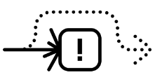
Safety | Obstacle Avoidance
Getting Started
Electrical Wires
GPS Only Flight
Moving Objects
Reflection
Beware of thin hanging wires, or wires secured to poles .5 inch.
OA is off during Low Light flight mode and can be impaired when in low light and poor visibility.
Skydio X10D does not avoid moving objects.
Avoid large transparent or reflective surfaces larger than 23 inches.
Notes:
Trainer Notes: Obstacle Avoidance, although extremely capable, is not foolproof. In low-light conditions, OA is limited or disabled. The X10D will not avoid moving objects like people, vehicles, or animals. Avoid flying near reflective surfaces like glass windows larger than 23 inches.

Slide 6
Hardware
Overview
Getting Started
02
Notes:
Trainer Notes: Let’s walk through the aircraft together. Knowing each component by name and function is critical in flight prep and troubleshooting. These include antennas, camera systems, attachment bays, and airflow features.

Slide 7
Hardware Overview | Skydio X10D
Getting Started
C2 | Skydio Connect SL or Skydio Connect MH
Flight Time | 40 minutes (ideal conditions)
Service Ceiling | 15,000 ft DA
Max Wind Tolerance | 28 mph (24 kts)
Weight | <5 lbs (w/battery, no attachments)
Notes:
Trainer Notes: Let’s dive into the aircraft’s performance envelope so you know exactly what it can and can’t do in the field. These specs matter tactically.
Skydio Connect SL and MH – These are the two radio link options.
SL = SkydioLink, which is the standard radio that uses Wi-Fi-based communication. Best for short-range, rapid deployment.
MH = Micro Hard. It operates on military-compatible bands and provides more robust connection in congested RF environments.
40 minutes of flight time | That’s with ideal conditions like minimal wind, moderate payload, no excessive maneuvering. Realistically, expect 30–35 minutes with active mission profiles, especially when using accessories like NightSense or the spotlight.
15,000 ft Density Altitude (DA) | This is your max effective ceiling. At higher elevations or in high-heat and humid environments, air density drops and propeller performance degrades. Always consider local DA conditions during mission planning, especially in mountain regions or hot climates.
Effects of operating at high altitudes are reduced propeller performance and reduced flight time due to the motors working harder to spin the propellers faster
Max wind 28 mph (24 knots) | This is operational wind tolerance. The X10D can handle gusts, but you should exercise caution with crosswinds and turbulent air near structures. The autonomous navigation compensates well, but don’t expect it to hold steady during max payload climbs in 25+ knot wind.
<5 lb | The Skydio X10D weighs under 5 pounds, which classifies it as a Group 1 UAS under DOD guidelines. This makes it easier to deploy in environments with stricter weight limitations, such as shipboard ops, small UAV airspace corridors, or when carried in a rucksack. Despite its low weight, the X10D remains exceptionally rugged and stable in moderate winds, and the small form factor enhances mobility for dismounted or rapid-response teams

Slide 8
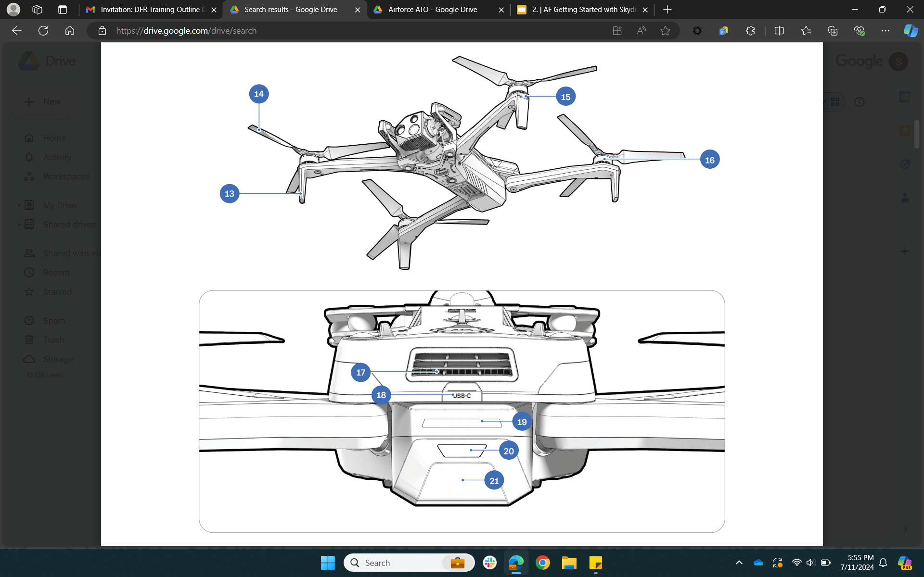
Hardware Overview | Skydio X10D
Getting Started
Landing feet/antennas
Propeller blades
RGB/Strobe/IR lights
Motors
2
3
4
1
Notes:
Trainer Notes: Here we’re looking at the major external flight components:
Landing feet also house antennas
Propeller blades. Check for nicks or cracks during preflight.
RGB/strobe lights for visibility and compliance.
Motors. Visually inspect for foreign object damage (FOD) or binding.

Slide 9
Hardware Overview | Skydio X10D
Getting Started
Air Outlet
Rear USB-C Port
Battery lights
Power button
Battery
5
6
7
8
9
Notes:
Trainer Notes: Continuing the hardware walkaround
Air outlet - part of the thermal management system. Avoid covering it.
Rear USB-C port - used for pairing, updates, and mission data transfer.
Battery lights indicate charge status before startup.
Power button - press and hold for 5 seconds to boot the drone.
Battery - slides in via guide rails. Secure it firmly before launch.”

Slide 10
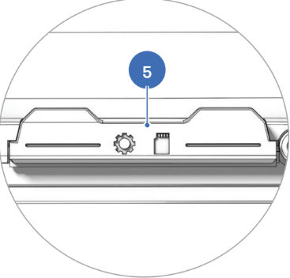
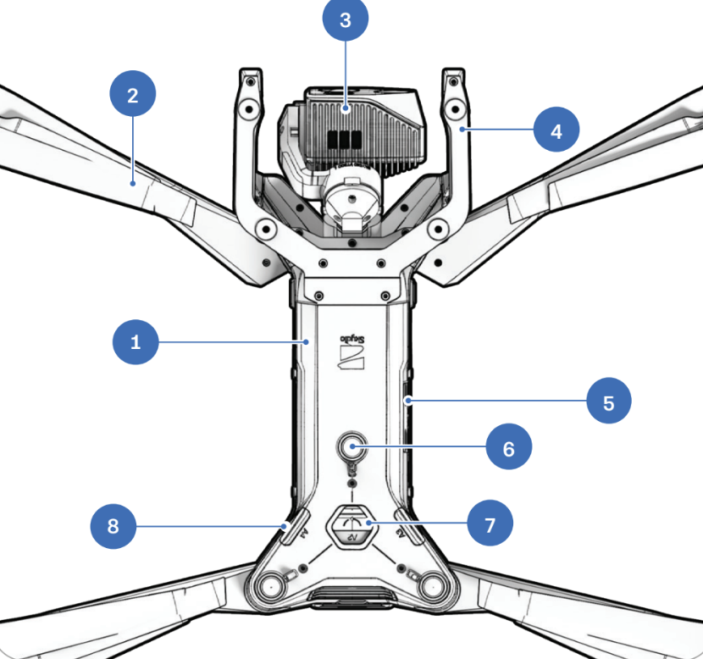
Hardware Overview | Skydio X10D
Getting Started
Chassis
Arm (4)
Sensor Package
Sensor Package Frame
Log and Media card slots (2)
Top navigation cameras (3)
Top attachment bay (A2)
Side attachment bay (A3, A4)
12
11
14
13
10
14
15
17
16
Notes:
Trainer Notes: The top and side of the aircraft house critical mission components
Chassis - lightweight but durable carbon fiber composite.
Four arms - structural and foldable. Handle with care.
Sensor package
Sensor Package frame
Two media card slots - used for video, photos, and DTED.
Top navigation cameras - enable obstacle avoidance above.
Top attachment bay (A2) - for accessories like spotlight or speaker.
Side attachment bays (A3, A4) - for modular payloads or mounts.

Slide 11
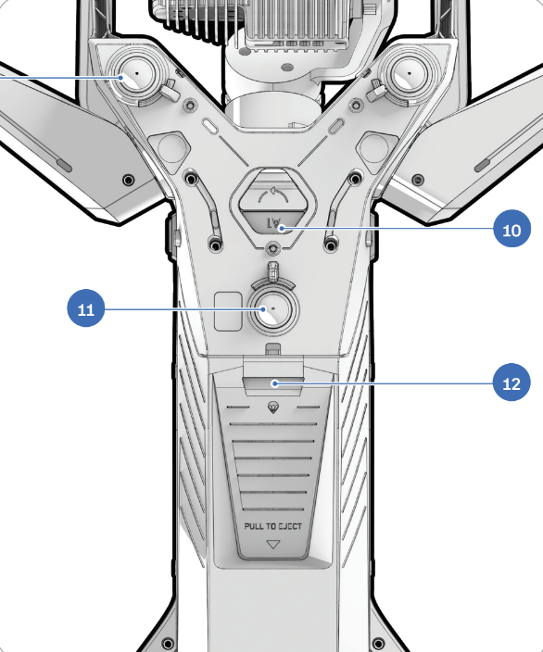
Hardware Overview | Skydio X10D
Getting Started
Bottom navigation cameras (3)
Bottom attachment bay (A1)
Time of flight sensor
18
19
20
Notes:
Trainer Notes: Bottom-mounted components include
Navigation cameras - key to Skydio’s 360° situational awareness.
Bottom attachment bay (A1) - used for speaker or payloads.
Time-of-flight sensor - used for measuring distance and landing accuracy.

Slide 12
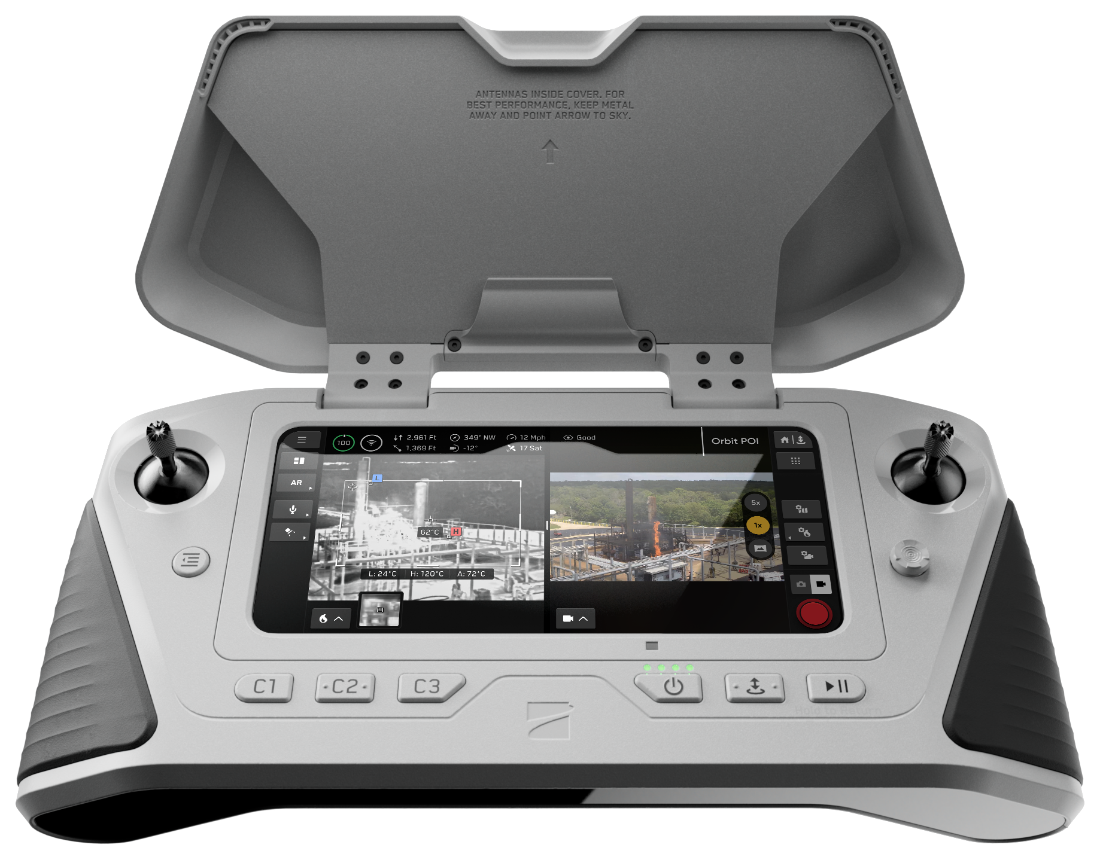
Hardware Overview | Skydio X10D Controller
Getting Started
Lightweight, ruggedized, weather resistant
Button mapping for pilot preference
USB-C + HDMI-out
5 hours operational time (can charge while flying)
Built-in antenna
Max Brightness | 1750 nits
Notes:
Trainer Notes: The controller is rugged, water-resistant, and optimized for tactical ops
5-hour battery life, and can be charged while flying
1750-nit display is readable in full sunlight
Nits = What the human eye perceives from that light
Customizable button mapping supports user preference
Ports include USB-C and HDMI for video-out or accessories
HDMI transmits RAW VIDEO only. It does not mirror your controller screen.
Do not use for flight control
Antennas are internal so don’t block the top or back of the controller

Slide 13
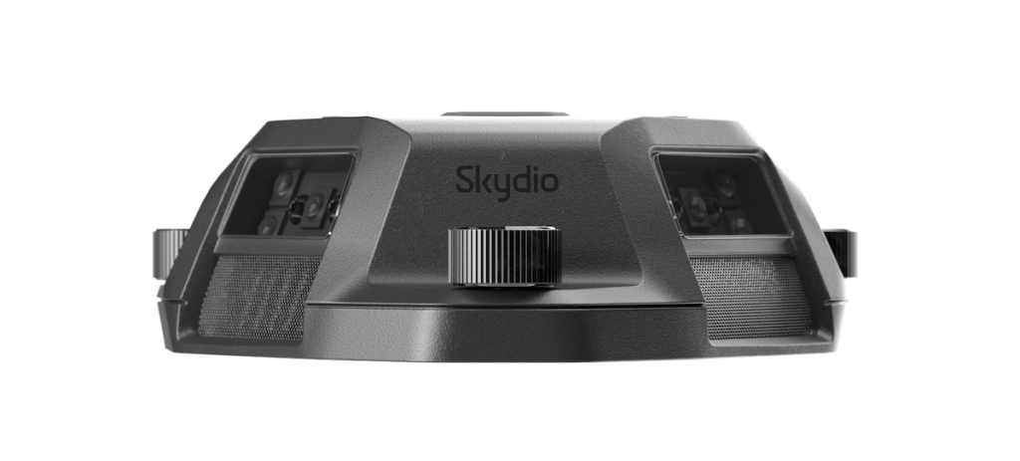
Hardware Overview | NightSense
Getting Started
Provides 360° obstacle avoidance at night or in dark spaces
Visible & Infrared options
IR NS strobes at the Nav Cam framerate to reduce impact to flight time
Mounted on top and bottom of X10
Must toggle on Low Light mode to use
Notes:
Trainer Notes: NightSense provides obstacle avoidance in darkness or confined indoor spaces
You must enable Low Light Mode in order to activate it
There are visible and infrared light options
It draws additional power and slightly reduces flight time
Used effectively in raids, urban overwatch, or inside structures. Just remember, it’s mounted top and bottom, so keep it clean and unobstructed
Off by default for battery management

Slide 14
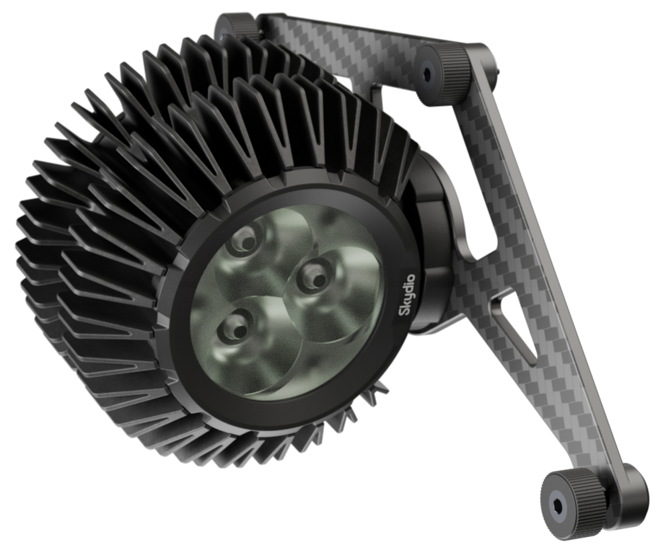
Hardware Overview | Spotlight
Getting Started
High-powered spotlight (5500 lumens)
Can tilt up to +/- 90 degrees (adjust on the ground)
Cannot adjust angle in flight
Identify people up to 500 ft (150 m) away
Can be hot to the touch after prolonged usage
Notes:
Trainer Notes: The X10D’s spotlight is ideal for low-light search and surveillance
5500 lumens… very bright
Tilt it manually during preflight up to ±90°, but remains fixed and cannot be changed during flight
Can identify targets or locations up to 500 ft away
Must be plugged in the right way (cord down)
After long flights, it gets hot… Give it about 30 seconds to cool down.

Slide 15
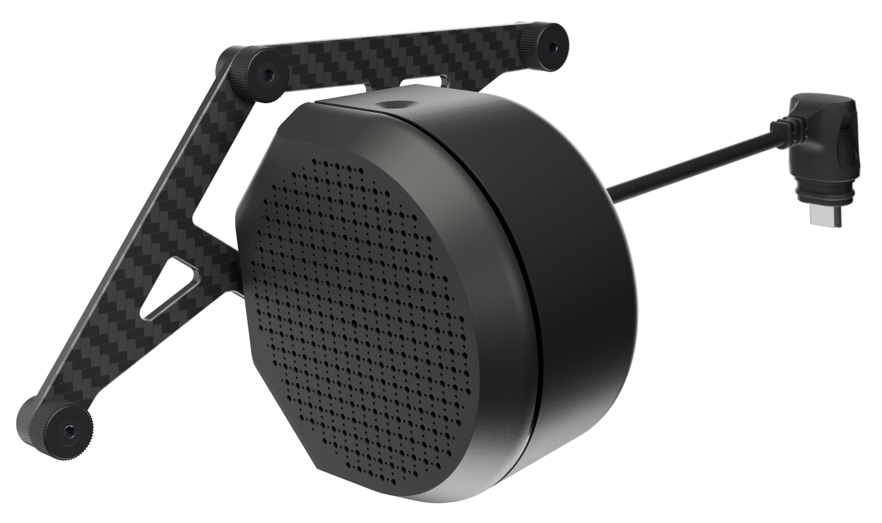
Hardware Overview | Speaker
Getting Started
Broadcast pre-recorded messages/sounds from X10 in flight
105 dB at 3 ft (1 m)
Effective range = 500 ft (150 m)
Record or import multiple audio files
Ideal positioning
  Tilt to ~45
  130 ft (40 m above
  164 ft (50 m) away
Notes:
Trainer Notes: This module allows for live or pre-recorded broadcasts
Up to 105 dB at 3 feet, effective out to ~500 feet
Includes default sounds like a siren, buzzer, and evacuate, or you can upload your own
This is especially useful in civil affairs, area clearance, or emergency response ops
Make sure to test audio quality and volume during prep
To avoid interference from propeller wash, do not broadcast audio directly above bystanders. Instead, fly about 130 ft (40 m) above and 164 ft (50 m) away
Position the Speaker attachment so it is directed toward listeners, and slightly angled toward the ground (roughly a 45° angle)
When recording custom audio, be sure to speak loudly, clearly, and slowly. Bring the controller closer to you to optimize audio quality.

Slide 16
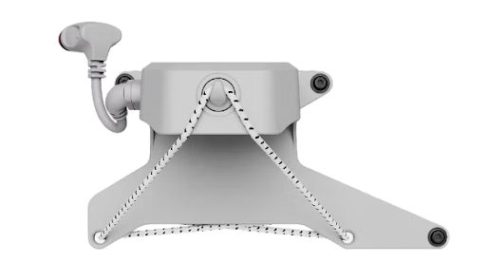
Hardware Overview | Dropper
Getting Started
Carry and precisely release lightweight items (<385g/.8 lbs)
Must be mounted on the left side of the aircraft
Do not operate the Dropper attachment in precipitation
Ideal for emergency response (SAR, water patrol, more)
Notes:
Trainer Notes:
Must be mounted on the left side of the aircraft
Carry and precisely release lightweight items (<385g)
Do not operate the Dropper attachment in precipitation

Slide 17
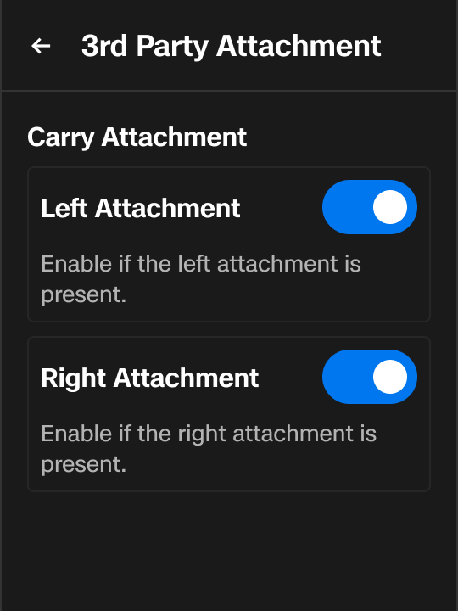
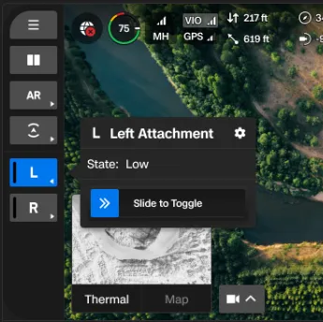
Hardware Overview | 3rd Party Attachments
Getting Started
Microhard (MH) Radio Only*
Integrate custom attachments
Carry Mode | non-powered payloads
Power Mode | USB-connected attachment
Actuate powered attachments
Integrate and optimize external radios
Notes:
Trainer Notes: Skydio X10D supports third-party attachments for integrators, expanding integration capabilities and providing customization options:
Carry mode allows you to safely attach non-powered payloads
[ask students] Why is this necessary if it’s non powered?
Because the drone will automatically adjust flight behavior like OA, power estimation and other flight characteristics
Power Mode allows you to plug in a USB-connected attachment, which the drone will recognize and power
You’ll also notice a quick action button appear on screen, allowing you to actuate that attachment

Slide 18
System
Setup
Getting Started
03
Notes:
Trainer Notes: We’re now moving into system setup. This is the step-by-step process to get your X10D flight-ready, from unfolding the aircraft to establishing a controller connection. In this section, precision matters. Failure to set up properly can lead to flight failures or damaged hardware, especially in tactical environments.

Slide 19
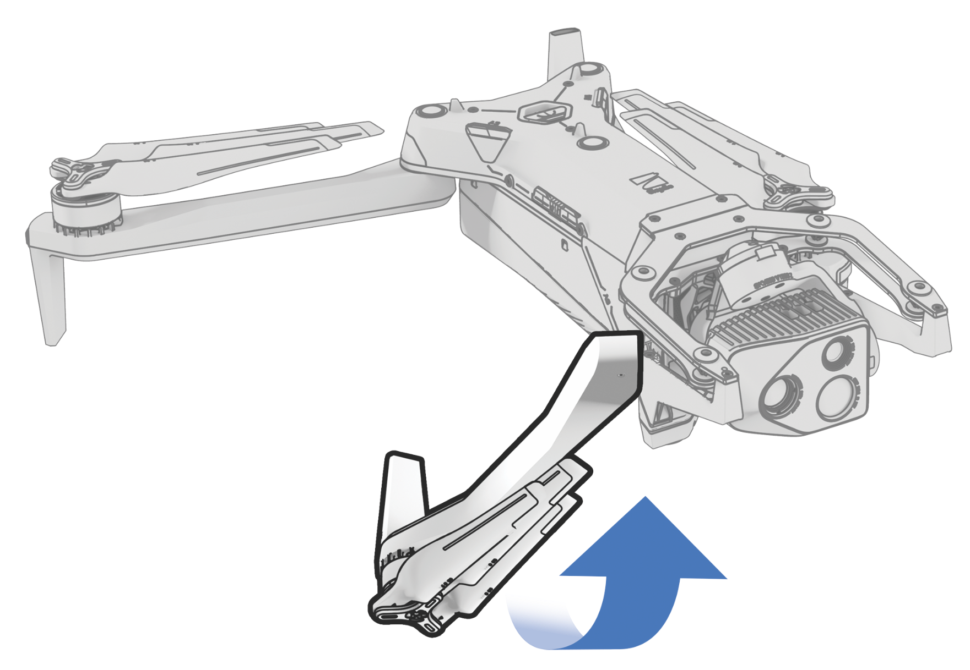
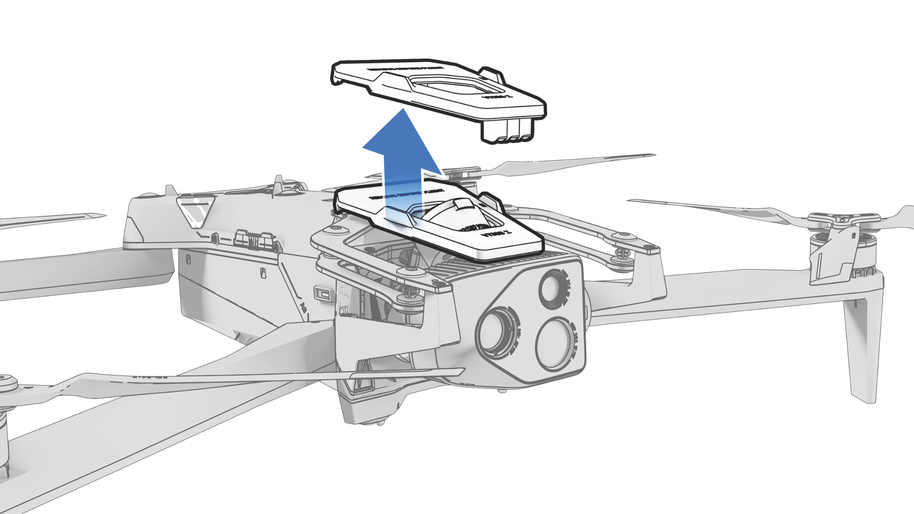
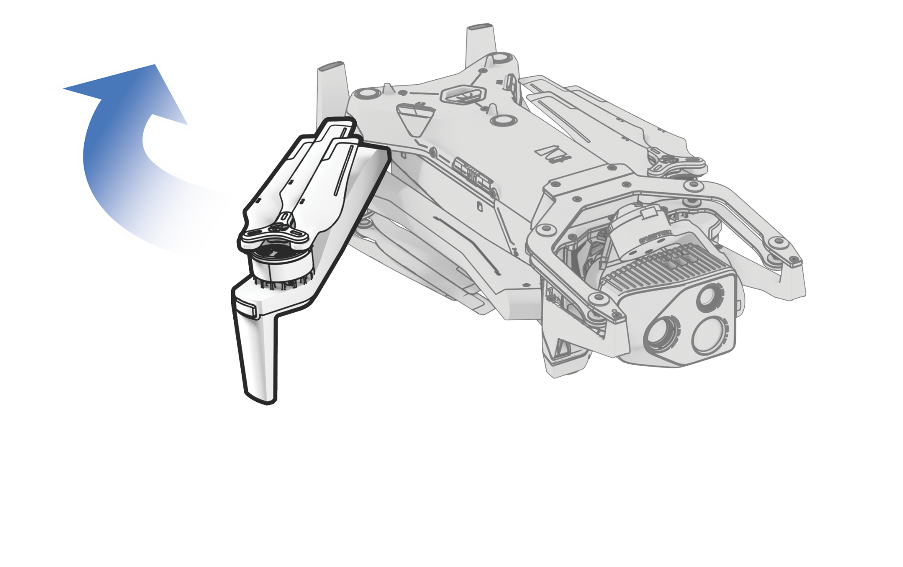
System Setup | Assembly
Getting Started
Unfold Rear Arms
Unfold Front Arms
Remove Sensor Lock
Unfold rear arms toward the rear of the drone.
Unfold front arms forward and down towards the sensor package.
Remove the sensor package lock before power up by pulling upward while bracing the sensor until it’s free.
Notes:
Trainer Notes: Let’s walk through physical assembly:
Unfold the rear arms first - these are the gray arms and should swing backward
Next, unfold the front arms - they’re black and rotate forward toward the sensor package
Before you power up, remove the sensor lock. This protects the sensor array during transport. With one hand, hold Pull it straight up until it clicks free.
Assembly is straightforward but critical. Rushed setups are how we see sensor damage or unstable flight performance.

Slide 20
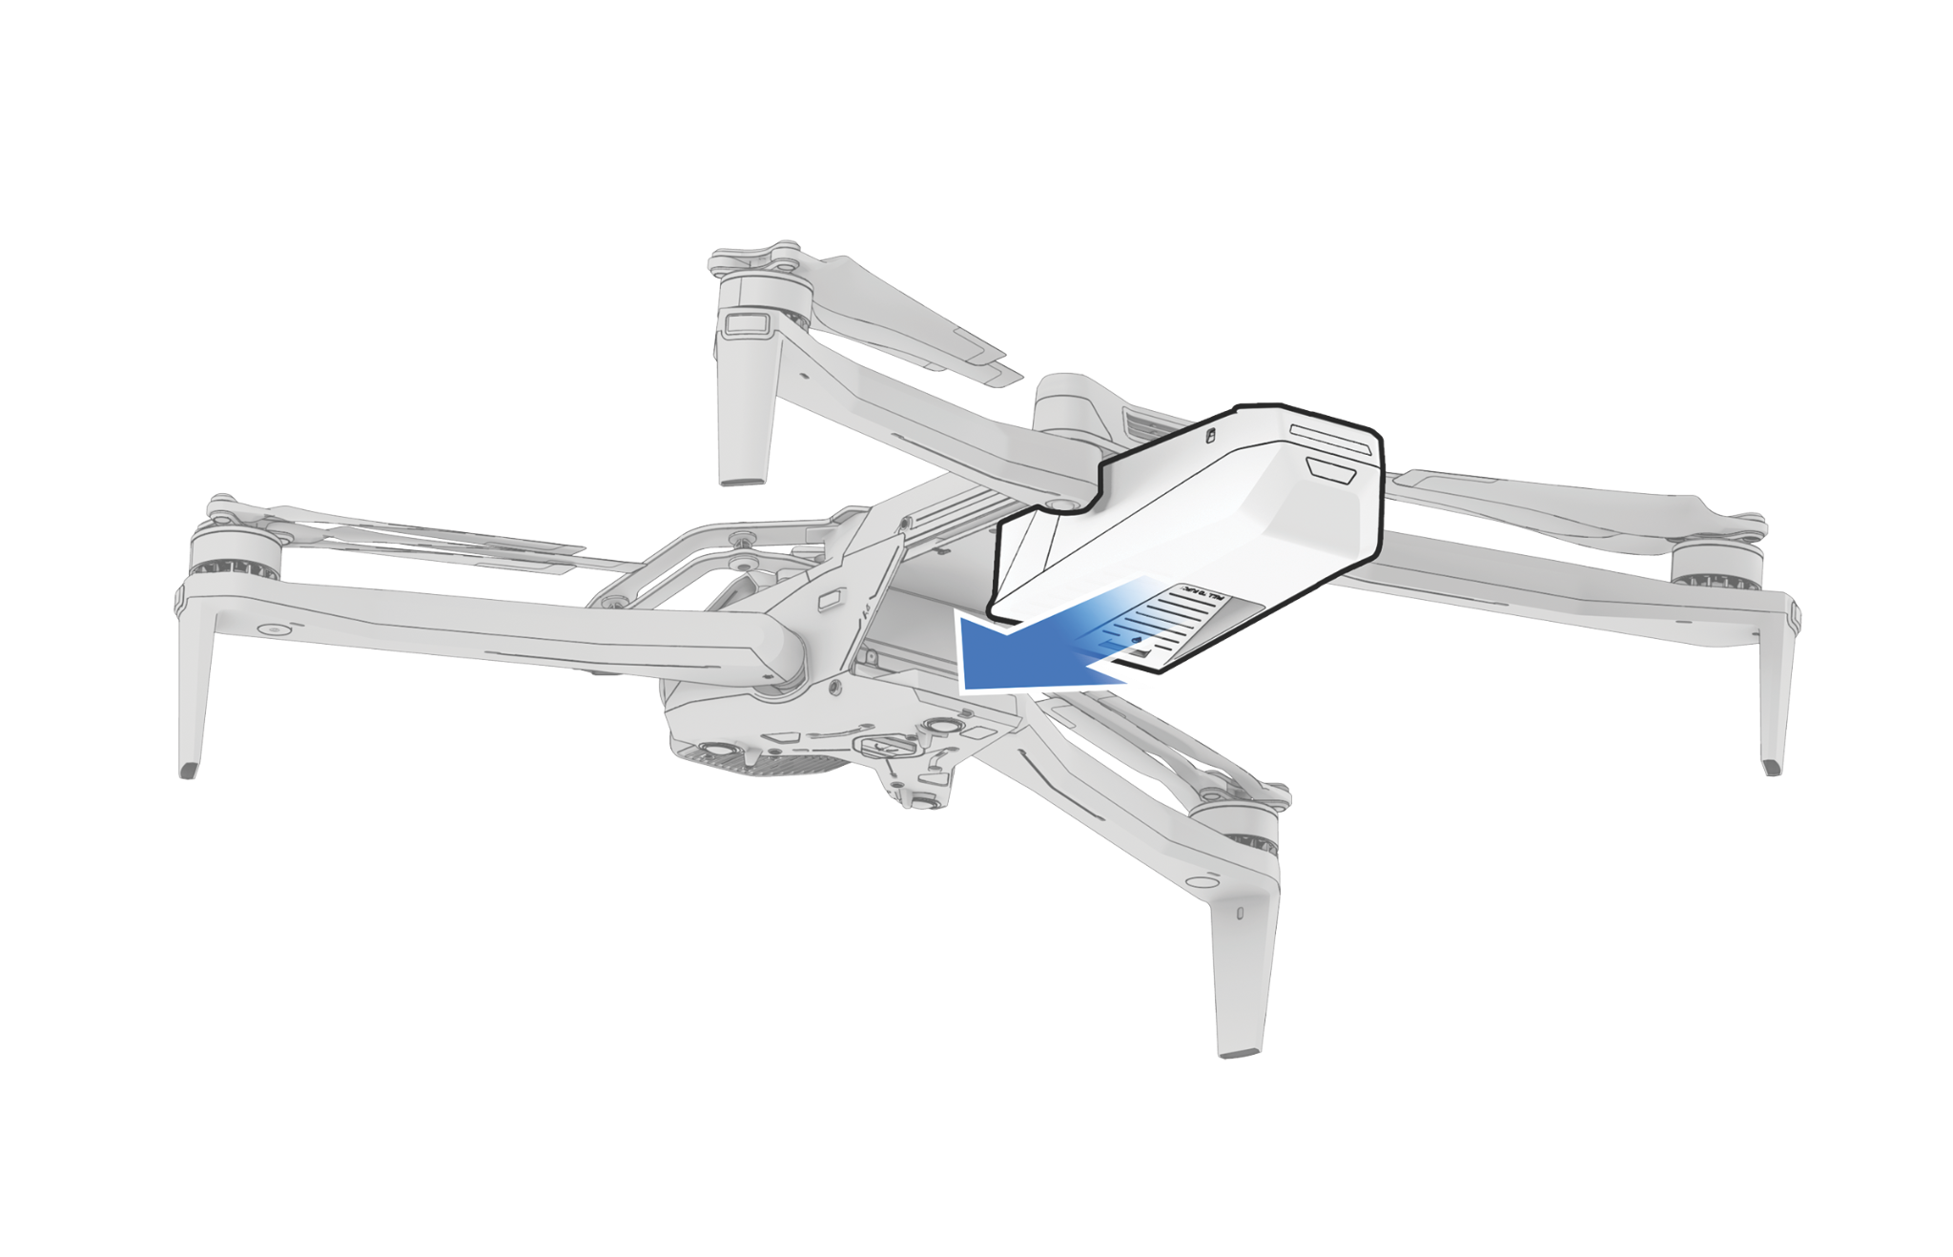
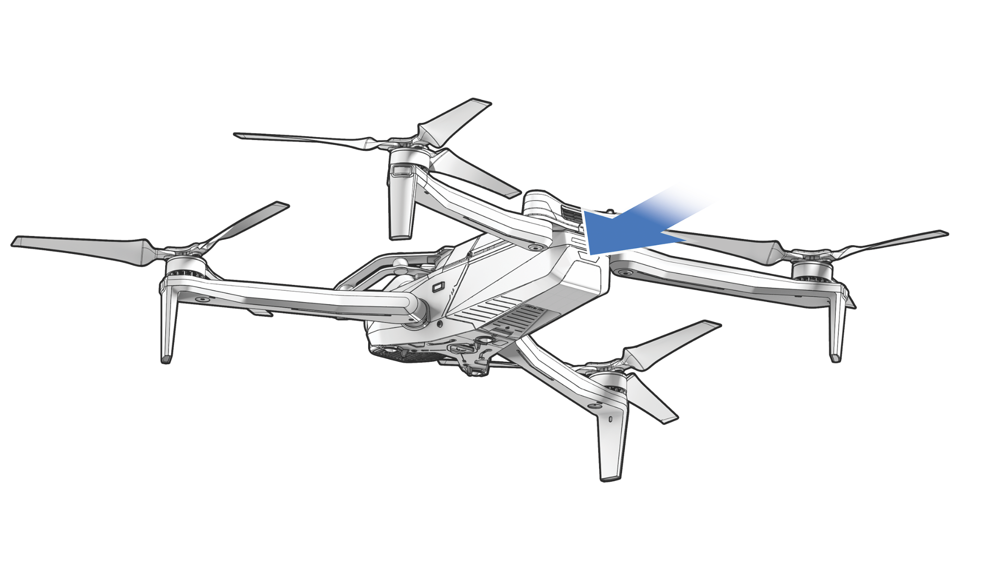
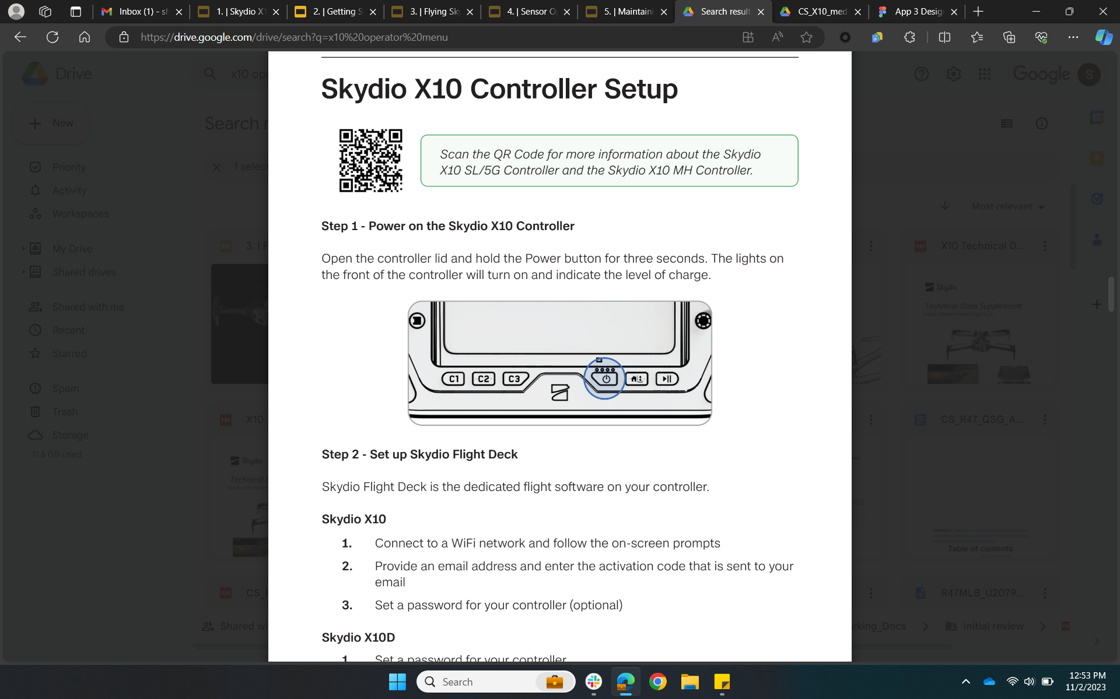
System Setup | Power On
Getting Started
Insert Battery
Power On Drone
Power on Controller
Ensure a full charge, insert battery using guide rails.
Press and hold battery button for 3 seconds.
Press and hold power button for 5 seconds.
Notes:
Trainer Notes: Once the drone is physically ready
Insert a fully charged battery using the guide rails. Make sure the magnets engage securely.
Power up the drone by pressing and holding the button for 3 seconds or until the LEDs slightly dim
Ensure the sensor lock is removed prior to power up
Sensor will do a functions check, so do not keep camera motors locked
Use caution around the USB-C port cover above the battery. If the cover is ripped off or otherwise disengaged, rain can now enter that port.
Power up the controller by pressing and holding its battery button for 5 seconds

Slide 21
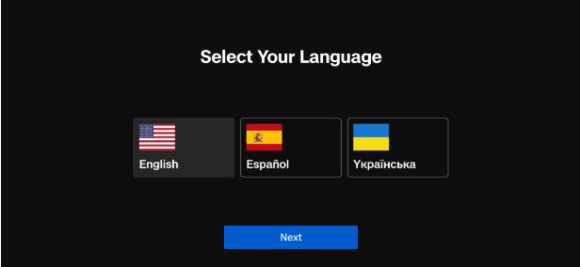
Getting Started
System Setup | Logging In (Non-WiFi Enabled)
Select your language when first powering on
English | Spanish | Ukrainian
Can change language later by going to Global Settings > Information > Language
Set a controller password
Skydio does not store controller passwords
Notes:
Trainer Notes: On initial startup, the system will prompt you to choose a language. English, Spanish, or Ukrainian.
This can be changed later under Global Settings > Information > Language.
For consistency during training and ops, default to English unless operational requirements dictate otherwise

Slide 22
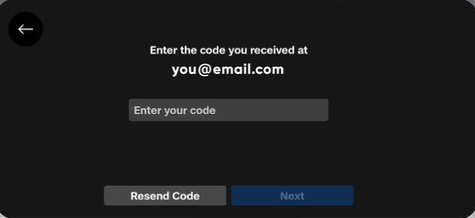
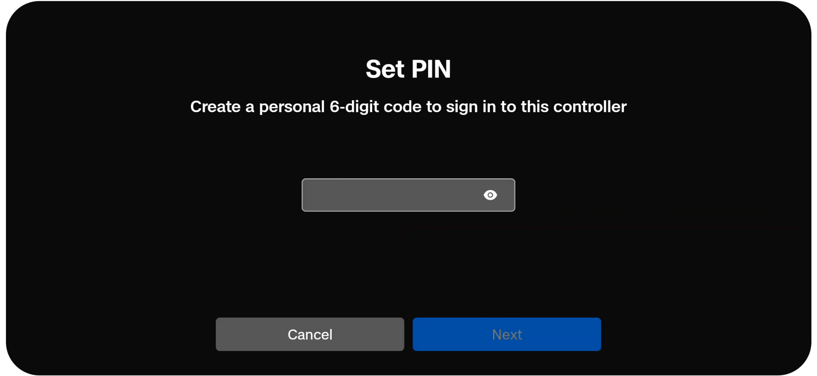
Getting Started
System Setup | Logging In (WiFi-Enabled)
Enter the email associated with your Fleet Manager for Offline Drones
Enter the 6 digit code sent to that email
Create a PIN for your controller profile
  Used for changing user profiles
Notes:
Trainer Notes: If your controller is wifi enabled, you will have to complete a few more steps
Input your email address that is associated with the Fleet Manager for Offline Drones (Skydio Cloud) account
You’ll receive a 6 digit code to that email
Plug it in when prompted
Finally, set a 6 digit PIN for security and for changing user profiles

Slide 23
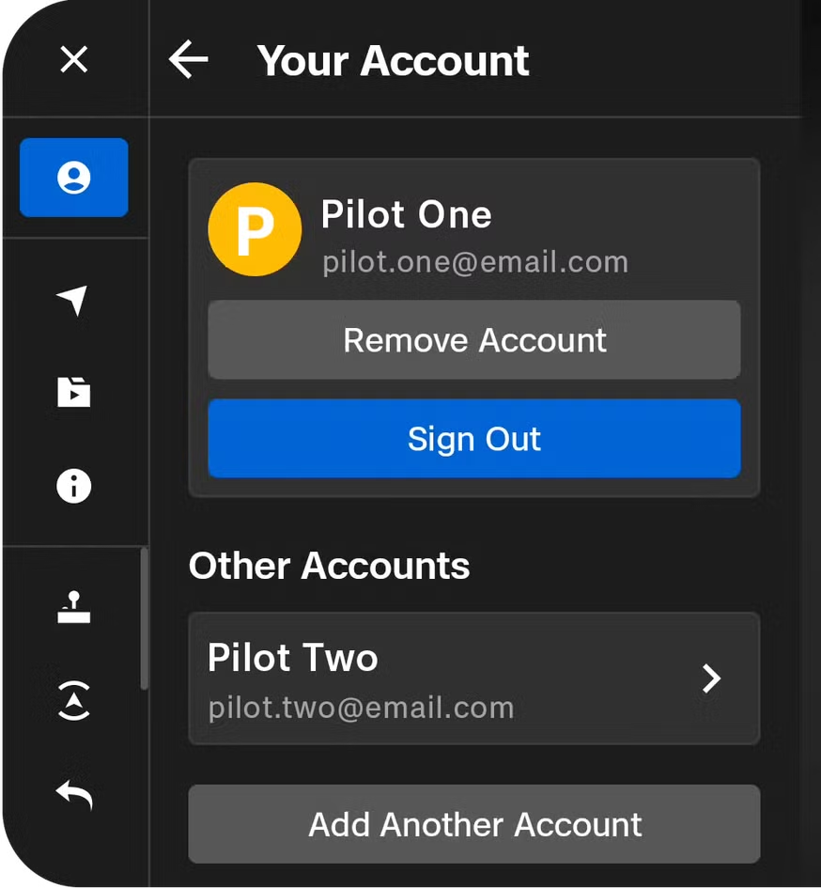
Getting Started
System Setup | User Profiles (WiFi-Enabled)
Global Settings > Select Your Account > Add Another Account
Enter email associated with your Skydio Cloud account
Enter the 6 digit code sent to that email
Create a PIN to easily switch between profiles
Notes:
Trainer Notes: Multiple users can log into the controller making flight attribution much easier
Select Global Settings and then select your account at the top of the menu
You’ll see “Add Another Account” at the bottom of that menu. Select it.
Follow the prompts to login and set a PIN

Slide 24
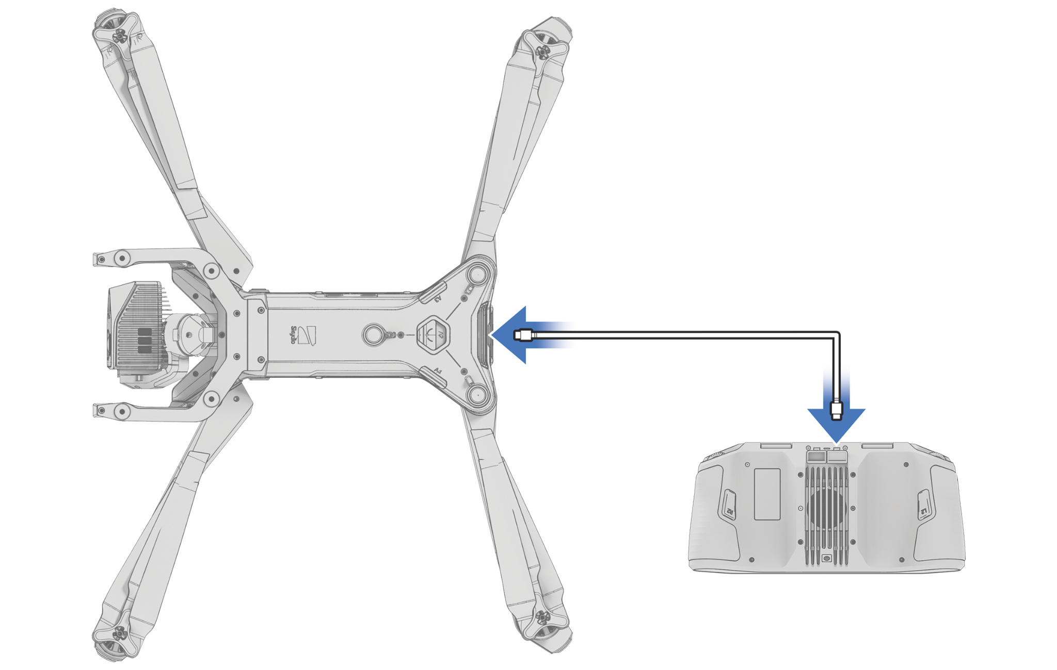
System Setup | Pairing
Getting Started
Pairing binds aircraft and controller
Insert USB-C cable into controller and drone (rear port)
Pairing channel is auto selected when USB-C cable is attached
Can pair many aircraft to a single controller
Must disconnect USB-C cable from aircraft before flight
Notes:
Trainer Notes: Pairing the controller with the aircraft is a simple but required step before first flight
Plug the provided USB-C cable into the rear port of both the drone and controller
The controller will recognize the drone and pair
You can pair multiple aircraft to one controller
You must unplug the cable before flying
Forgetting to unplug can cause startup errors or flight lockouts.

Slide 25
Practical Application
Assemble, Power On, Log In, Pair
Getting Started
Notes:
Trainer Notes: You’ll now assemble, power on, log in, and pair your X10D system. This hands-on flow should be second nature in field conditions.

Slide 26
Skydio Fleet Manager
For Offline Drones
Getting Started
04
Notes:
Trainer Notes: Next, we’ll cover Skydio Fleet Manager for Offline Drones. It allows secure fleet and user management. Think of it as your digital armory log for UAS assets.”

Slide 27
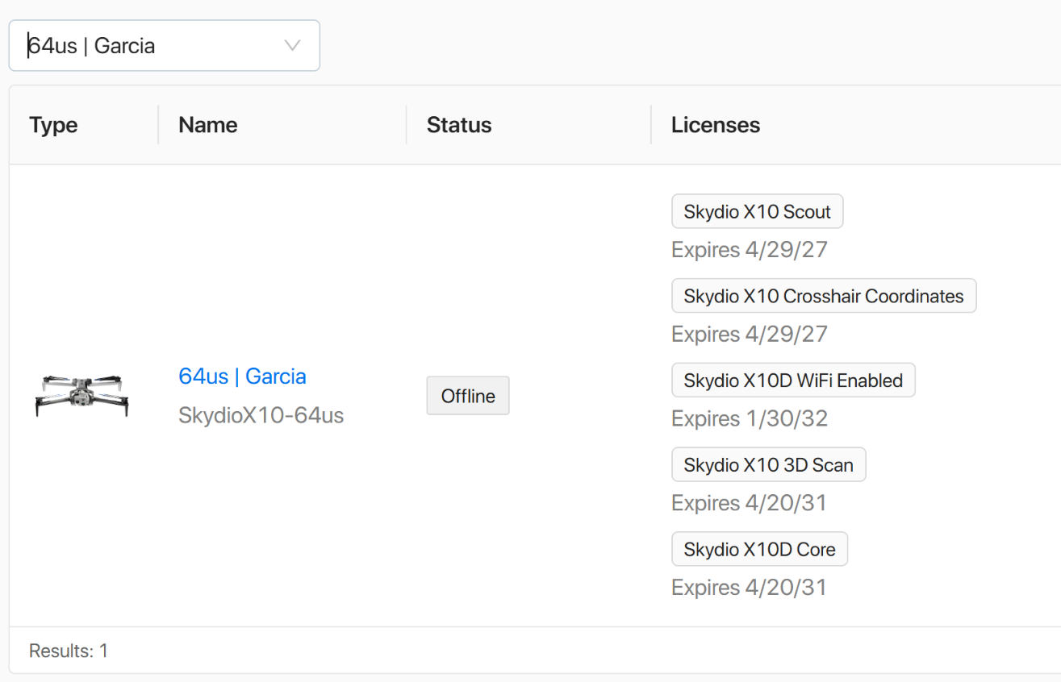
Skydio Fleet Manager for Offline Drones | Overview
Getting Started
Manage your fleet and operators via Skydio Offline Cloud Portal
Keep your drone up to date and review support resources
Securely maintain inventory of your equipment
Self-serve application of software updates
Contact support and issue feedback as needed
Notes:
Trainer Notes: Fleet Manager gives you centralized oversight
Manage aircraft and operators from one secure dashboard
Securely track all drones and accessories assigned to your unit
Self-serve firmware updates and license applications are built in
You can also access support resources directly through this interface

Slide 28
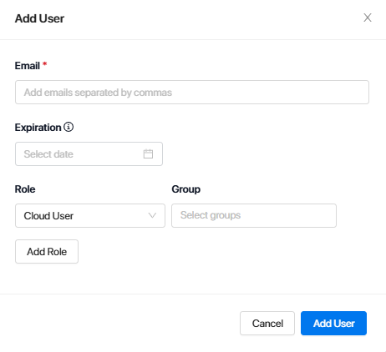
Skydio Fleet Manager for Offline Drones | Invite Users
Getting Started
Org Admins must add their pilots and assign roles/permissions
  Organization Admin | Manage system level settings (fleet, settings, users, integrations, etc…)
  Remote Pilot | Required to fly over cellular connectivity, can plan and run missions
  Cloud User | View data and run reports
  Pilot | No access.
Notes:
Trainer Notes: Fleet Manager uses a role-based permission structure
Org Admins control the whole environment; users, fleet, settings, etc…
Cloud Users can view and manage portal data, but cannot adjust settings, claim devices, or add users
Roles
Pilot - User is assigned to a vehicle, but has no Cloud dashboard access
Cloud User - Can view dashboard, download flight data, and sync, manage and view media (with the purchase of Media Sync)
Remote Pilot - Required to fly over cellular connectivity (including Fusion), can plan and run missions (Skydio Dock and Remote Ops only)
Organization Admin - Has full Cloud access

Slide 29
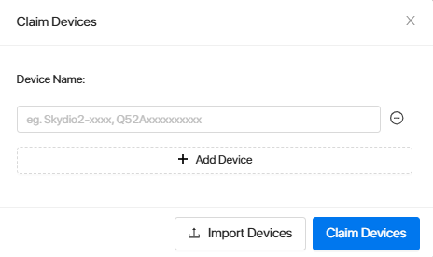
Skydio Fleet Manager for Offline Drones | Claim Devices
Getting Started
Only Org Admins can claim devices
Claim devices individually or bulk upload via .CSV
Devices must be added in order to produce software updates
Notes:
Trainer Notes: To update any drone in your organization, you must first claim it
This can be done individually or by uploading a CSV file with multiple serial numbers
If the drone isn’t claimed, you won’t be able to push updates
Make sure your team claims newly fielded systems as soon as they’re received. This keeps your inventory current and ensures operational readiness.

Slide 30
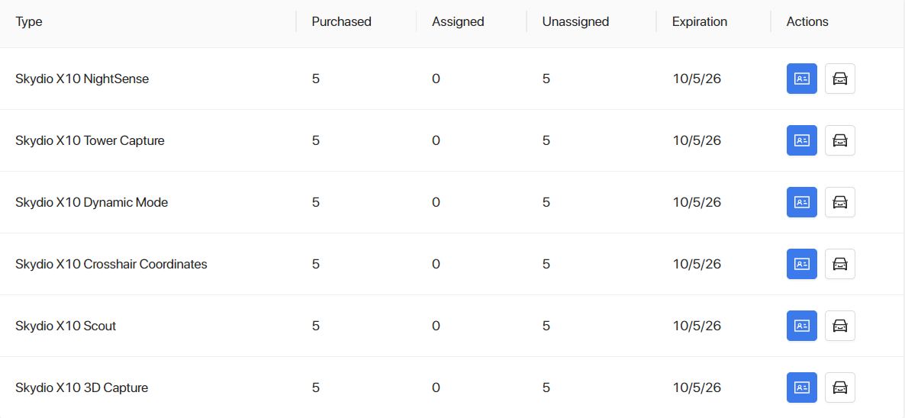
Skydio Fleet Manager for Offline Drones | Manage Software Licenses
Getting Started
Software licenses must be applied to eligible drones
Settings > Licenses
Apply/move licenses to any drone in your fleet
Must generate, download, and install update to apply the features
Notes:
Trainer Notes: Every drone needs a valid software license to access full features
Go to Settings > Licenses to apply or transfer licenses between drones
After applying a license, generate and download the update and install it on the aircraft
Full SW update- for Skydio releases
Configuration only- for license, settings, and name changes
This allows you to keep your fleet fully mission-capable without waiting on external support.

Slide 31
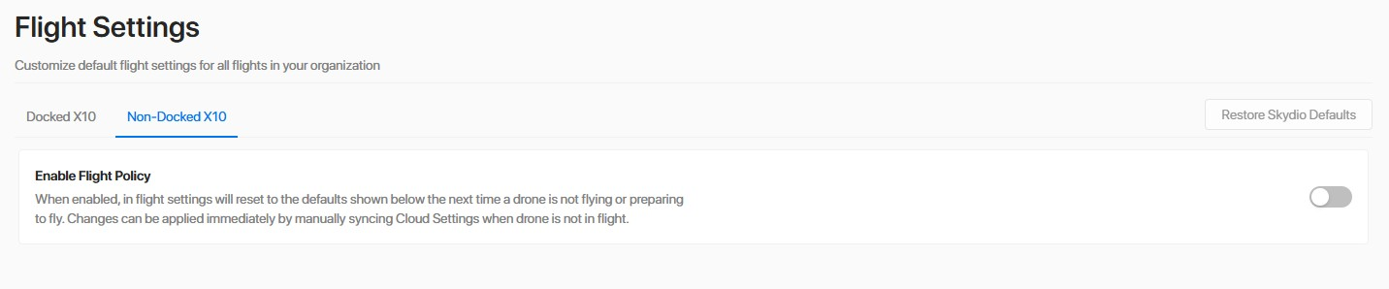
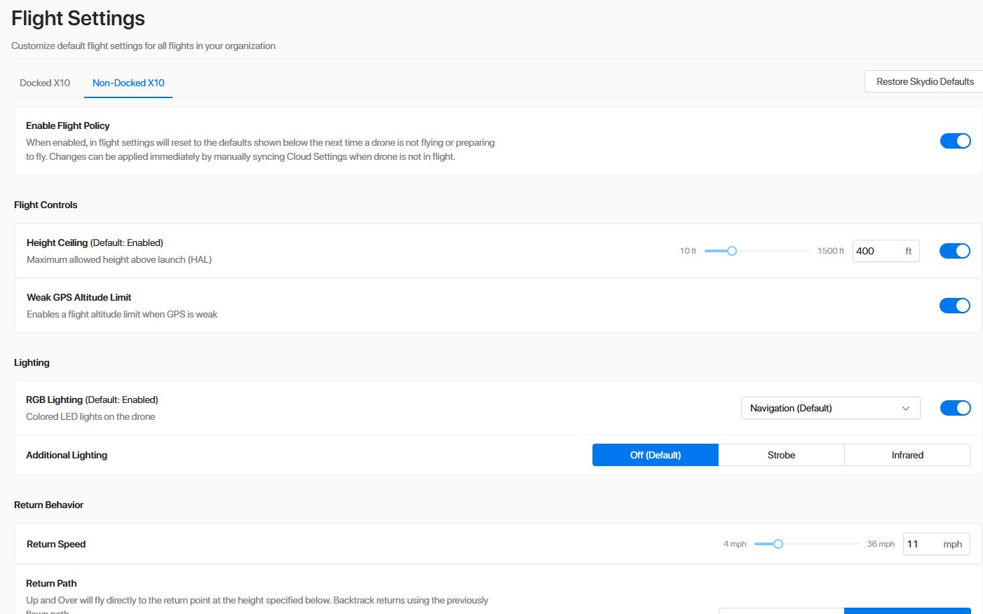
Skydio Fleet Manager for Offline Drones | Flight Settings
Getting Started
Establishes default settings for all aircraft in your fleet
Customize default settings org-wide
  Flight Controls
  Lighting
  Return Behavior & Lost Connection
Must generate a Configurations Only update and apply to the aircraft
Notes:
Trainer Notes: Flight Settings allows Org Admins to apply default settings to all drones in the org when Flight Policy for Non-Docked drones is enabled.
This sets default configurations for settings like Flight Controls, Lighting, Return Behavior, and Lost Connection
In order to tapply these settings, Admins MUST generate a Configurations Only update file and apply to the aircraft as you would a normal software update
Plots can still edit these settings on the controller. However, settings will default back to the Flight Policy after every flight and/or power cycle.

Slide 32
Practical Application
Log in, Add users, Claim devices, Apply flight settings
Getting Started
Notes:
Trainer Notes: Now log into the portal, add your users, and claim your equipment.

Slide 33
Before
You Fly
Getting Started
05
Notes:
Trainer Notes: This section is all about mission prep. Before a single propeller spins, you need to ensure your drone, controller, environment, and software are ready. Tactical UAV failures don’t usually happen mid-air. They happen during sloppy prep. These steps will help you avoid that.”

Slide 34
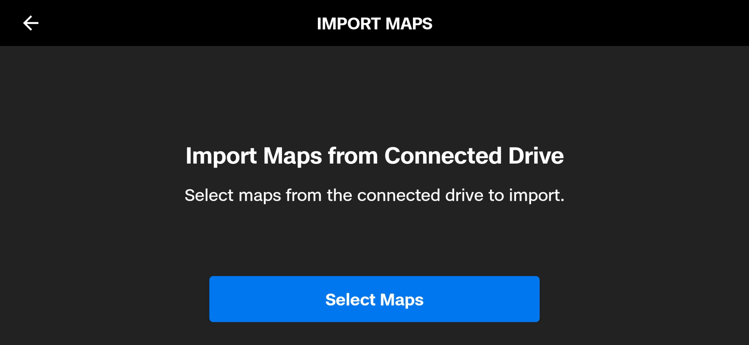
Before You Fly | Importing Maps (Non-WiFi Enabled)
Getting Started
Maps are not required to fly, but improve SA
Drone can still navigate without maps, your GPS Skills still work
Must be .mbtiles format
View and manage maps in Map Library
Notes:
Trainer Notes: Although not required, importing map data improves situational awareness during mission planning.
These maps help orient you in areas with limited GPS fidelity or visual landmarks
Only .mbtiles base maps are supported
Store map files on a USB-C drive, plug it into the controller, then navigate to Global Settings > Import Maps
Once imported, they live in your Map Library for offline use
This is extremely useful for pre-mission briefings and flight route validation.

Slide 35
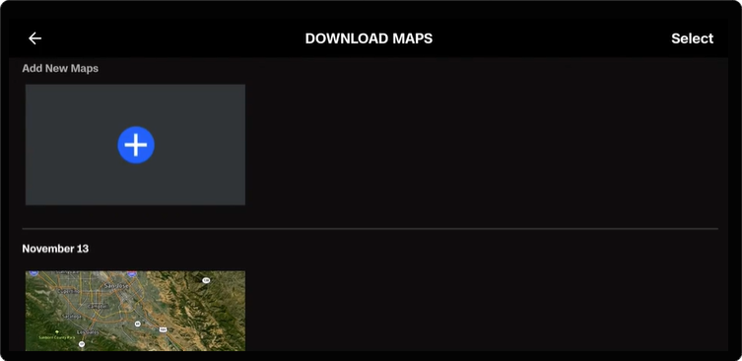
Before You Fly | Importing Maps (WiFi Enabled)
Getting Started
Connect controller to Wifi
Navigate to Info > Download maps
Adjust map centerpoint
3.5 mile x 3.5 mile area downloaded
Disable Wifi when complete (as needed)
Notes:
Trainer Notes: If your controller is wifi-enabled, you can download map data directly to your controller.
Just ensure you’re connected to Wifi and navigate to Global Settings > Info > Download Maps > Add New Maps, then scroll to the area you’d like to download and tap Download
The download area will always be 3.5 miles x 3.5 miles
This differs from the previous process where the area downloaded is limited by the file size or tile count
Disable wifi once you’re done
Navigate to Global Settings > Info > Network > Wifi
We’ll go through both map downloading processes in a bit during the prac app

Slide 36
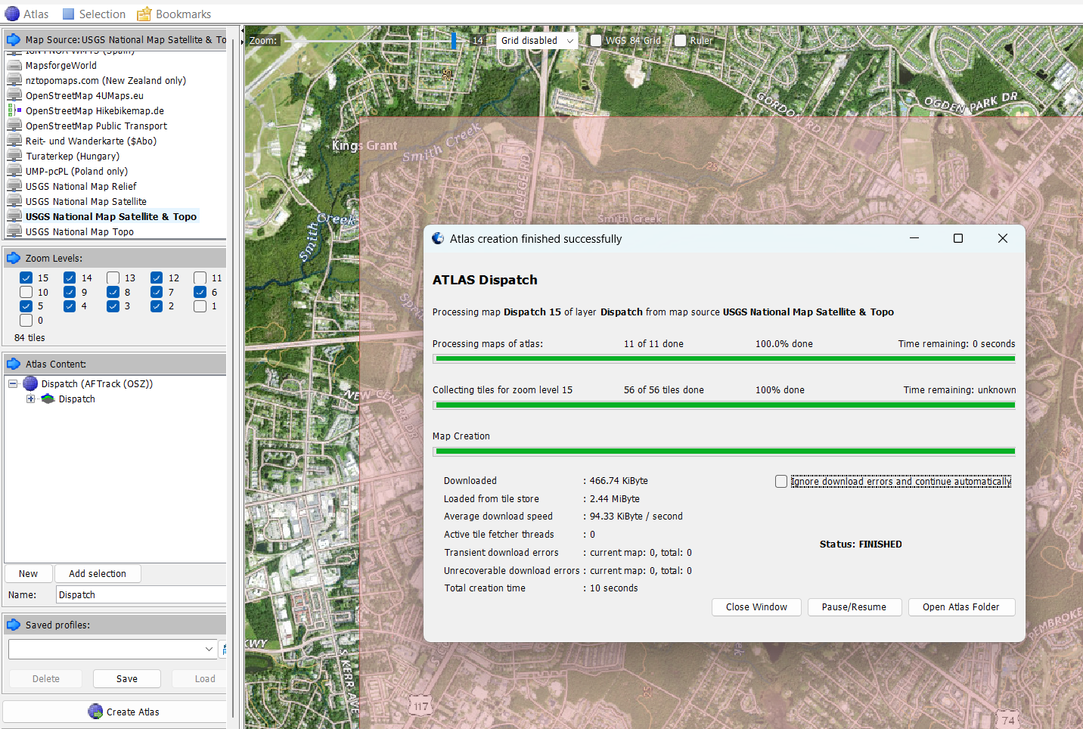
Getting Started
Before You Fly | Importing Maps
Notes:
Trainer Notes: This is a software application called MOBAC (Mobile Atlas Creator). This is one tool you can use to generate and download map imagery.

Slide 37
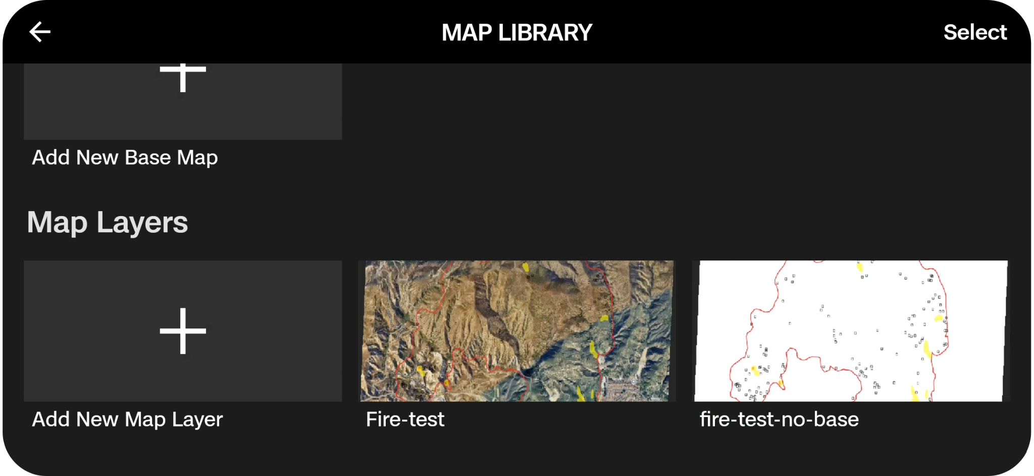
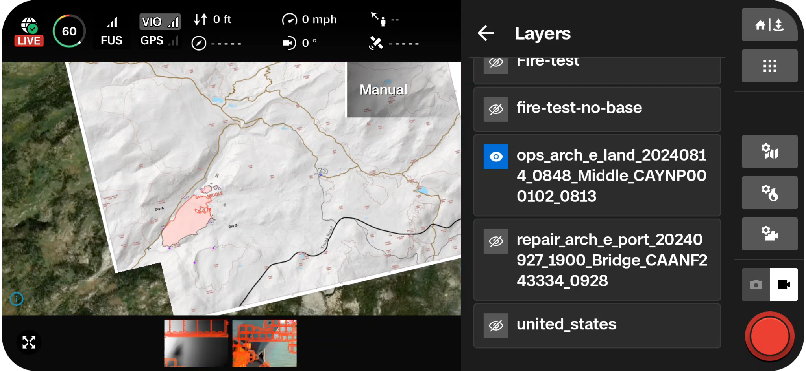
Before You Fly | Importing Map Layers
Getting Started
Microhard (MH) Radio Only*
Import KML/KMZ, GeoJSON, GeoTIFF, or GeoPDF files
Allows pilots to use standardized map layers when participating in emergency response ops
Choose which layers are displayed at any point throughout the flight
Notes:
Trainer Notes: In addition to map data, pilots can also import Map Layers.
Map layers are useful when working with other pilots or groups
Adding custom map layers enables you to display mission critical information like mission or airspace boundaries, wildfire zones, asset locations, or any other important information as visual overlays on the controller
These improve situational awareness and help you stay aligned with operational requirements
We’ll go over how exactly to download and import these during the prac app

Slide 38
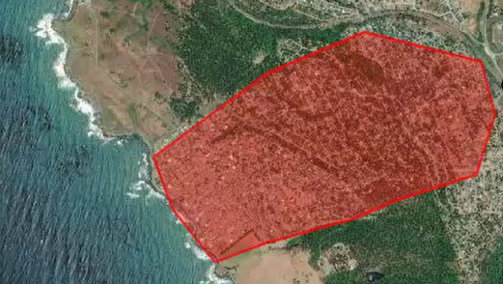
Before You Fly | Digital Terrain Elevation Data (DTED)
Getting Started
Skydio X10D uses DTED to display coordinates for sensor crosshairs (not for navigation)
Can use USGS.gov to download DTED information
Only accepts DTED level 2
Load DTED onto media card, insert, and power on the drone
Select Media menu in Global Settings to force X10D to ingest DTED
Notes:
Trainer Notes: Crosshair Coordinates requires DTED in order to provide MGRS coordinates not navigation but it’s valuable Only DTED Level 2 (1 arc second) is supported
You can download DTED from usgs.gov, save it to the media card
Go to the Media menu in Global Settings to force ingestion
DTED is NOT used for navigation
Valuable when running ISR or targeting missions

Slide 39
Practical Application
Download & Import Maps, Map Layers and DTED
Getting Started
Notes:
Trainer Notes: Let’s practice downloading and importing maps and DTED info.

Slide 40
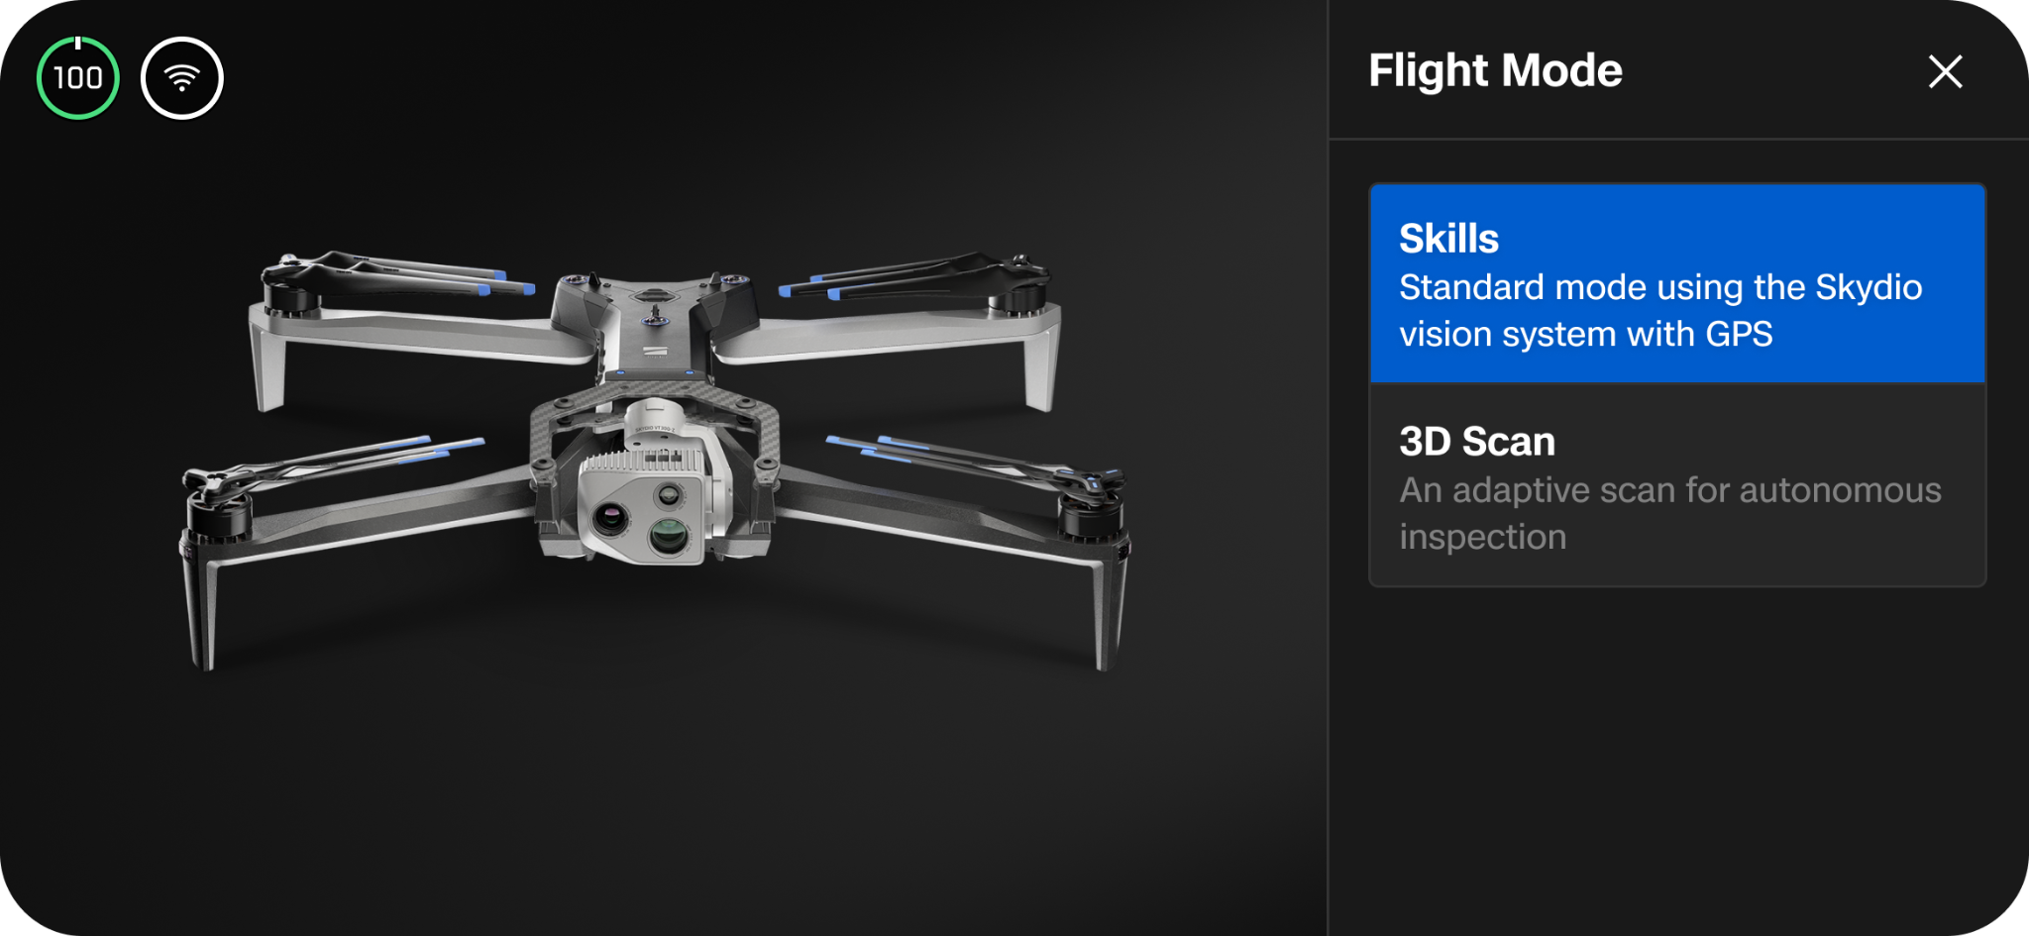
Before You Fly | Flight Mode
Getting Started
Choose the appropriate flight mode for the mission
  Skills | Use for standard flight mode
  3D Scan | Use for autonomous scanning/Mapping missions
Flight modes persistent through flights and power cycles
Notes:
Trainer Notes: You must select the correct flight mode for your mission
Skills Mode is your default manual/autonomous hybrid mode for general flights
3D Scan Mode is for photogrammetry, structure scans, and recon mapping
Modes persist across flights and reboots, so always double-check before takeoff
Choosing the wrong mode will affect navigation behavior, or sensor engagement

Slide 41
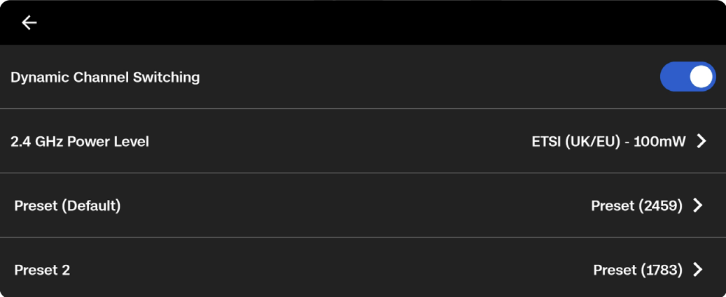
Before You Fly | Radio Frequency Selection
Getting Started
Microhard (MH) Radio Only*
Enable Dynamic Channel Switching prior to flight
  Auto channel switching during link loss
  Allows manual channel switching in flight
Verify radio power output and adjust to approved levels
Select 6 radio channel presets prior to flight
Maintain 10 channel separation when operating near other aircraft
Notes:
Trainer Notes: Microhard radio settings must be configured prior to flight via the INFO tab. Specifically, Dynamic Channel Switching (DCS) and radio power output settings..
DCS allows for automatic channel switching in flight during link loss events
So when the aircraft experiences a loss of link, the system will automatically switch to the next preset in the list
It also allows you to manually switch between the 6 presets as well, allowing you to be more proactive in flight
In order for this to work, you have to toggle it on and select 6 presets in the INFO tab (we’ll cover how to do this once we start flying later
Brand new systems WILL be in low power mode
Ensure to turn the power to max or whatever power settings are allowed for the region
The system will alert you if low power mode is engaged
Always deconflict frequencies when operating near other drones or RF-sensitive equipment
Maintain 10-channel separation between systems to prevent link interference
This is especially critical in joint training environments or congested RF airspace

Slide 42
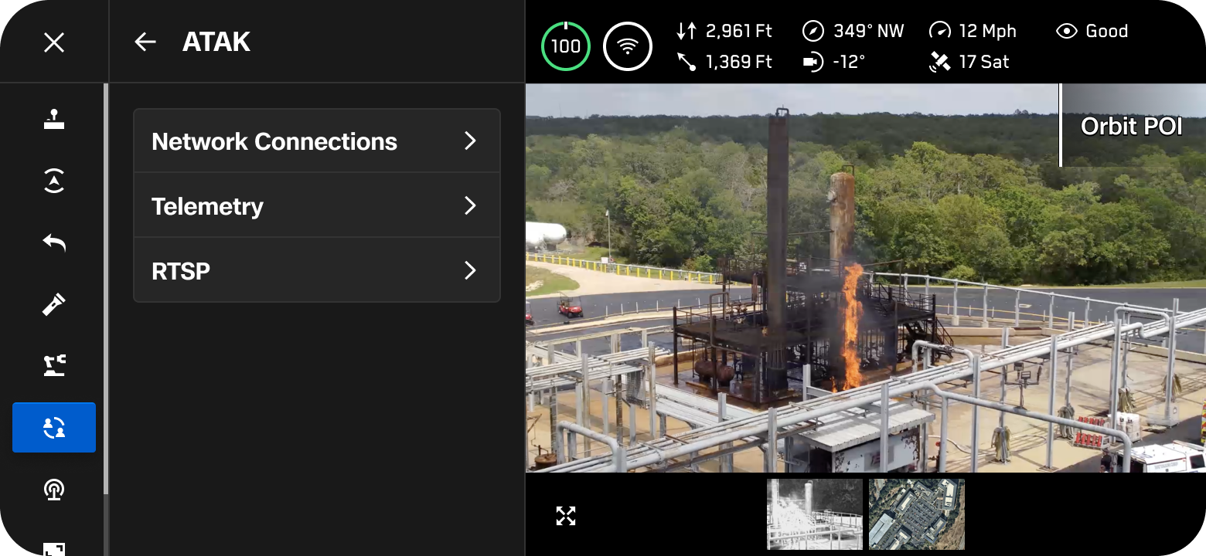
Before You Fly | ATAK
Getting Started
Enable live stream using internal or external RTSP server
Add and manage multiple TAK servers
Publish telemetry including position and call sign
Multicast CoT shared to default multicast group
Notes:
Trainer Notes: ATAK integration brings the X10D into your wider tactical network
You can stream live video via RTSP
Push telemetry data like position, heading, and call sign to TAK servers
Multicast support allows CoT (Cursor on Target) sharing in real time
For joint ops, this enables shared situational awareness without relaying data manually. Configure it under Sharing settings (we’ll do this later) prior to mission.

Slide 43
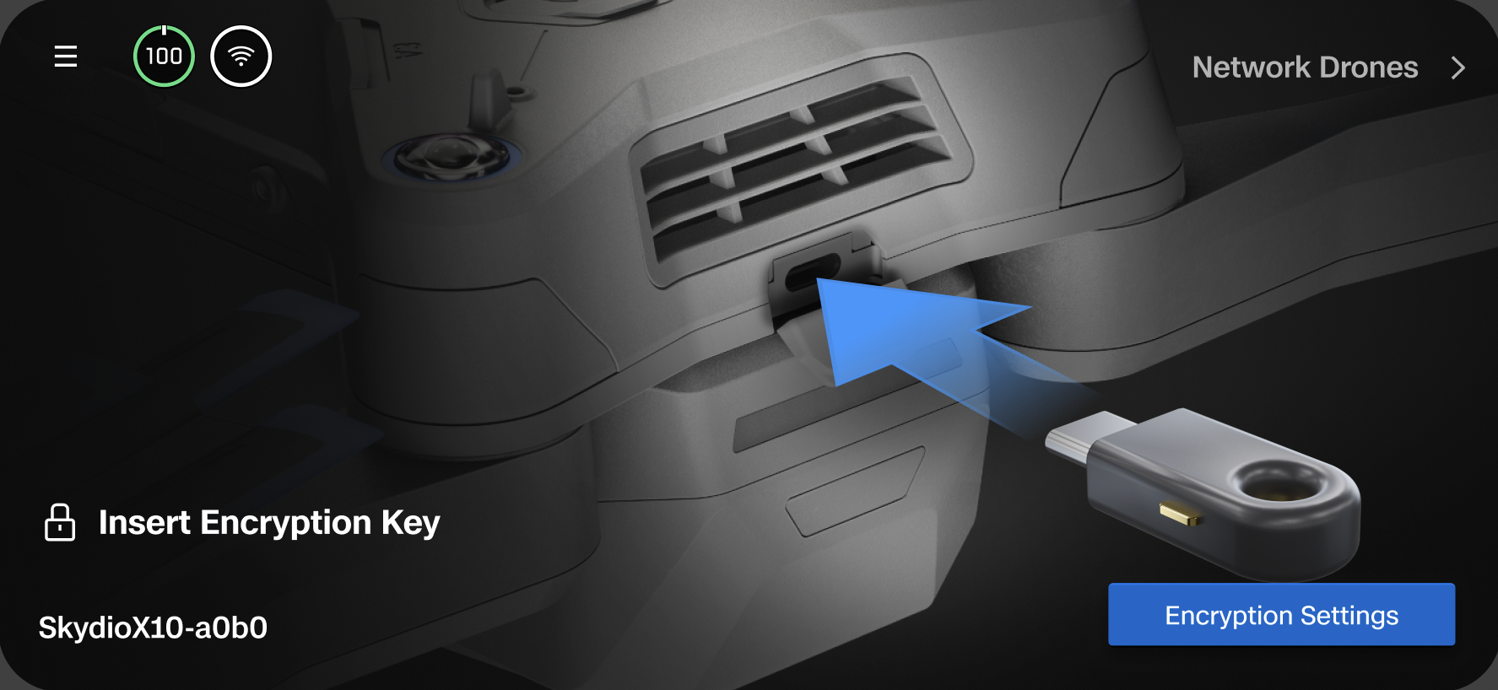
Before You Fly | Encryption
Getting Started
Use the security key to create an encrypted storage area on the media card
Inserting the security key does not encrypt media, just provides the ability
To enable/disable, Global Settings > Information > Drone > Encryption
Decrypt media with same encryption key
Notes:
Trainer Notes: Encryption ensures your media stays secure if your drone is lost or recovered by the enemy
Not required, navigate to Global Settings > Information > Drone > Encryption to disable
Insert your Skydio encryption key to activate encrypted storage on the media card
Just plugging in the key doesn’t encrypt, you must enable it under Global Settings > Information > Drone > Encryption
The same key is required to decrypt files
Best practice: store keys securely, track key issuance, and rotate periodically during extended deployments.

Slide 44
Before You Fly | Preflight Inspection
Getting Started
Visually inspect hardware components for serviceability and cleanliness
Check props, motors, chassis, arms, nav cameras
Ensure sensor package is functional
Clean ALL camera lenses (including NAV)
Notes:
Trainer Notes: Final step before takeoff… inspect everything
Check arms, props, motors, chassis, and nav cameras for cleanliness, damage, or debris
Ensure every camera, including the nav cameras is clean
Confirm that the sensor package is seated and operational.
These inspections are the last chance to catch something that will cost you in flight. Make it muscle memory.

Slide 45
Practical Application
Preflight Inspection
Getting Started
Notes:
Trainer Notes: Let’s practice performing preflight inspections.

Slide 46
Skydio
Paraverse
Getting Started
06
Notes:
Trainer Notes: Finally, the Skydio Paraverse. The Paraverse is a rich simulated environment that allows you to train without having to leave the office.

Slide 47
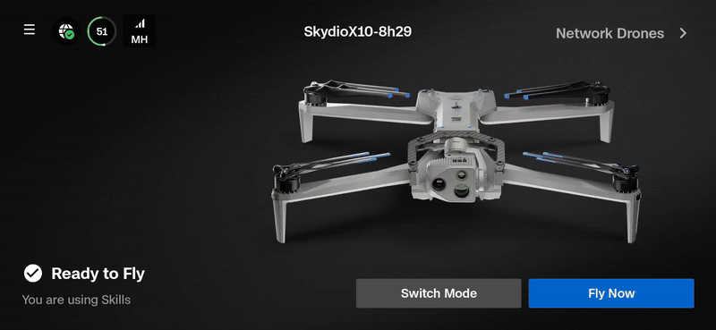
Skydio Paraverse | Overview
Getting Started
Connect to the Paraverse to fly an X10D simulator
Requires Cloud set up
Great tool for training and to maintain proficiency with the X10D
Wifi-enabled controllers only
Notes:
Trainer Notes: Paraverse is the environment in which the simulator lives. So to create a simulator, you have to connect the controller to the paraverse.
We’ll do this in just a minute but this requires you to log into Skydio Cloud, determine the simulator setup (location, attachments, etc…)
Typical time it takes is usually between 5 and 10 minutes but truly depends on the settings you configure
Overall, the simulator is a great way to continue training on days when weather or logistics prevent live flights

Slide 48
Practical Application
Create a Simulator
Getting Started
Notes:
Trainer Notes: Let’s go through the process!

Slide 49
You Learned
Getting Started
Safety Guidelines
Fleet Manager for Offline Drones
01
04
Identify and understand safe practices when flying your Skydio X10D
Manage drones and users across your organization with single dashboard
Hardware Overview
Before you Fly
02
05
Introduce the Skydio X10D hardware components, including controller
Prepare your Skydio X10D for flight with a series of hardware and software checks
System Setup
Paraverse
03
06
Prepare your Skydio X10D system for use with radio pairing
Create and fly an X10D simulator.
Notes:
Trainer Notes: You’ve now built foundational knowledge on the X10D platform. From assembly and safety to preflight procedures and fleet management, these are mission-essential skills. You’ll need them to operate confidently in high-stakes environments.

Slide 50
Questions
Getting Started

Slide 51

Use or disclosure of data contained on this sheet is subject to the restriction on the second page of this proposal

